Slide 1
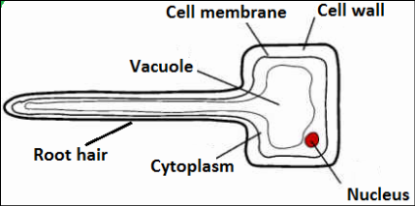
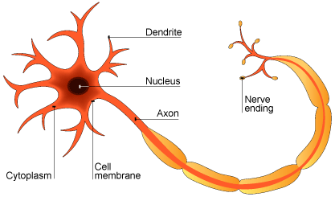
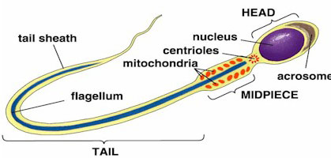
GCSE Knowledge Organiser Cells
NUSA
SCIENCE
ONE
TWO
CELL STRUCTURE |  | Eukaryotic |  | Prokaryotic
Cell Structure | Function | Animal Cells | Plant Cells | Bacterial Cells
Nucleus | Contains genetic information that controls the functions of the cell. | Y | Y
Cell membrane | Controls what enters and leaves the cell. | Y | Y | Y
Cytoplasm | Where many cell activities and chemical reactions within the cell occur. | Y | Y | Y
Mitochondria | Provides energy from aerobic respiration. | Y | Y
Ribosome | Synthesises (makes) proteins. | Y | Y | Y
Chloroplast | Contains chlorophyll and is where photosynthesis occurs. |  | Y
Permanent vacuole | Used to store water and other chemicals as cell sap. |  | Y
Cell wall | Strengthens and supports the cell. (Made of cellulose in plants.) |  | Y | Y
DNA loop | A loop of DNA, not enclosed within a nucleus. |  |  | Y
Plasmid | A small circle of DNA, may contain genes associated with antibiotic resistance. |  |  | Y
SPECIALISED CELLS
Specialised Cell | How structure relates to function
Sperm cell | Acrosome contains enzyme to break into egg; tail to swim; many mitochondria to provide energy to swim.
Nerve cell | Long to transmit electrical impulses over a distance.
Muscle cell | Contain protein fibres that can contract when energy is available, making the cells shorter.
Root hair cell | Long extension to increase surface area for water and mineral uptake; thin cell wall for shorter distance for water and mineral to travel.
Xylem cell | Waterproofed cell wall; cells are hollow to allow water to move through.
Phloem cell | Some cells have lots of mitochondria for active transport; some cells have very little cytoplasm for sugars to move through easily.
THREE
FOUR
MICROSCOPY
Magnification | The degree by which an object is enlarged. Magnification = size of image__ size of real object
Resolution | The ability of a microscope to distinguish between two points (detail).
Light microscope | Basic microscope with a maximum magnification of 1500x. Low resolution.
Electron microscope | Microscope with a much higher magnification (up to 500 000x) and resolving power than a light microscope. This means that it can be used to study cells in much finer detail.
ORDERS OF MAGNITUDE
Unit Prefix | Size in metres | Standard Form
Centimetre (cm) | 0.01m | 10⁻²m
Millimetre (mm) | 0.001m | 10⁻³m
Micrometre (μm) | 0.000001m | 10⁻⁶m
Nanometre (nm) | 0.000000001m | 10⁻⁹m

Slide 2
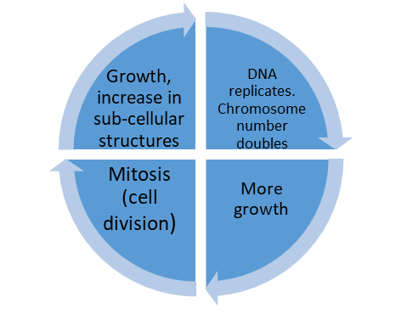
GCSE Knowledge Organiser Unit 1 – Cells
NUSA
SCIENCE
FIVE
SIX
MITOSIS AND CELL CYCLE
Step 1 | Number of sub-cellular structures (e.g. ribosomes and mitochondria) increase.
Step 2 | Number of chromosomes double.
Step 3 | One set of chromosomes is pulled to each end of the cell.
Step 4 | The nucleus divides.
Step 5 | Cytoplasm and cell membranes divide to form two identical cells
TRANSPORT ACROSS MEMBRANES
Cell Structure | Definition | Uses
Diffusion | Spreading out of the particles (gas/ solution) resulting in a net movement from an area of higher concentration to an area of lower concentration. | Oxygen and carbon dioxide in gas exchange (leaves and alveoli). Urea from cells into the blood plasma for excretion in the kidney.
Osmosis | The diffusion of water from a dilute solution to a concentrated solution through a partially permeable membrane. | Movement of water into and out of cells.
Active Transport | The movement of substances from a more dilute solution to a more concentrated solution (against a concentration gradient). Requires energy from respiration. | Absorption of mineral ions (low concentration) from soil into plant roots. Absorption of sugar molecules from lower concentrations in the gut into the blood which has a higher sugar concentration.
SEVEN
EIGHT
STEM CELLS
Stem Cell | Properties | Uses
Embryonic stem cell | Can form any type of cell. | Therapeutic cloning – embryonic stem cells produced with same genes as patient. No rejection.
Adult stem cell | Can divide into a limited number of cells e.g. bone marrow stem cells can form various blood cells. | Maintain and repair tissue from which they are found
Meristem | Found in plants. Can differentiate (specialise) into any type of plant cell. | Clone rare species to prevent extinction. Crops with special features can be clones
Pros and Cons of Using Stem Cells
Pros | Treatment of diseases such as diabetes, dementia and paralysis.
Cons | Ethical and religious objections. Can transfer viruses held within cells.
FACTORS AFFECTING DIFFUSION
Factor | Explanation
Difference in concentrations (concentration gradient) | The greater the difference in concentrations, the faster the rate of diffusion.
Temperature | Particles move more quickly at higher temperatures, so rate of diffusion increases.
Surface area of membrane | The greater the surface area the quicker the rate of diffusion.
ADAPTATIONS OF EXCHANGE SURFACES (4 FEATURES)
1 | Large surface area
2 | Thin membrane to provide a short diffusion path
3 | Ventilation (in animals for gas exchange – maintains a concentration gradient)
4 | Efficient blood supply (in animals – maintains a concentration gradient)

