Slide 3
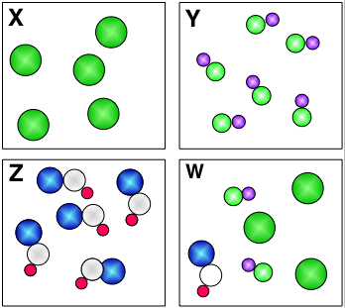
Chemistry definition of PURE
PURE
PURE
PURE
NOT PURE

Slide 4
How do you know if something is pure?
If an element or a compound is pure and not a mixture then it will melt or boil at a very specific temperature. We can use this information to find the purity of a substance.
100 °C!
What temperature does pure water boil at?
Notes:
Can do demo with mp determination equipment – have a specific chemical, melt it, as students to decide what compound it is.

Slide 5
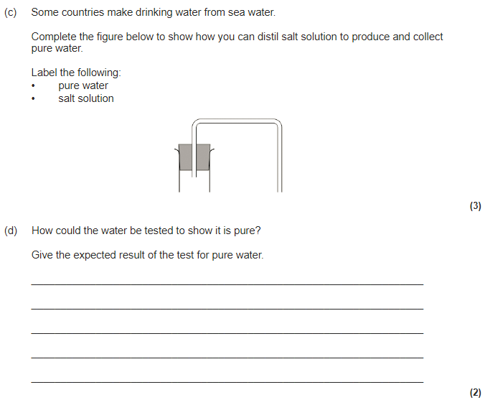
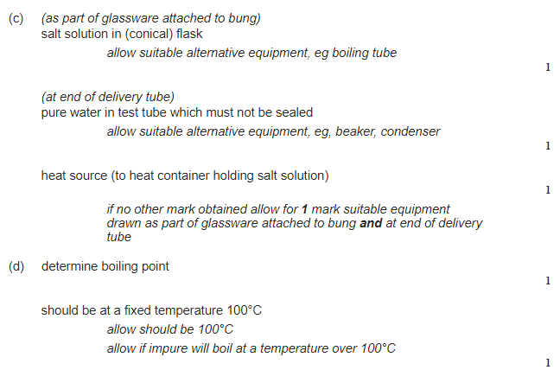

Slide 7
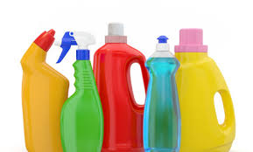
Formulations
Spec definition
A formulation is a mixture that has been designed as a useful product. Many products are complex mixtures in which each chemical has a particular purpose.
Formulations are made by mixing the components in carefully measured quantities to ensure that the product has the required properties. Formulations include fuels, cleaning agents, paints, medicines, alloys, fertilisers and foods.

Slide 8
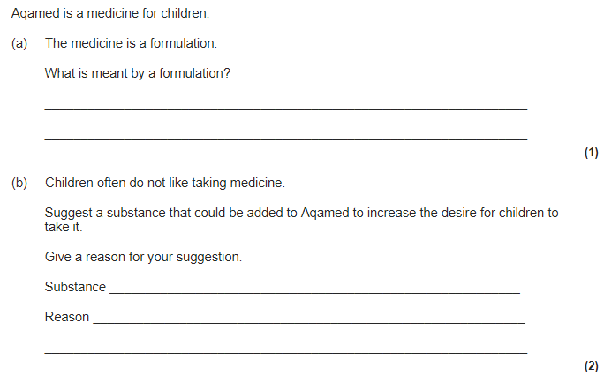
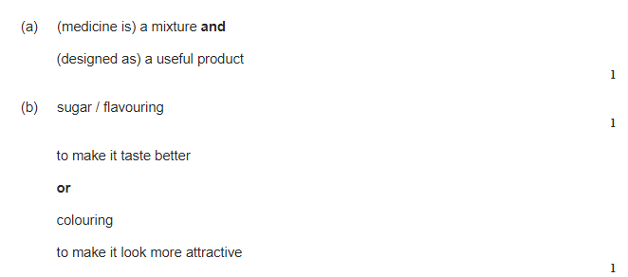

Slide 9
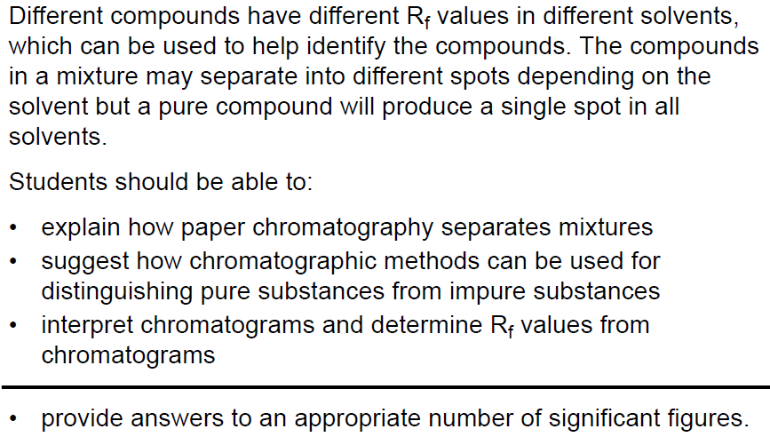

Slide 11
Draw a pencil line 1cm up from the bottom of your chromatography paper. This is your baseline.
Spot four different inks along the baseline.
Secure the paper from the top and dip into your solvent, make sure the solvent does not go above the baseline.
Allow the solvent front (mobile phase), to travel up the paper (stationary phase). When it is one cm from the top, remove the paper from the solvent and allow to dry.
Use a pencil to draw around any marks on the paper and stick it to your page.
Conclude which colours the black ink is made from.

Slide 13
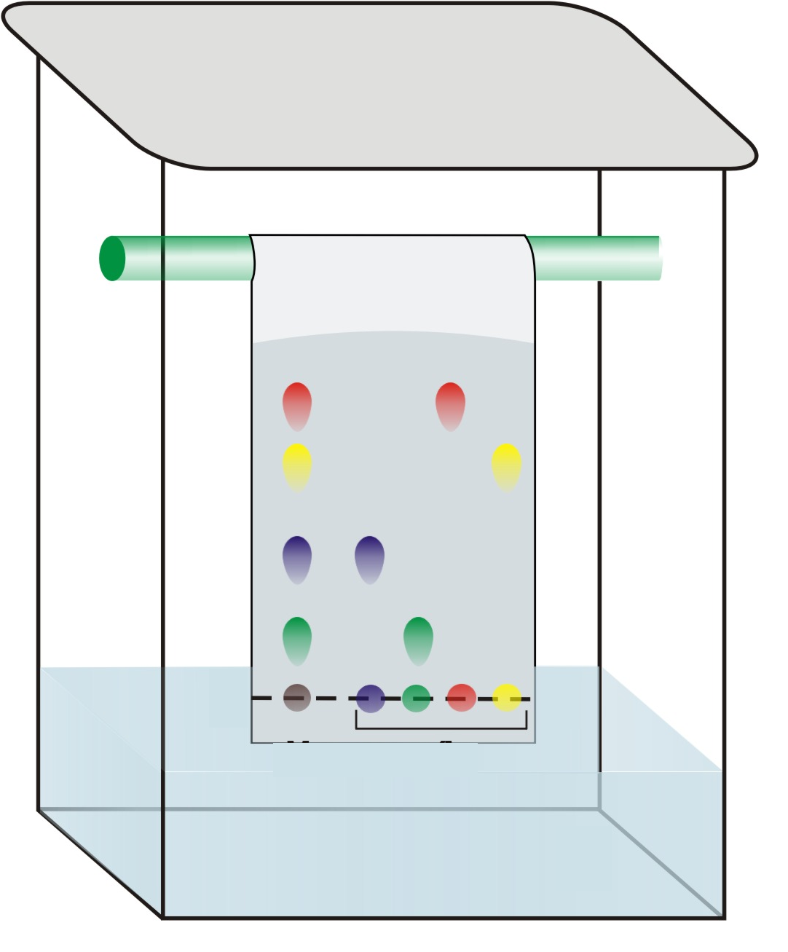
Chromatography
Lid to prevent evaporation
Distance moved by the solvent
Stationary phase (filter paper)
Distance moved by the chemical
Pencil line
Solvent (the mobile phase)

Slide 14
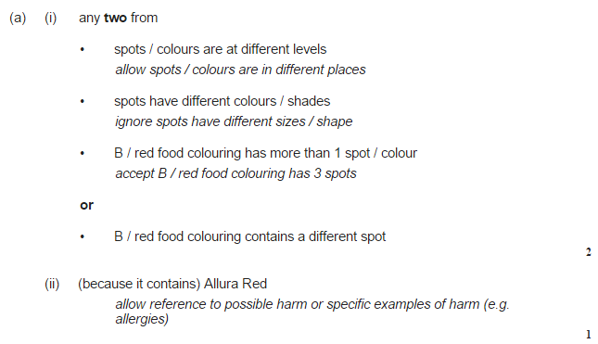
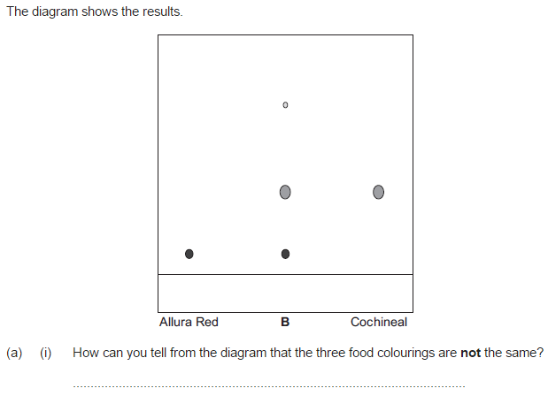

Slide 15
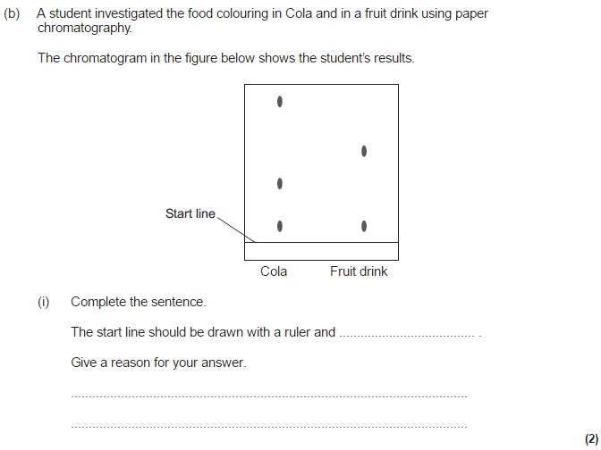

Slide 16
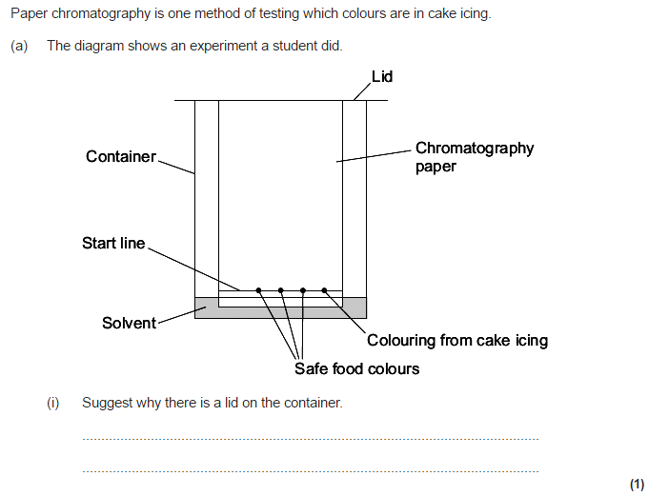

Slide 17
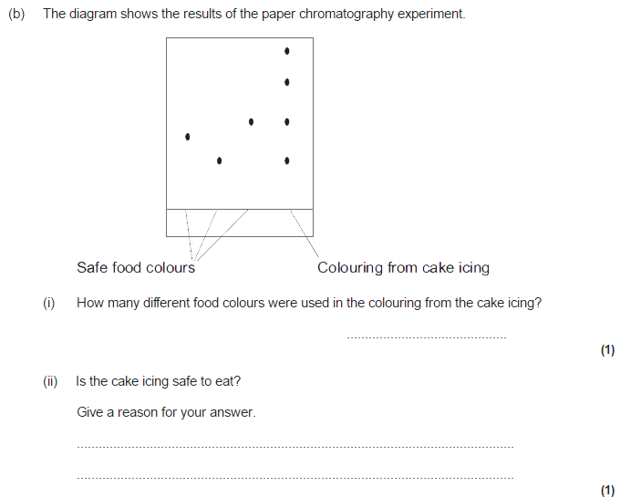
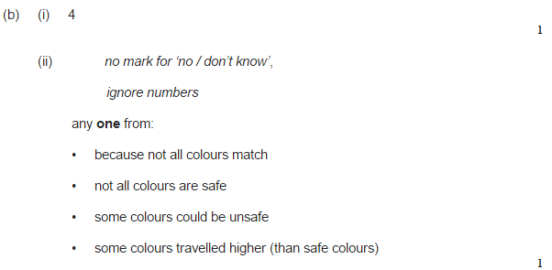

Slide 18
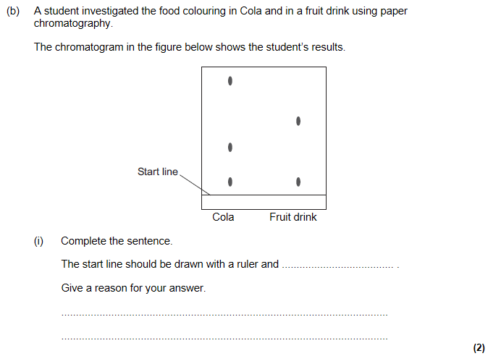
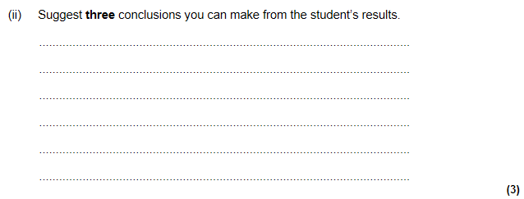
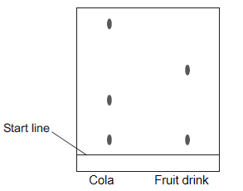
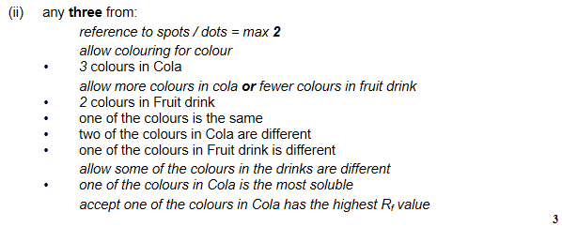

Slide 19
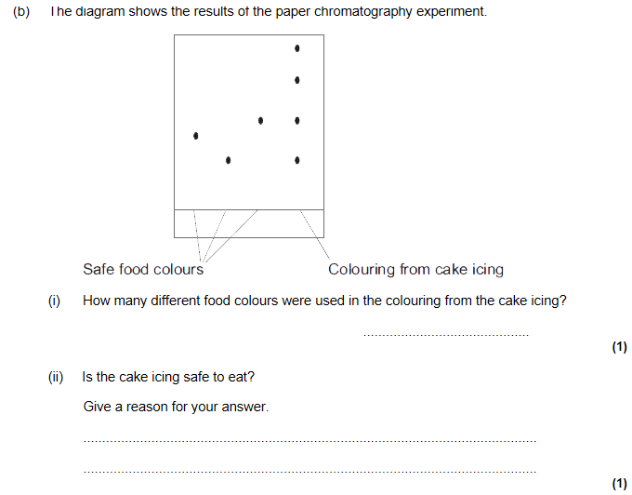
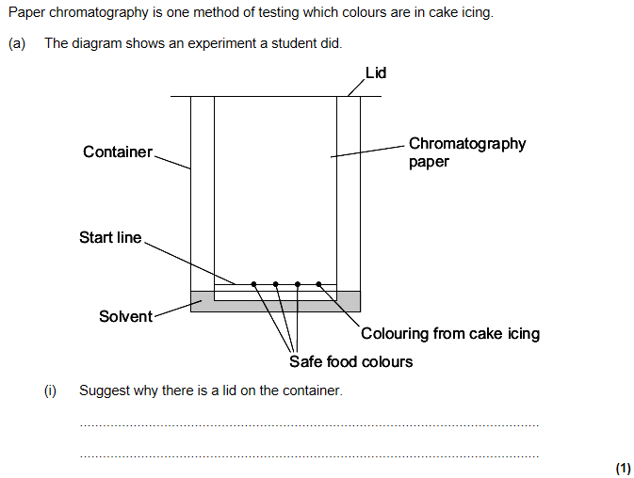
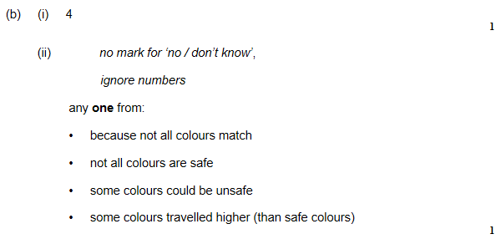

Slide 20
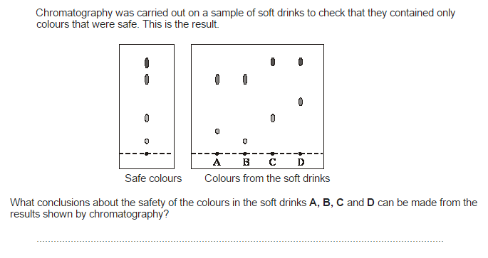

Slide 21
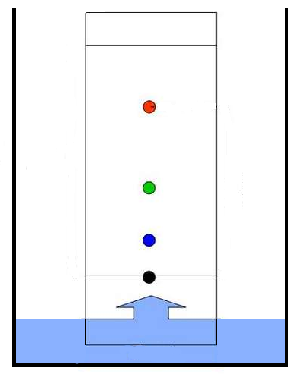
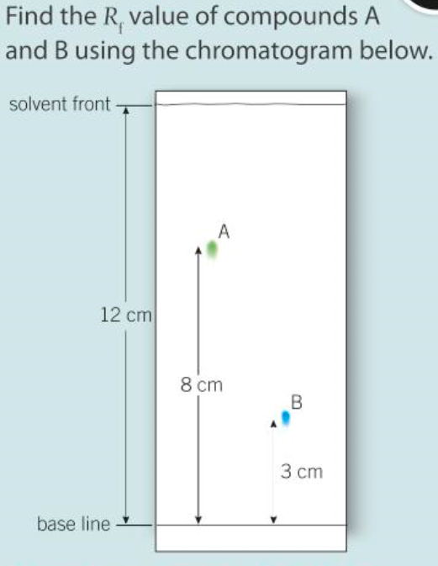
Retention factor (Rf) values
Always measure to the MIDDLE of the spot
The Rf factor is used to compare the components of various samples. The Rf values of suspect samples can be compared with known samples.
Rf = distance from the base line to the spot
distance from the base line to the solvent front
Solvent front
the point at which the water stopped moving up the paper
If two substances have the same Rf value, they are likely (but not necessarily) the same compound. If they have different Rf values, they are definitely different compounds.
Spot
the point at which a band or spot of colour is
Base line
the line where the original sample was placed

Slide 22
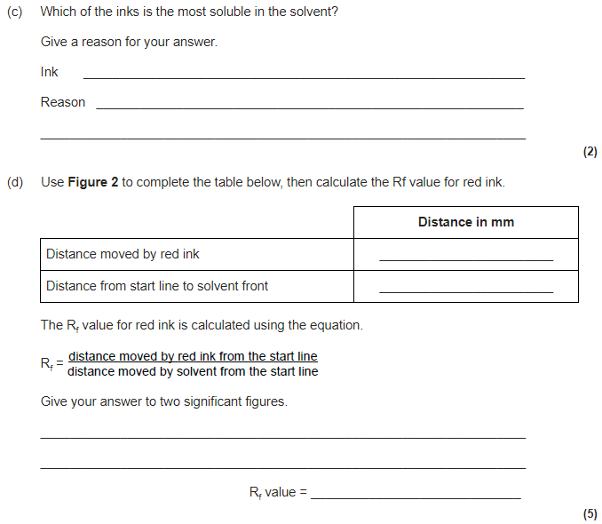
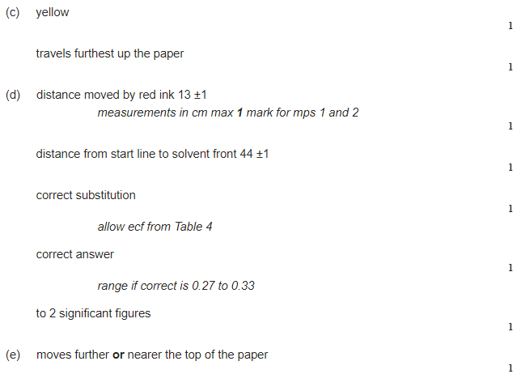

Slide 23
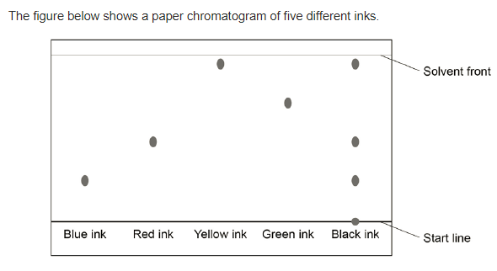
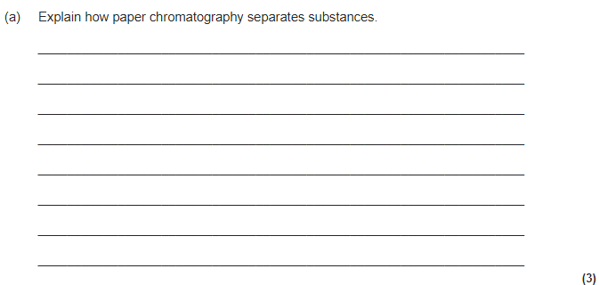
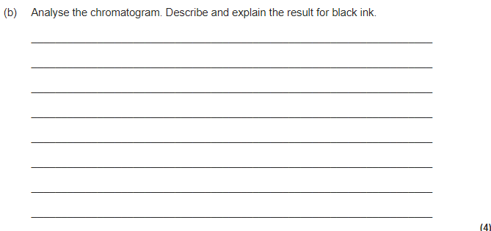

Slide 24
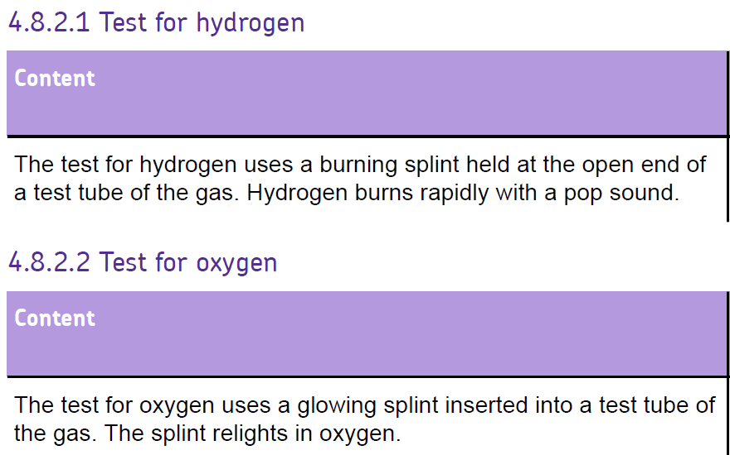

Slide 25
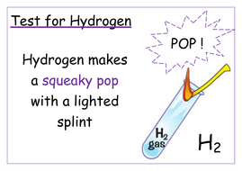
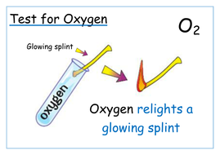
Test for oxygen
Test for hydrogen

Slide 26
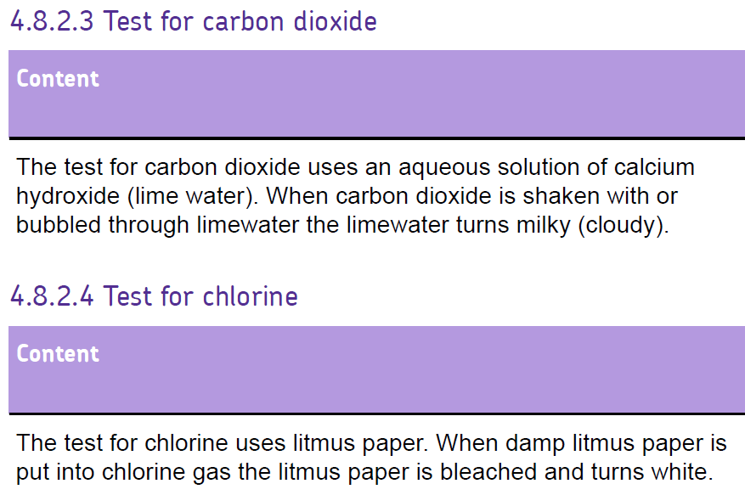

Slide 27
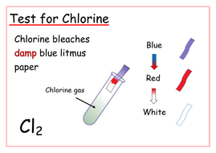
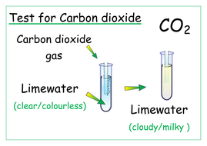
Test for carbon dioxide
Test for chlorine

Slide 28
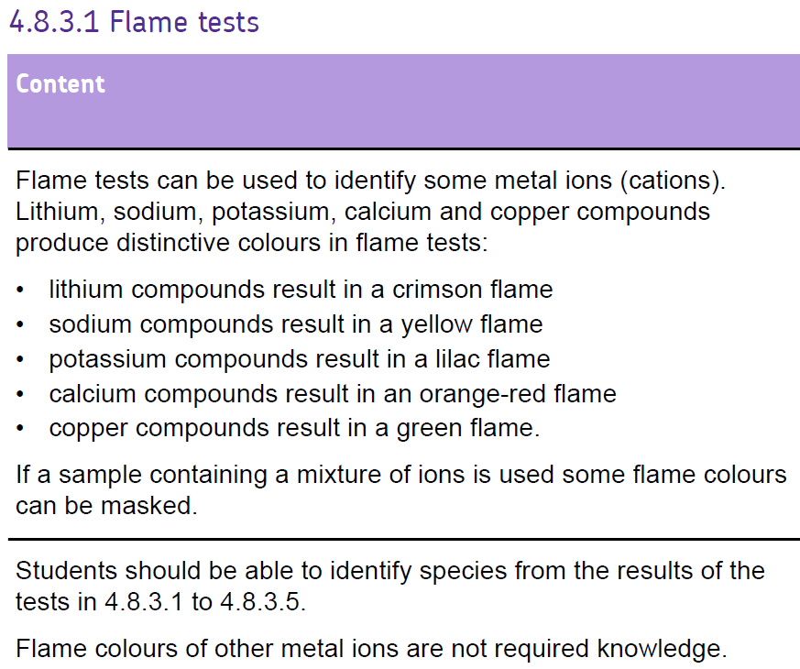
Remember these colours

Slide 29
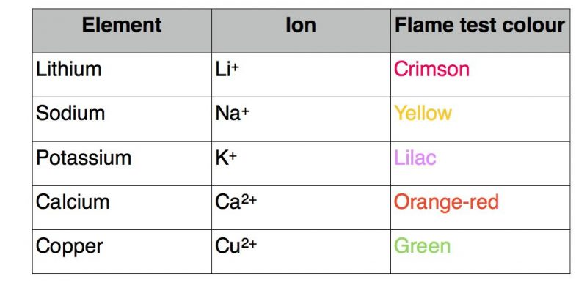
Flame tests

Slide 32
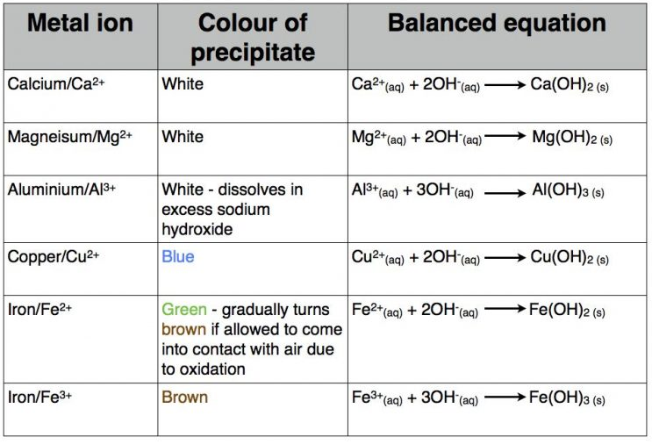
Testing for positive ions
To test for positive ions, react the unknown substance with sodium hydroxide solution and observe the result
Then flame test

Slide 33
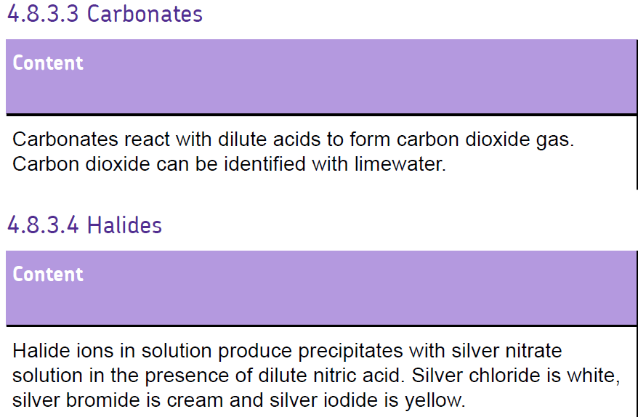

Slide 34
Testing for negative ions

Slide 36
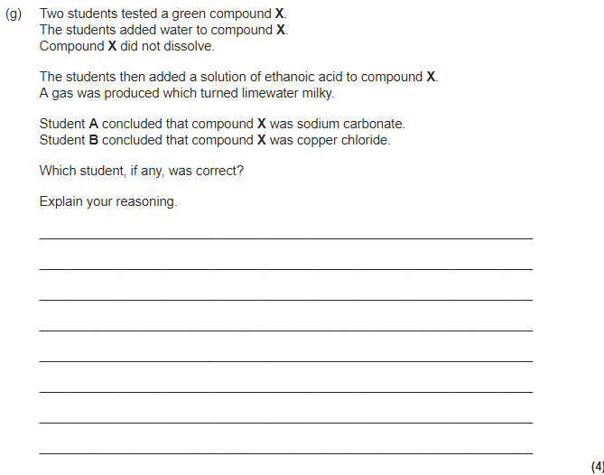
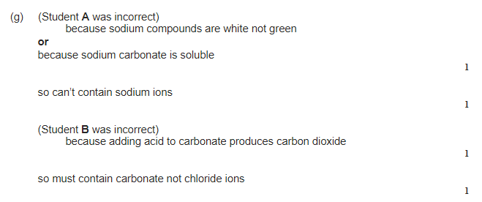

Slide 39
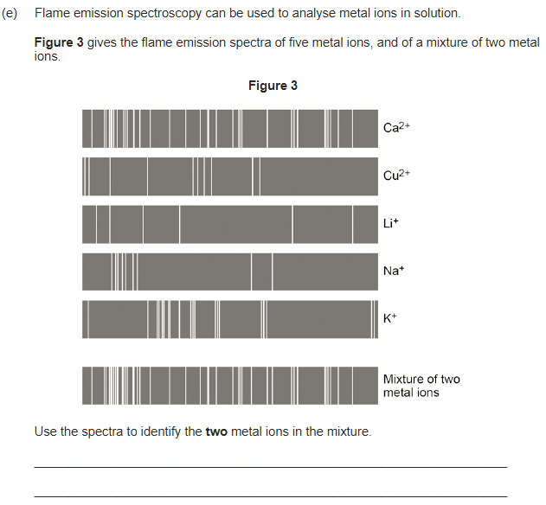

Slide 40
