Slide 1
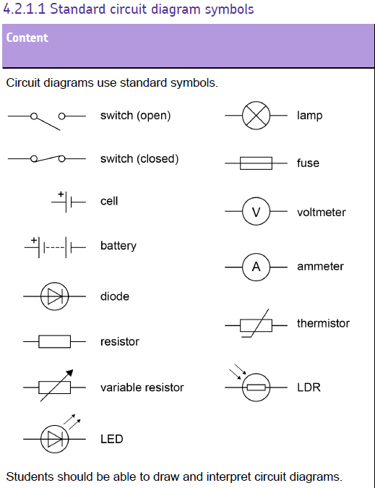

Slide 2
Circuit Symbols
Battery
Cell
Variable resistor
A
V
Bulb (lamp)
Ammeter
Voltmeter
LED
Switch (open)
Diode
Thermistor
Fuse
Resistor
LDR

Slide 3
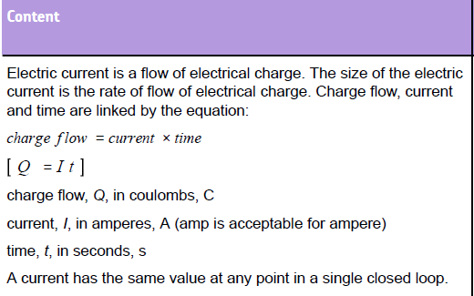

Slide 4
Current
Q
Flow of electrons (number of coulombs per second)
Current (Amps) = Charge (Coulombs)
Time (seconds)
I x t
Notes:
A coulomb would be a stupendous amount of unbalanced charge (two objects each with one coulomb of unbalanced charge of the same type, placed 1 m apart, would rip through thick concrete to get away from each other). But one coulomb of moving charge per second (i.e. one amp) in a circuit is not a particularly large amount, and can be achieved with a couple of batteries. The reason this is possible is that in a circuit the charge is not unbalanced – the negative charge moves but is always balanced by the stationary positive ions it is moving through, so that each section of wire is neutral overall.
This presentation begins with a definition of voltage, something which is often neglected or only mentioned in passing at GCSE level. Students are often simply taught the rules about voltage in series and parallel circuits without ever really understanding what voltage is. I have found, in teaching A* to B grade level students in Year 10, that circuits make more sense to them, and they do better in exam questions on circuits, if they have developed an understanding of voltage.

Slide 5
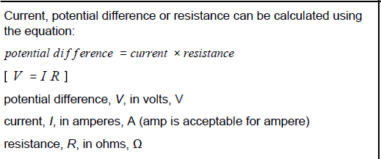

Slide 6
Resistance and resistors
Voltage = current x resistance
V = IR
V = Voltage (V)
I = Current (A)
R = Resistance (Ohms, Ω)

Slide 7
Resistance is measured in ohms (Ω)
What is resistance?
Ions in a metal/wire/component resist the passage of electrons passing through it. The more difficult it is for electrons to pass through the metal, the more resistance there is, and the more energy the electrons use trying to get through it.
V
Resistance (ohms) = Voltage (volts)
Current (amps)
R x I

Slide 8
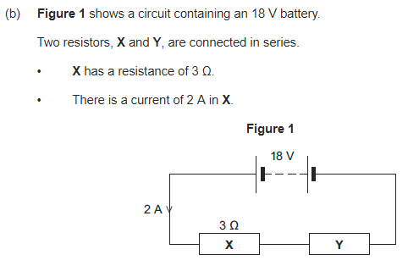
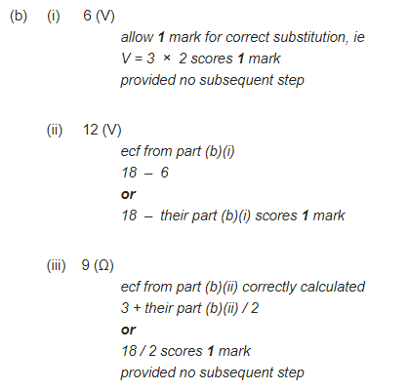

Slide 9
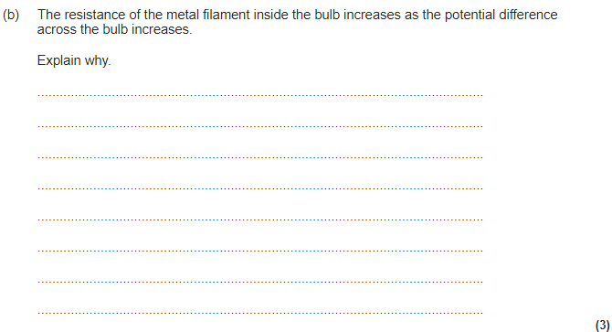
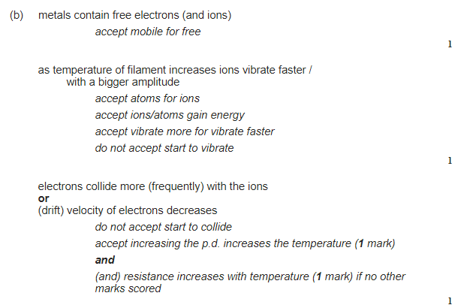

Slide 10
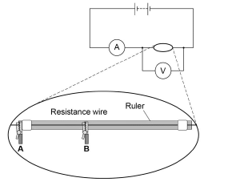
https://youtu.be/X9cAcsDmo8w
https://youtu.be/QHlIrtAcOAg
1. Connect the circuit as shown
2. Connect a lead from the negative side of the ammeter to the crocodile clip at the zero end of the ruler. Connect a lead from the other crocodile clip to the negative side of the battery. Use this lead as a switch to disconnect the battery between readings.
3. Decide the interval distance (eg 10cm) you will investigate and connect the first distance to be tested between crocodile clips A and B.
4. Measure the readings on the voltmeter and ammeter at this distance.

Slide 12
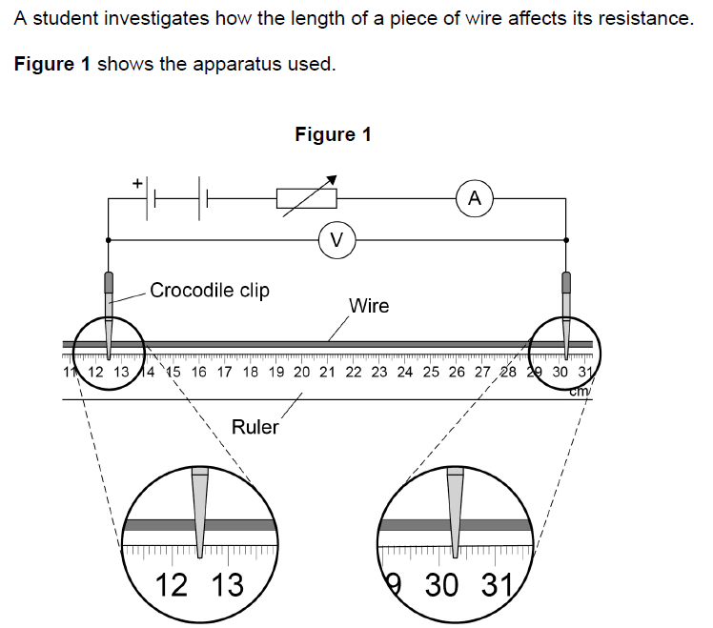

Slide 13
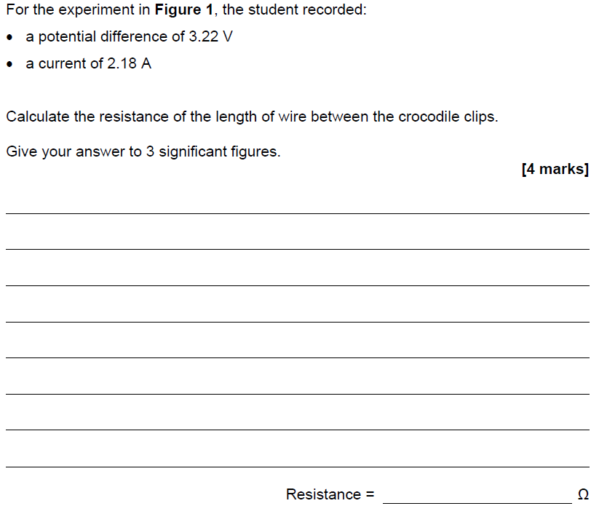
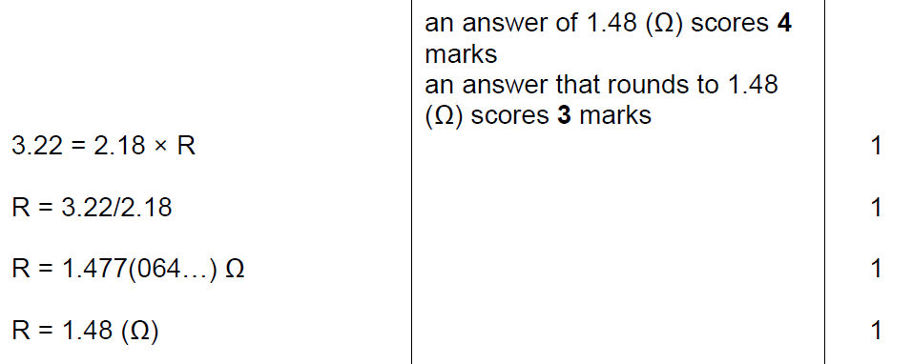

Slide 15
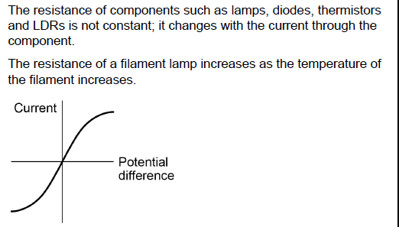
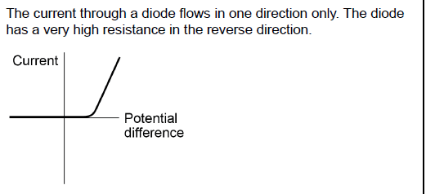

Slide 16
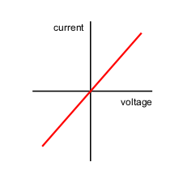
Ohm’s Law
https://www.youtube.com/watch?v=2CA1mcYw3IQ
Which line is the most and least resistant component?
The current flowing through a resistor at a constant temperature is directly proportional to the voltage across the resistor. So…
If you double the voltage,
the current also doubles.
Least resistant
Most resistant

Slide 17
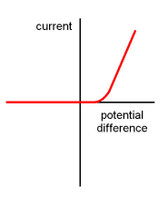
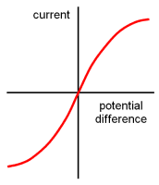
Resistance changes through different component
Filament lamp
Ohmic resistor
Diode

Slide 19
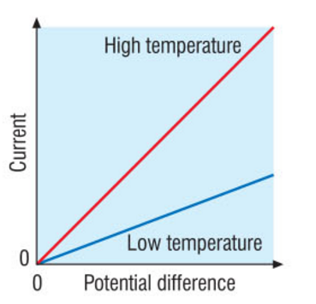
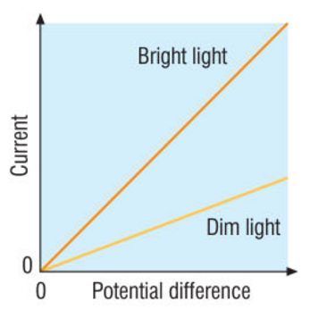
Non-Ohmic Components
A thermistor is a component whose resistance decreases when the temperature increases.
Useful in thermostats to control temperature
An LDR is a component whose resistance decreases as the light intensity that falls on it increases
Useful in nightlights to switch on lights when it is dark

Slide 20
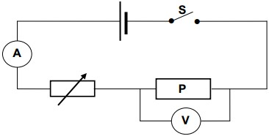
https://youtu.be/vnRQnp6limA
Potential difference (volts) | Current (amps) | Resistance (R = V/I) (ohms)

Slide 21
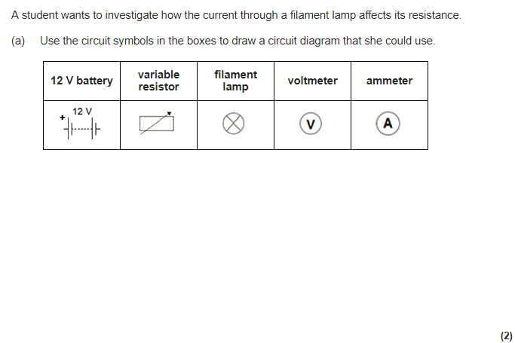

Slide 22
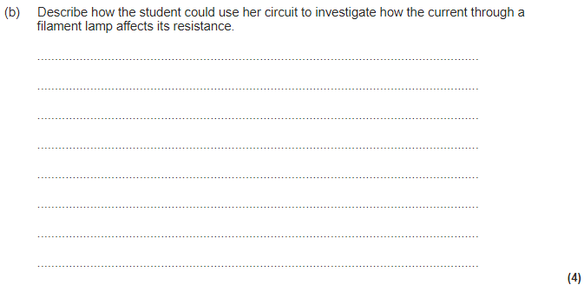
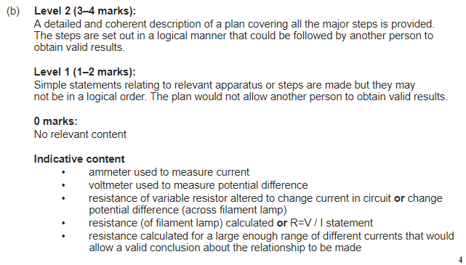

Slide 23
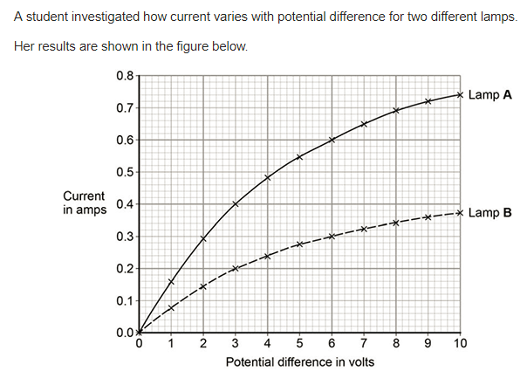

Slide 24
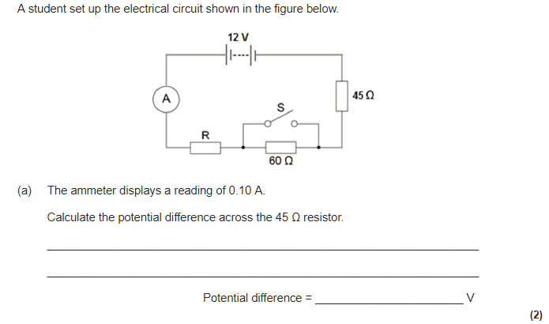

Slide 26
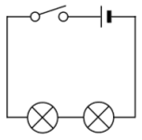
Series Circuits Rules - Current
The same current passes through components in series with each other
If the current through the lamps is 0.12A, what is the current through the cell?
0.12A
0.12A
0.12A
0.12A

Slide 27
Series Circuits Rules - Voltage
The total potential difference of the voltage supply in a series circuit is shared between the components.
If the potential difference of the cell is 1.2V and the potential difference of across one lamp is 0.8V, what is the potential difference across the other lamp?
0.4V
1.2V
0.8V
0.4V

Slide 28
Series Circuits Rules - Resistance
The total resistance of components in series is equal to the sum of their separate resistances.
What is the total resistance if one lamp in series has a resistance of 2Ω and the other has a resistance of 3Ω?
5Ω
2Ω
3Ω

Slide 29
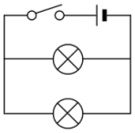
Parallel Circuits Rules - Current
The total current through the whole circuit is the sum of the currents through the separate components.
0.4A
If ammeter A₁ reads 0.4A and A₂ reads 0.1A, what would A₃ read?
0.3A
A₁
A₂
0.1A
A₃
0.3A

Slide 30
Parallel Circuits Rules – potential difference
For components in parallel, the potential difference across each component is the same.
6V
If the potential difference of the cell is 6V, the potential difference across each lamp will also be 6V.
6V
6V

Slide 31
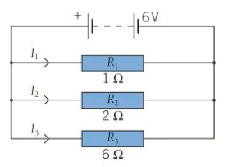
Parallel Circuits Rules – resistance
The total resistance of two (or more) resistors in parallel is less than the resistance of the smallest individual resistor.
I₁ = V/R = 6/1 = 6A
I₂ = V/R = 6/2 = 3A
I₃ = V/R = 6/6 = 1A
Total current = 6+3+1 = 10A

Slide 32
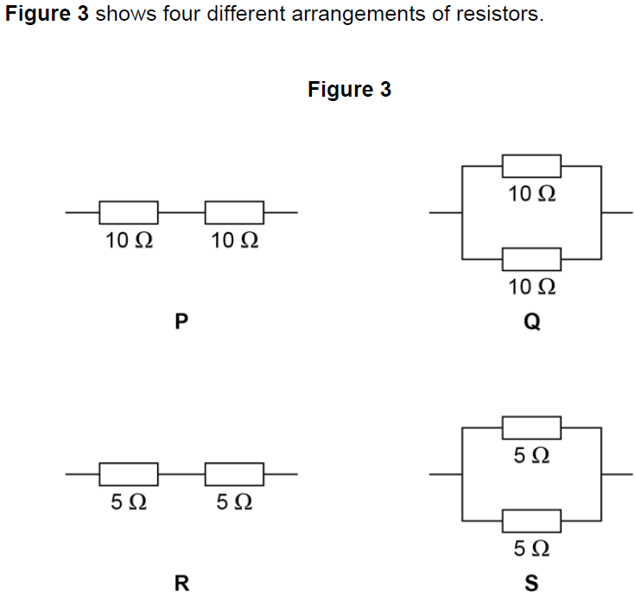

Slide 33
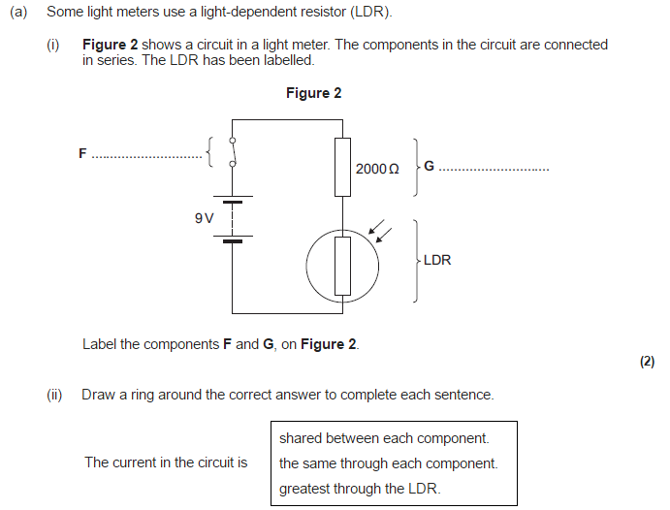

Slide 34
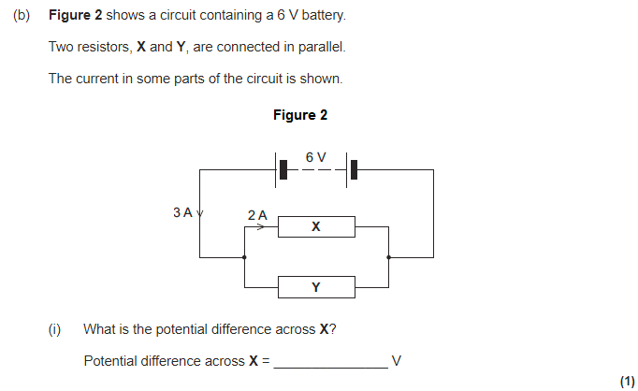

Slide 35
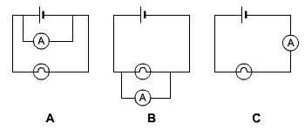
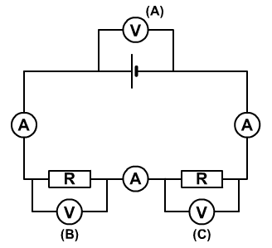

Slide 36
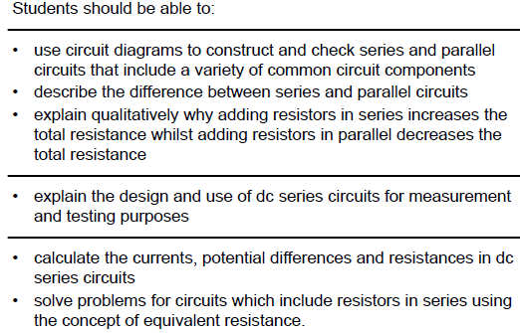

Slide 38
Direct Current
Voltage
Time
This current is found in batteries
The charge flows in one direction only

Slide 39
Alternating Current
Mains electricity uses an alternating current.
This means that the current repeatedly reverses direction.
The UK mains supply being about 230 V.
It has a frequency of 50 Hz (50 hertz), which means it changes direction, and back again, 50 times a second.

Slide 40
Alternating Current
Voltage
Time
Frequency (Hz) = 1 ÷ time period

Slide 41
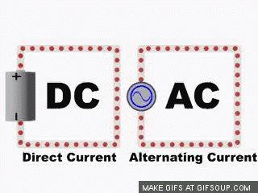
Direct current vs alternating current

Slide 42
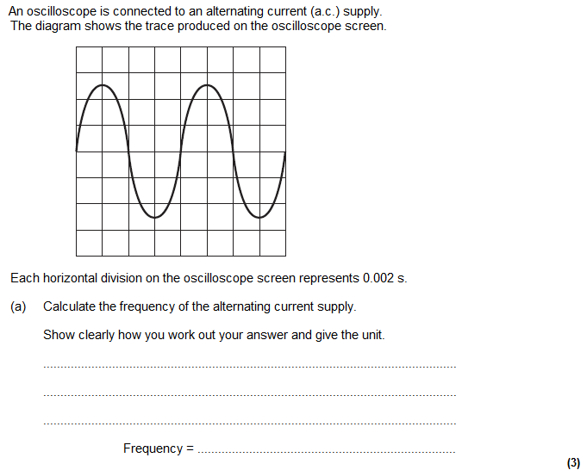
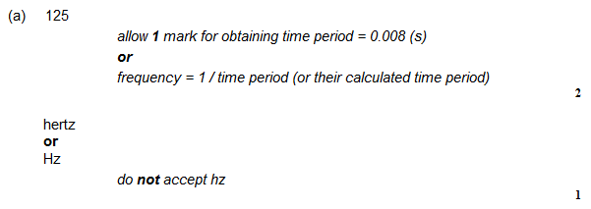
Frequency = 1/time period

Slide 43
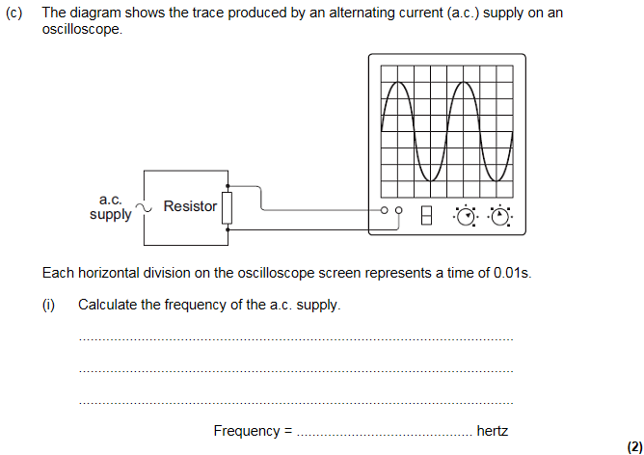

Slide 44
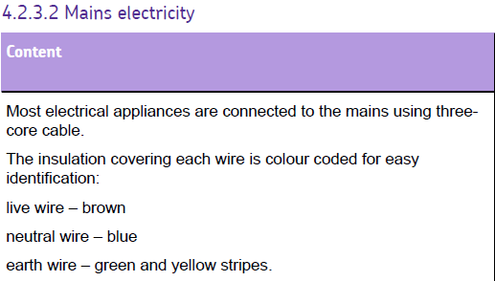
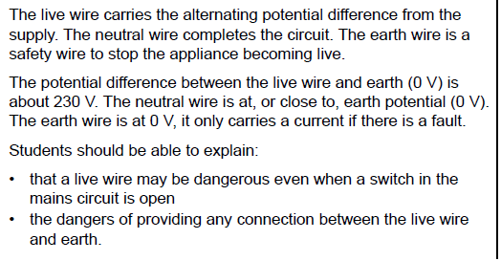

Slide 45
The three-pin plug

Slide 46
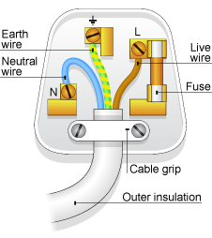
Components of a plug and cable
Live wire (brown) – This carries the current to the appliance. Touching this can be deadly!
Neutral wire (blue) – This completes the circuit and is usually at 0V
Earth wire (green/yellow) – This ‘earths’ the appliance in case one of the wires touches the casing
Fuse – This stops the flow of current if it gets too high

Slide 47
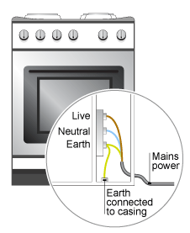
The Earth Wire
Many electrical appliances have metal cases. The earth wire creates a safe route for the current to flow through if the live wire touches the casing.
Some appliances (hairdryers, vacuum cleaners) don’t have an earth wire.
This is because they are DOUBLE INSULATED

Slide 48
How does the Earth wire protect us from electric shock
This will massively increase the current running through the fuse, the fuse melts and breaks the circuit
Normally current comes in from the live and leaves through the neutral
If the live wire touches the metal casing, the Earth wire is used to conduct the current away

Slide 49
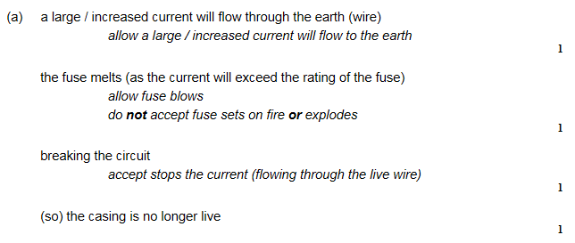

Slide 51
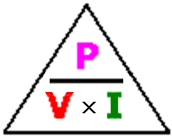
Calculating Power
This is a very useful equation, it will help you working out the current through any appliance knowing the power. We can calculate power in two ways.
Power (watts) = Current (amps) x Potential Difference (volts)
Power (watts) = Current² (amps) x Resistance (ohms)
R
2

Slide 52
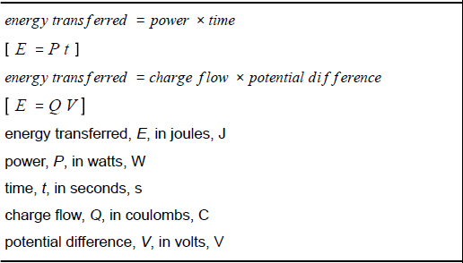
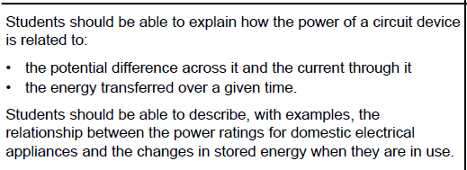

Slide 53
Calculating energy transferred
Energy transferred in a circuit can be calculated in 2 ways:
Energy (joules) = Charge (coulombs) x Potential Difference (volts)
Energy (joules) = Power (watts) x Time (seconds)
E
E
V x Q
P x t

Slide 54
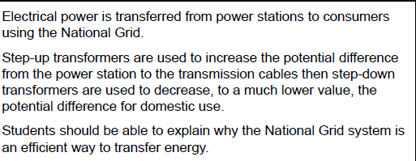

Slide 55
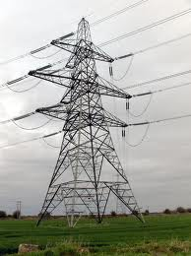
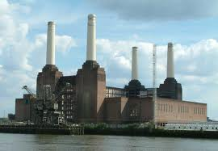
Transporting electricity
INCREASES voltage
REDUCES current REDUCES energy loss INCREASES efficiency
Step-Down Transformer
Step-Up Transformer
Reduces voltage back down to 230V
This is how our
National Grid
Works!!

Slide 56
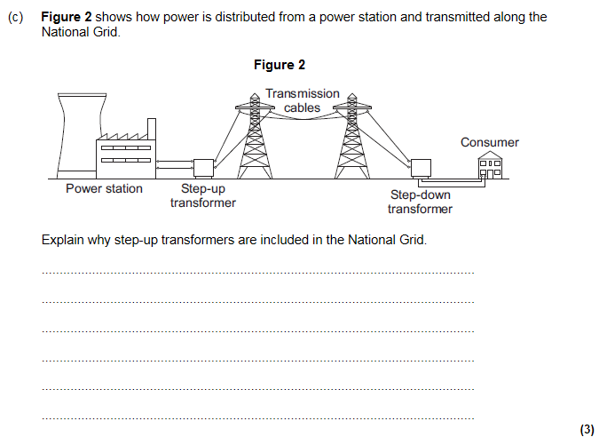
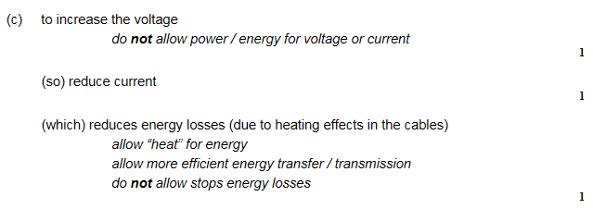

Slide 59
Van de Graaff generator

Slide 60
Charging by Friction
When you rub two different insulated materials against each other they become electrically charged.
This only works for insulated objects.
Metals just conduct the charge
Remember it is ELECTRONS moving from one place to another

Slide 61
Like charges repel: unlike charges attract
Two charged rods of different materials will attract each other if they have a different charge.
Two rods made of the same material will repel each other due to having the same charge.

Slide 66
Electric fields

