Slide 1
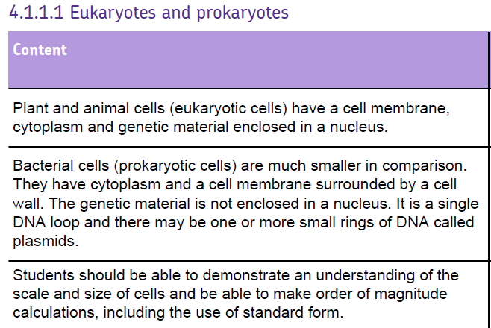

Slide 2
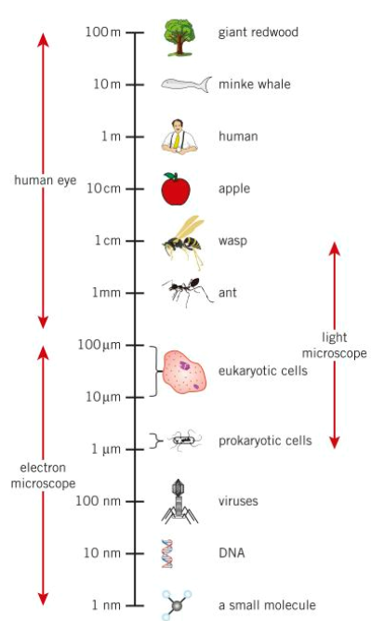
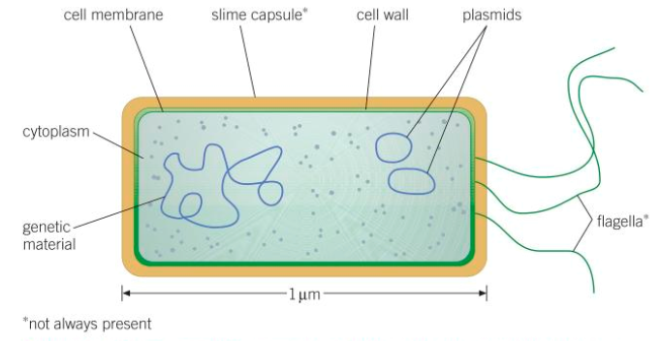
Bacterial cell (prokaryotic)

Slide 3
Can you list the metric prefixes from largest to smallest?!
https://www.youtube.com/watch?v=djTNUp4XIRo
  Tera (T) = 1.0 x 10¹²
  Giga (G) = 1.0 x 10⁹
  Mega (M) = 1.0 x 10⁶
  Kilo (k) = 1.0 x 10³
  ‘no prefix’ = 1.0 x 10⁰
  Centi (c) = 1.0 x 10⁻²
  Milli (m) = 1.0 x 10⁻³
  Micro (µ) = 1.0 x 10⁻⁶
  Nano (n) = 1.0 x 10⁻⁹
  Tera
  Nano
  Giga
  Micro
  Mega
  Centi
  Milli
  Kilo
x 1000
÷ 1000
x 1000
÷ 1000
x 1000
÷ 1000
x 1000
÷ 1000
x 100
÷ 100
x 10
÷ 10
x 1000
÷ 1000
x 1000
÷ 1000

Slide 4
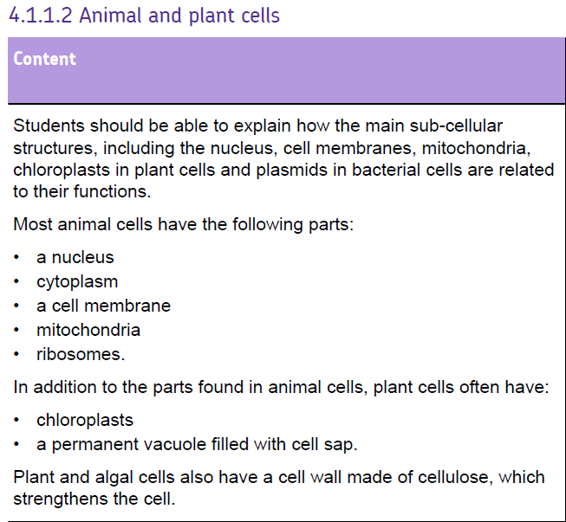
Be clear about the similarities and differences of bacterial, plant and animal cells.
Know the difference between eukaryotic and prokaryotic

Slide 5
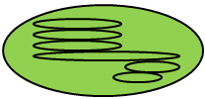
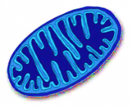
Learn the location, names and functions
Chloroplast
Ribosome
Plant cell
Animal cell
Mitochondria
Vacuole
Cytoplasm
Nucleus
Cell wall
Cell membrane
Key words:
mitochondria, nucleus, ribosome, vacuole, chloroplast, cell wall, cell membrane, cytoplasm

Slide 6
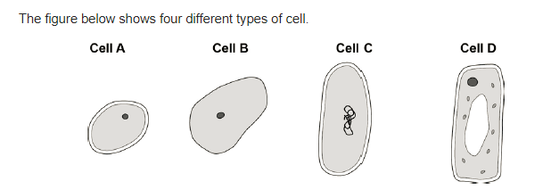
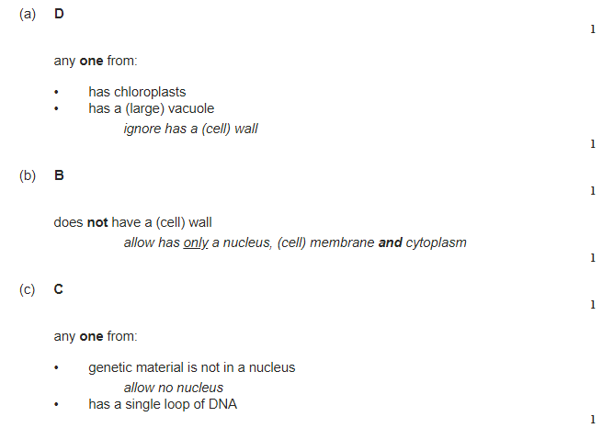
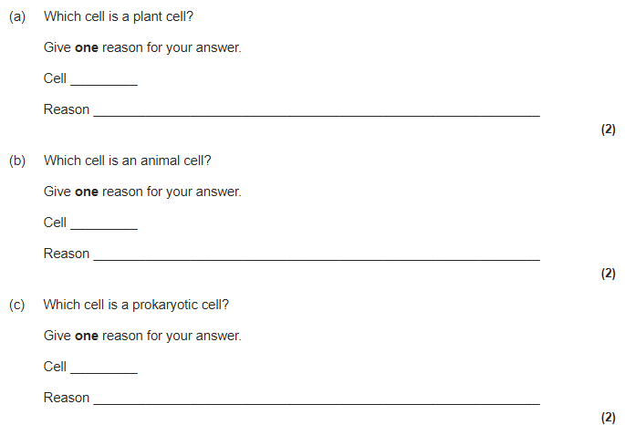

Slide 7
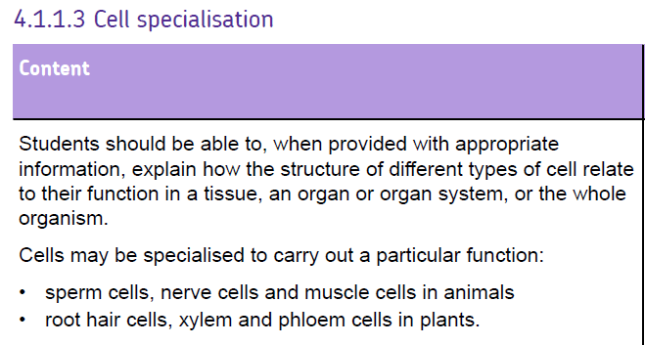

Slide 8
Things to look out for
Lots of mitochondria – needs lots of energy (for active transport, movement etc.)
Big surface areas – for efficient transport of substances
Animal cells
Nerve cell – long, lots of mitochondria to make neurotransmitter
Muscle cell – able to contract and relax to bring about movement, lots of mitochondria, can store glycogen
Sperm cell – big nucleus, mitochondria, tail to swim
Plant cells
Root hair cell – big surface area, large vacuole to speed up osmosis, many mitochondria for active transport, no chloroplasts
Palisade cells – lots of chloroplasts
Xylem and phloem – for transport

Slide 9
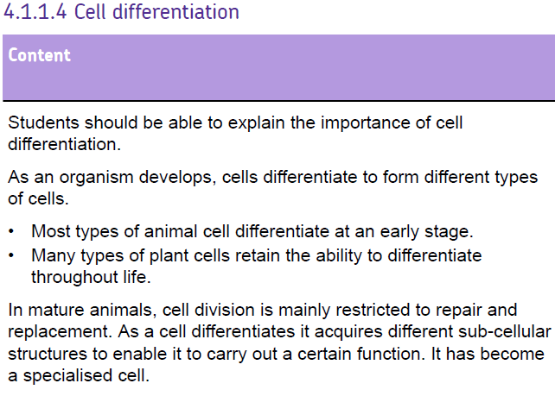

Slide 10
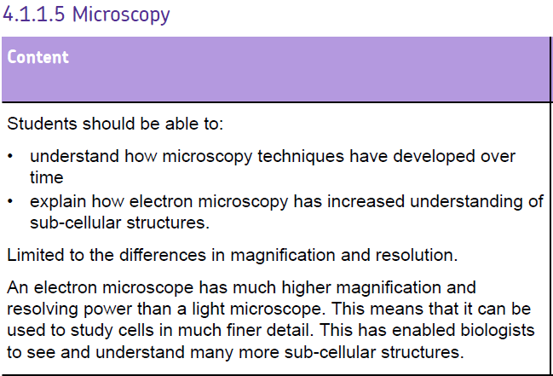

Slide 11
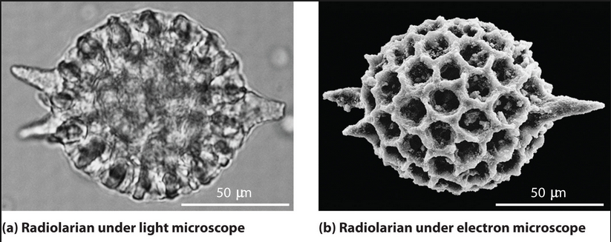
Microscopes
Spot the differences:
which is a better image and why?
Resolution – the smallest distance between two points that can be seen as separate entities. Structures less than 0.2 micrometres cannot be seen with a light microscope.
Notes:
Optional slide – discuss resolution and focus. Differences between light and electron microscopes. Could be left to the end as challenge task.

Slide 12
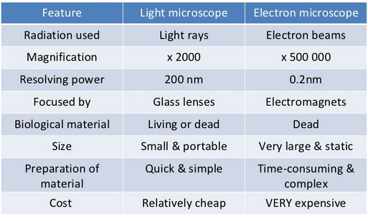
Microscopes
Key words: cell, light microscope, focus, slide, stage, magnification, image, object
Notes:
Optional slide – discuss resolution and focus. Differences between light and electron microscopes. Could be left to the end as challenge task.

Slide 13
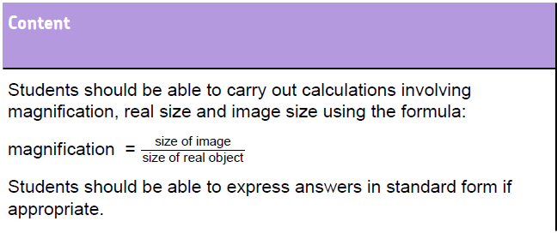

Slide 14
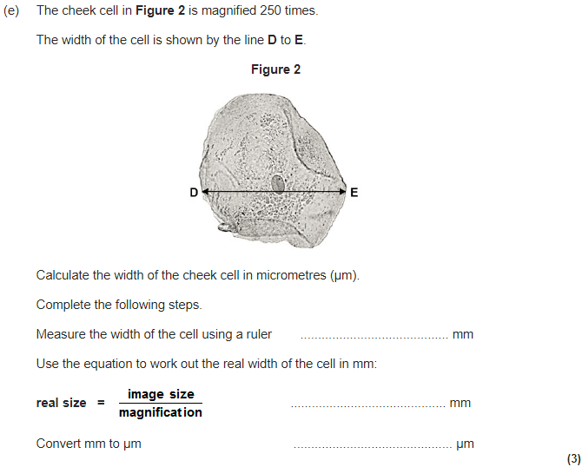
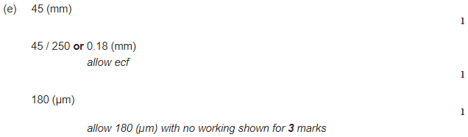
45mm

Slide 15
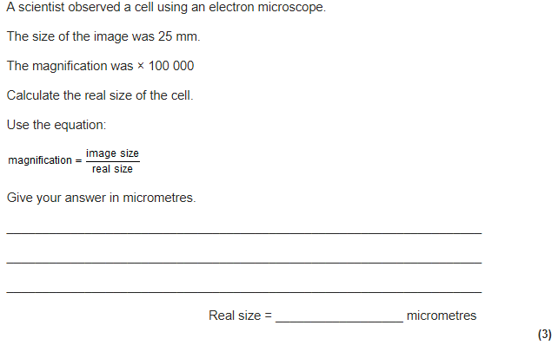
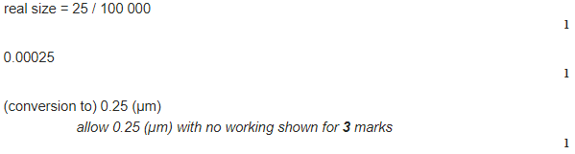

Slide 16
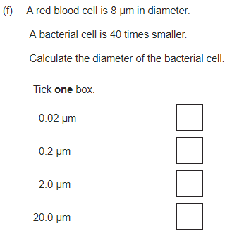


Slide 17
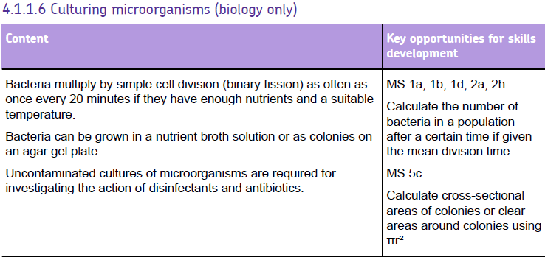

Slide 18
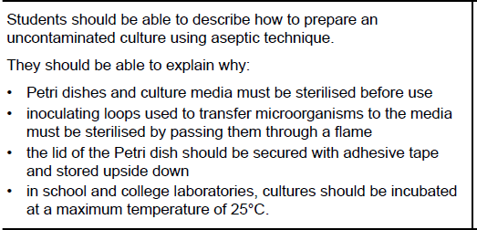
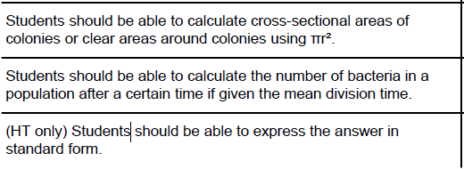

Slide 19
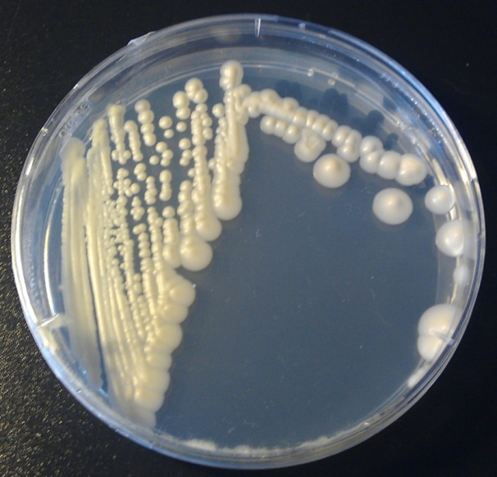
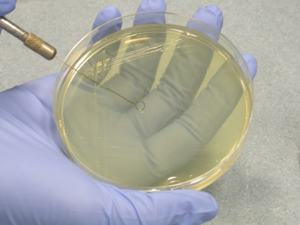
Growing bacteria
Step 1:
Sterilise petri dish and inoculating loop
Reason: To kill any unwanted microorganisms
Step 2:
Transfer microorganism onto agar jelly, only opening lid a small amount
Reason: Stop any unwanted microorganisms entering the petri dish
Step 3:
Secure petri dish with tape (but not all the way round)
Reason: Stop any unwanted microorganisms entering the petri dish, avoid anaerobic bacteria
Step 4: Incubate
Reason: To allow bacteria to grow
Microorganisms can be cultured in the lab
A culture medium (agar) is given containing an energy source (carbohydrate) and minerals. They are kept warm and allowed oxygen to grow
Safety:
Bacteria may mutate so contamination must be avoided – e.g. From skin, air, water..
Petri dishes and agar must be sterilised from an autoclave or using gamma radiation / UV
Inoculate the plates – sterilise the loop, dip in suspension, zig-zag then incubate
Grow in maximum temp of 25˚C to stop harmful pathogens growing

Slide 20
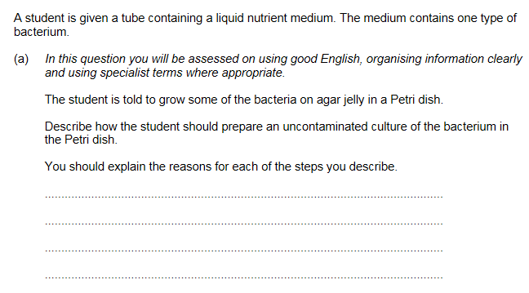
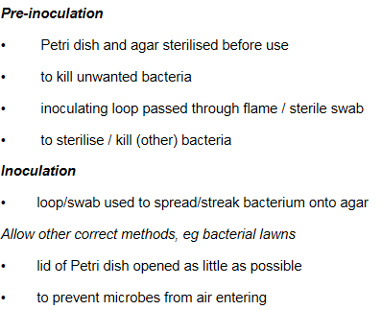
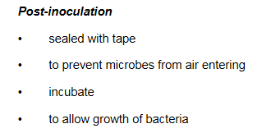

Slide 21
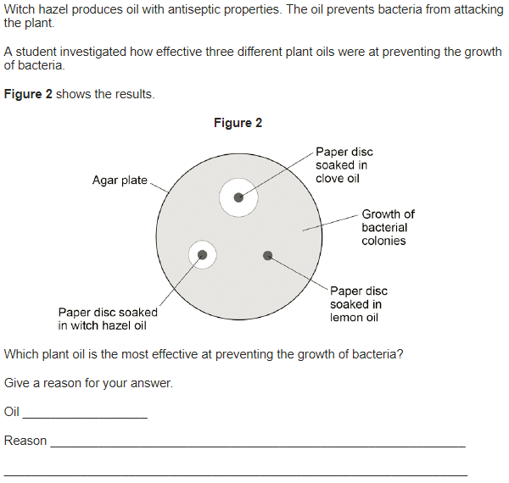

Slide 22
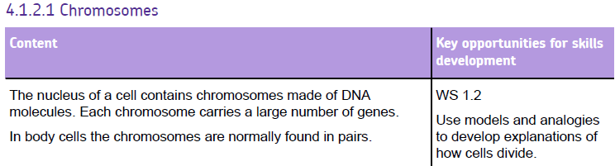

Slide 23
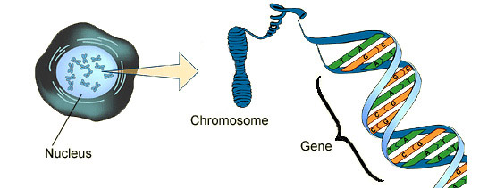
Where is the genetic information in a cell?
Inside each cell is a nucleus.
Inside the human nucleus are 46 chromosomes (two sets of 23, one set from Mum, one set from Dad).
Chromosomes are made from DNA.
A section of DNA is called a gene.

Slide 24
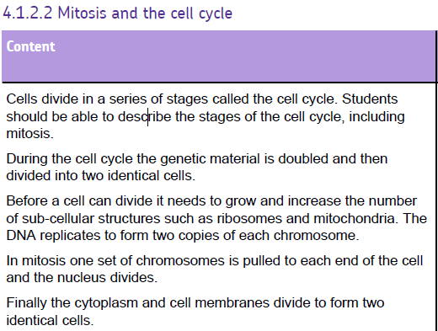
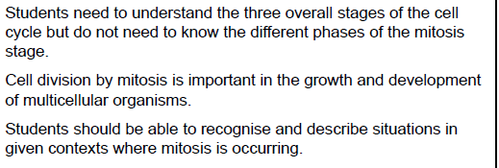

Slide 25
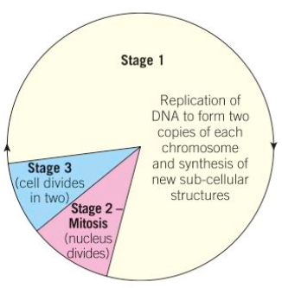
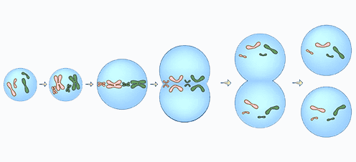
Mitosis
Mitosis is used for growth or to replace cells.
Stage 1 – cells grow bigger and replicate their DNA to form 2 copies of their chromosomes ready for cell division.
Stage 2 – Mitosis: one set of chromosomes is pulled to each end of the dividing cell and the nucleus divides.
Stage 3 – the cytoplasm and the cell membranes also divide to form two identical daughter cells

Slide 26
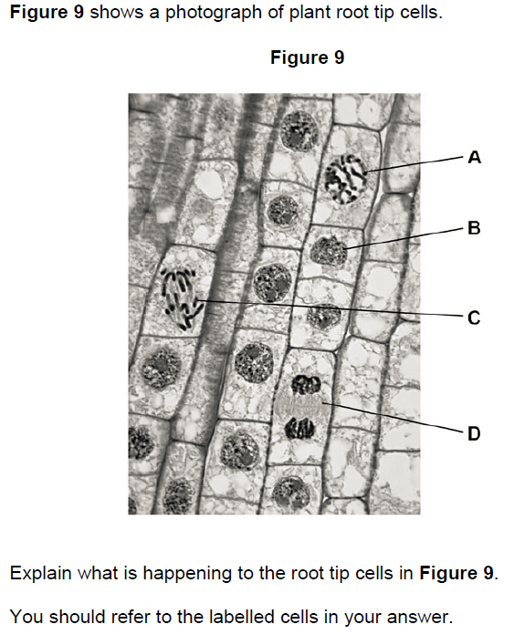
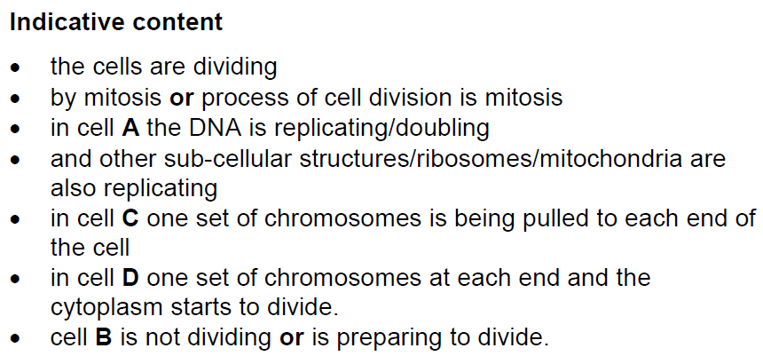

Slide 27
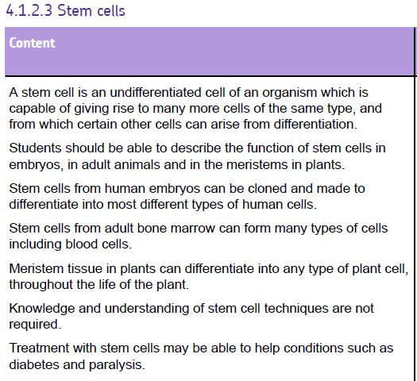
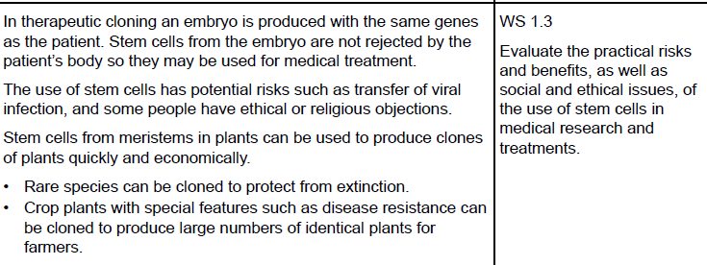
What is a stem cell?

Slide 28
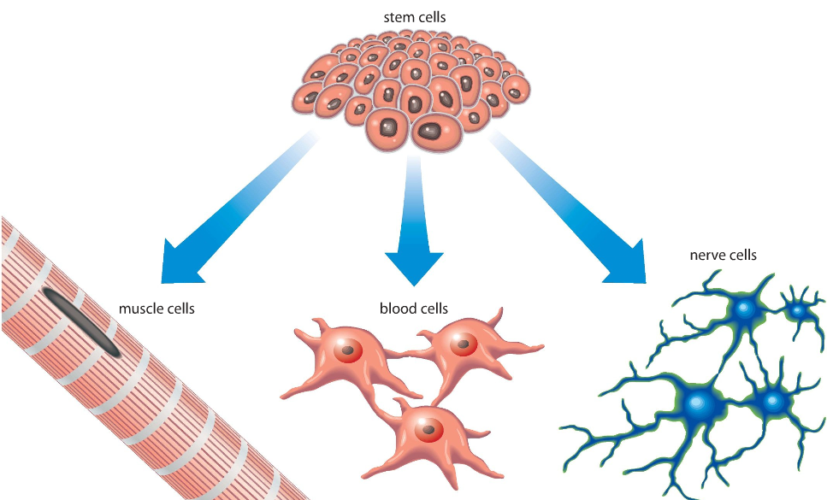
Embryo Stem Cells
Unspecialised - they can become any type of cell in the human body.
As the cells of an embryo divide (by mitosis) and the embryo develops, the cells become differentiated.

Slide 29
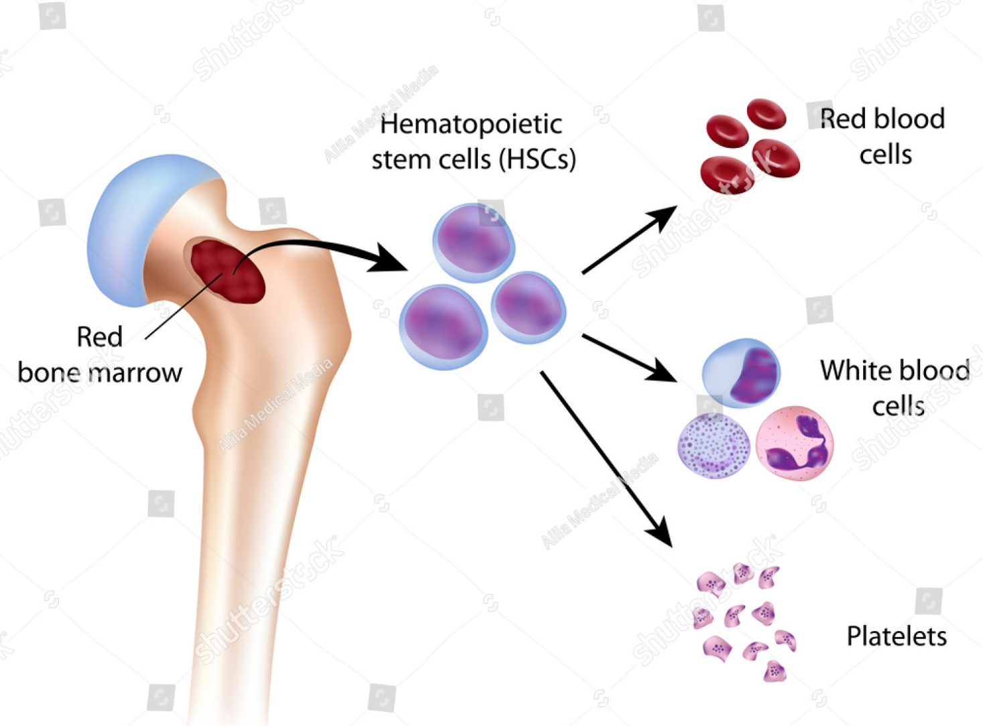
Adult Stem Cells
Come from bone marrow. Can form many types of cell including blood cells. Can be used to treat some diseases, but less than embryo SC.

Slide 30
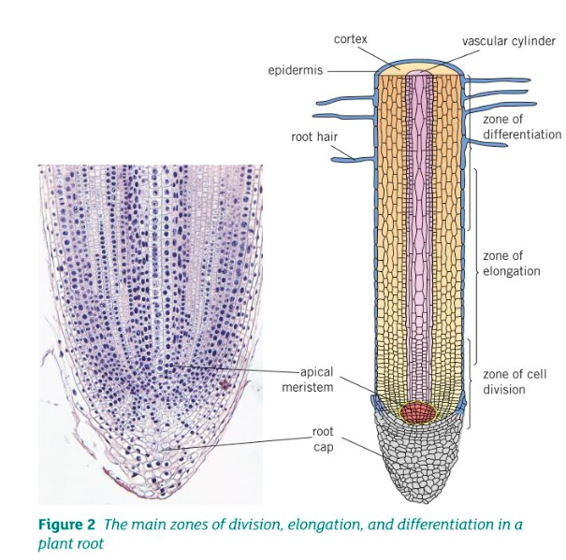
Meristem Tissue
Can differentiate into any plant tissue through the whole of the plants life.
Can be used to produce clones quickly and economically.
E.g. to protect rare species, or to produce large amount of crops with special features

Slide 31
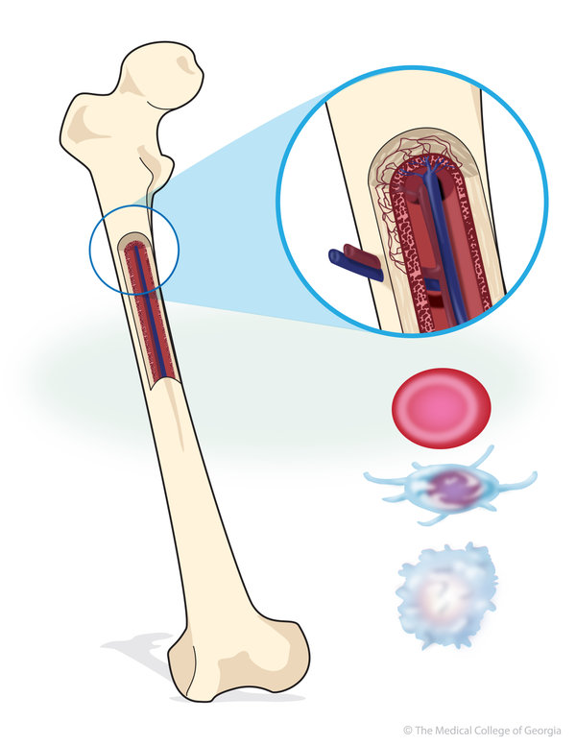
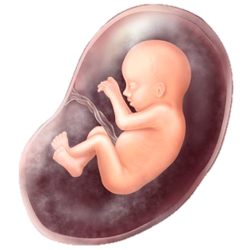
Therapeutic cloning
An embryo is produced with the same genes as the patients. They are therefore not rejected by the persons body.
Stem cells can be used in new treatments for diabetes and paralysis.
Can be harvested from inside embryos, umbilical cords and bone marrow. Advantages are that it won’t be rejected by the body if grown from their own stem cells.
There are social and ethical issues concerning the use of human embryonic stem cells.

Slide 32
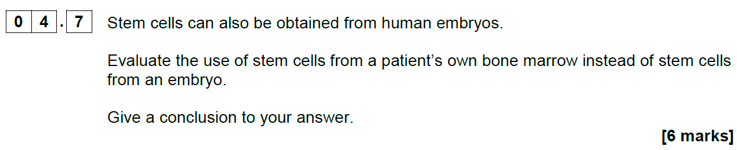
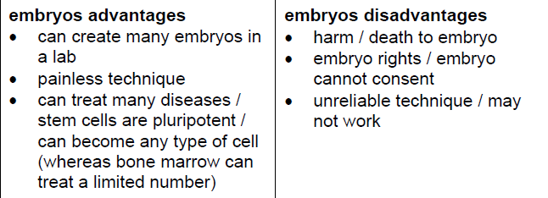
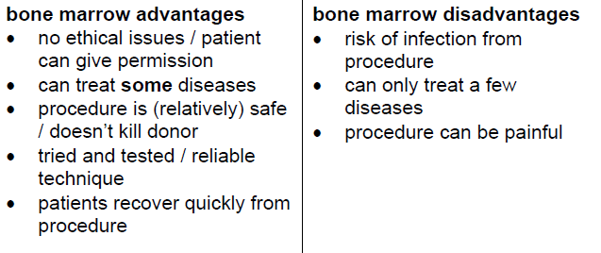
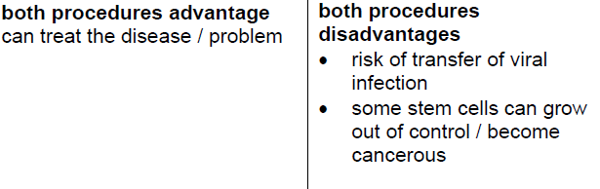

Slide 33
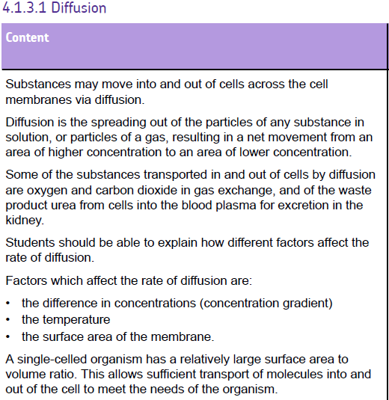
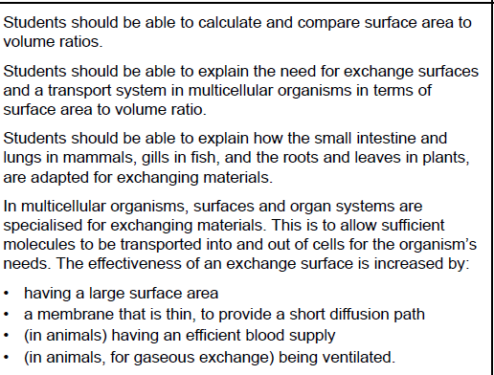

Slide 34

Substances have to pass through the cell membrane to get into or out of a cell.
Diffusion is a process that allows this to happen.
Particles diffuse from an area of high concentration to an area of low concentration.
Factors that increase rate of diffusion:
Big concentration gradient
High temperature
Large surface area

Slide 35
Factors affecting diffusion that living things can control
Variable that affects rate of diffusion
Concentration gradient
Distance particles must travel
Surface area
Faster Diffusion When...
Large concentration gradient – good blood supply
Short distance – for shorter diffusion path
Large surface area to volume ratio (villi)

Slide 36



Small intestine - villi
The epithelium of the villi is only one cell thick –
Villi and microvilli
short diffusion path
increase the surface area for absorption
A good blood supply
Spec link – diffusion
How is the small intestine adapted for exchanging materials
maintains a concentration gradient

Slide 37

Adaptation
Surface of alveoli is only one cell thick
Very good blood supply
Lots of alveoli with a bulbous shape
  Shorter diffusion distance
  Maintains concentration gradient
  Increases surface area

Slide 38




Slide 39



Slide 40




Slide 41


Slide 42
Solve, solute & solution?
What is the difference between a solvent, solute and solution?
  Solvent: A substance that dissolves a solute, resulting in a solution e.g. water
  Solute: A substance that is able to dissolve in a solvent to form a solution e.g. salt
  Solution: A mixture of two substances when a solute has been dissolved in a solution e.g. salt water

Slide 43
Osmosis
The movement of water from a dilute to concentrated solution
Or
The movement of water from an area of high water concentration to an area of low water concentration
Or
Water moves from an area of high water potential to an area of low water potential

Slide 44

Partially permeable membrane
Water wants to join the solute party
A partially permeable membrane is one that will only let some types of particles through

Slide 45


What happens?
Using this information, try to describe what osmosis is in terms of water potential:
Key words: High water potential, low water potential, water, movement, partially permeable membrane
Lower concentration of water
Lower water potential
Higher concentration of solute
Higher concentration of water
Higher water potential
Lower concentration of solute (dilute solution)

Slide 46



Slide 47





Slide 48




Slide 49
Osmosis Required Practical

Slide 50
Plotting the graph
3. Plot the three points
1. Put the independent variable on the X axis. In our experiment this is the strength of the solution
Above the line they are absorbing water
0.30
4. Draw a line of best fit
Change in mass of the potato (g)
Concentration of sugar solution (M)
2. Put the dependent variable on the Y axis. In our experiment this is the change in mass of the potato
0
0.25
0.50
Above the line they are losing water
This is the concentration of the potato
Use the graph to estimate the concentration inside the potato
- 0.41

Slide 51
How to calculate percentage change
Percentage change = amount it has increased/decreased by
original value
X 100
Example
Potato starts at 1.12 g and increases to 1.52 grams, what is the percentage increase.
1.52-1.12 = 0.4
Original value = 1.12
(0.4/1.12) x 100 = 35.7%

Slide 52


Slide 53
Active transport - moving UP or against a concentration gradient
ENERGY
The particles can move up the concentration gradient if energy is used
This is active transport

Slide 54
Active transport
Video
This DOES require energy
Particles move against a concentration gradient.
The energy is needed to make “pumps” move particles the wrong way.
e.g. glucose from the intestine into the blood

Slide 55

Active Transport
Inside of cell Outside of cell
Energy

Slide 56



Slide 57




Slide 58



Slide 59



Slide 60

What will happen here?

Slide 61
DIFFUSION
OSMOSIS
Place these features in the correct part of the Venn Diagram
Involves water only
Requires energy
Is passive
Movement of particles
Needs a semi-permeable membrane
High to low concentration
Against a concentration gradient
Occurs in nature
How minerals get into root hair cells
How oxygen leaves a leaf
How water keeps plant cells turgid
Involves transport of solutes
ACTIVE TRANSPORT

Slide 62
DIFFUSION
OSMOSIS
Involves water only
How oxygen leaves a leaf
Is passive
High to low concentration
How water keeps plant cells turgid
Movement of particles
Occurs in nature
Involves transport of solutes
Needs a semi-permeable membrane
Requires energy
How minerals get into root hair cells
Against a concentration gradient
ACTIVE TRANSPORT

