Slide 1
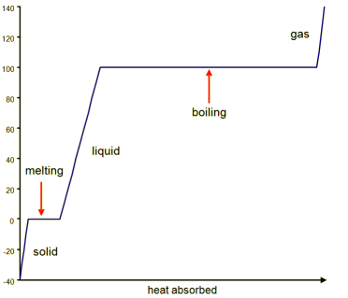
ONE
GCSE Knowledge Organiser Unit 1 – States of Matter
NUSA
SCIENCE
A PARTICLE MODEL
Solid | Liquid | Gas
High density | High density | Low density
Retains it’s own shape | Assumes shape of container | Assumes shape of container
Fixed volume - compressible | Fixed volume - compressible | No fixed volume - Highly compressible
Vibrates | Moves randomly and freely | Moves randomly and freely
TWO
HEATING AND CHANGES OF STATE
melting
boiling
Freezing / solidifying
condensing
Internal energy | The energy stored in a system by the particles (the total kinetic energy and potential energy of all the particles).
Intermolecular forces (Potential energy) | The forces between particles. Applying heat will break the intermolecular forces.
Kinetic energy | The energy resulting in the movement of the particles.
Physical change | A change that is reversible. Changes of state are all examples of physical changes.
THREE
DENSITY
Density is the Mass per unit Volume
Density = $\frac{mass}{volume}$
Density: ρ, kg/m³
Mass: m, kg
Volume: V, m³
FIVE
SPECIFIC LATENT HEAT
FOUR
There is no temperature change at a substances melting or boiling point.
Specific latent heat is the HIDDEN HEAT ENERGY that broke the intermolecular bonds for the substance to change state.
SPECIFIC HEAT CAPACITY
gas
Three things affect temperature increase:
Mass | the more mass, the more energy needed to change its temperature.
Material | different materials require different amounts of energy to raise their temperature.
Amount of energy supplied | the more heat energy transferred to it the greater its temperature increase.
Temperature / ºC
boiling
liquid
Specific heat capacity is the amount of energy required to raise the temperature of 1Kg of the substance by 1⁰C’
E = m x L
Transferred energy: ΔE, J
Mass: m, kg
Specific heat capacity: c, J/ kg ºC
Temperature change: Δϴ, ºC
solid
Energy: E, J
Mass: m, kg
Specific Latent heat: L, J/kg
ΔE = m x c x Δϴ
Heat absorbed

Slide 2
GCSE Knowledge Organiser Unit 1 – States of Matter
NUSA
SCIENCE
SIX
SEVEN
GAS PRESSURE AND TEMPERATURE
PURE SUBSTANCES AND MIXTURES
Gas pressure | The pressure of a gas is due to the particles colliding with the wall of the container that the gas is held in.
Temperature | The temperature of a gas is related to the average kinetic energy of the particles. The more kinetic energy the higher the temperature.
Pure substance | A substance which is made up of only one type of atom/ molecule. Pure substances have a fixed melting and boiling point which can be used to distinguish the substance.
Mixture | A mixture consists of two or more different substances, not chemically joined together.
HEAT
At room temperature the particles have lower kinetic energy. There are fewer collisions per second and therefore the balloon has a lower pressure.
At high temperatures the particles have more kinetic energy therefore there are more collisions per second. The balloon has a higher pressure which may result in the balloon bursting.
A pure compound
A mixture of elements

