Slide 1
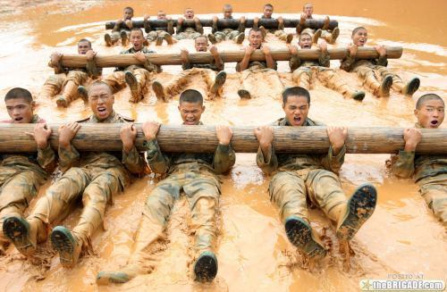
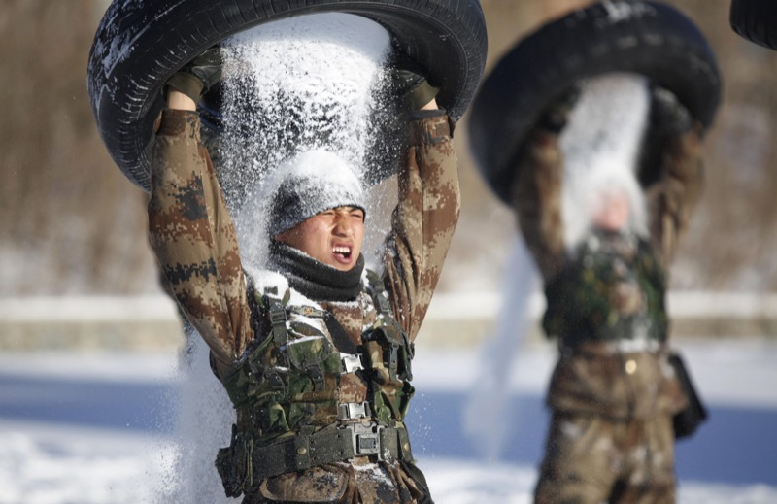
1.2 Physical Training

Slide 2
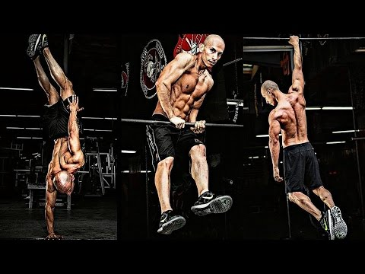
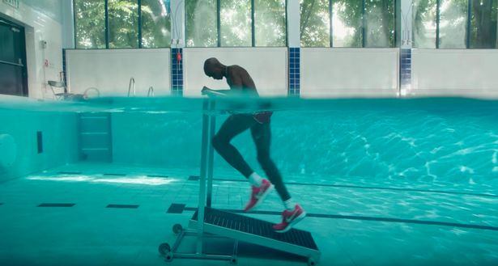
1.2b Applying the principles of training S.O.P.R.

Slide 3
Contents
1.2 Physical Training
1.2b Applying the principles of training
Principles of training: S.O.P.R……....……………………………….4
Mark scheme: How many did you get right…………………….7
Green pen action……………..……………………10
Optimising training: F.I.T.T…..………………….…..……………..11
Mark scheme: How many did you get right…………………..14
Green pen action……………..……………………16
Optimising training: Types of training….….………………..17
Mark scheme: How many did you get right…………………..26
Green pen action……………..……………………34
Optimising training: Warm up and cool down procedures………………………..……………………………………...35
Mark scheme: How many did you get right…………………..39
Green pen action……………..……………………42

Slide 4
Exam Questions: How much do you know?
1
2
3

Slide 5
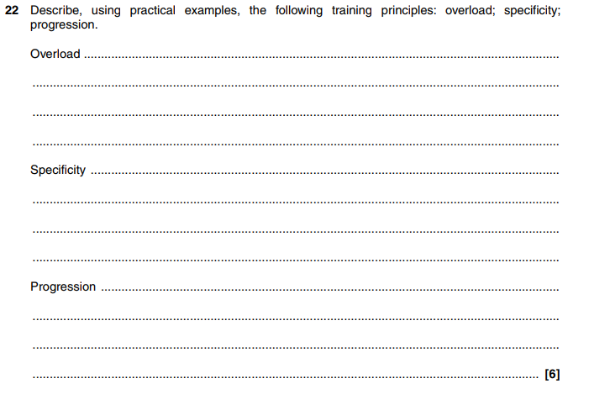
4

Slide 6
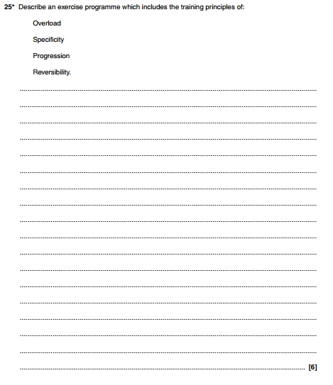
5

Slide 7
Mark scheme: How many did you get right?
1
2
3

Slide 8
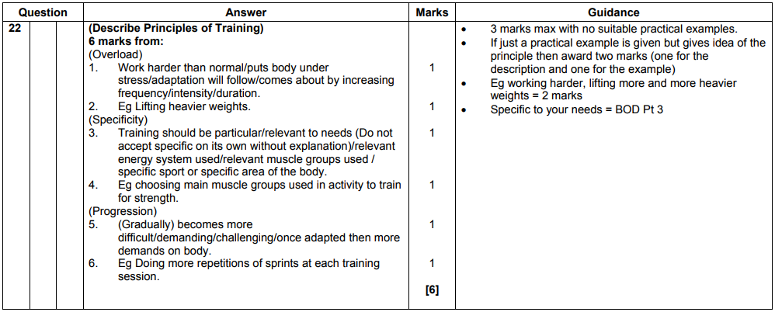
4

Slide 9
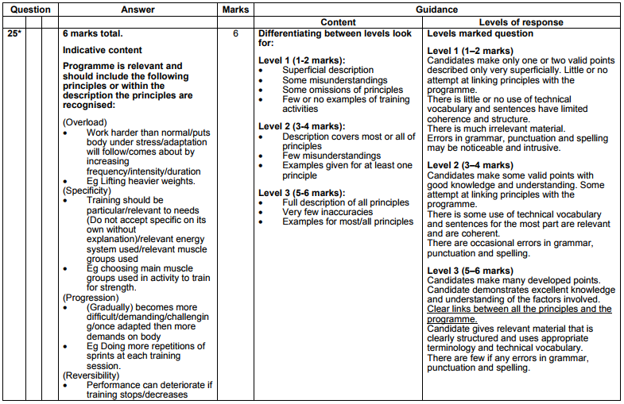
5

Slide 10
Green Pen Action
I have highlighted using the mark scheme, the marks I missed out on…
I have a secure knowledge and understanding of… | I need to improve my knowledge and understanding of…
Next time I need to remember the following key words / terms in my answer… _____________________________________________ _____________________________________________ _____________________________________________
Yes
No

Slide 11
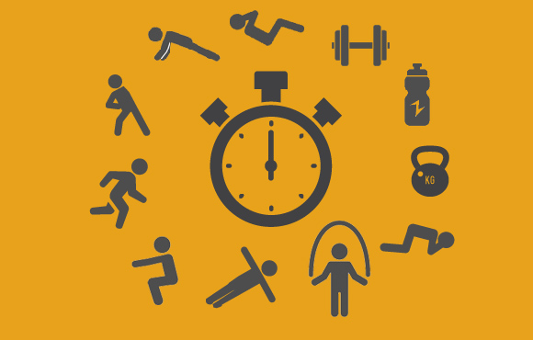
1.2b Optimising training F.I.T.T.

Slide 12
Exam Questions: How much do you know?
1
2
3
4

Slide 13
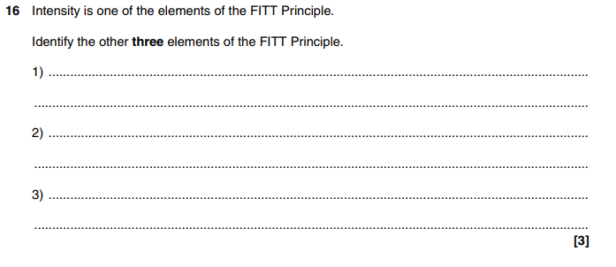
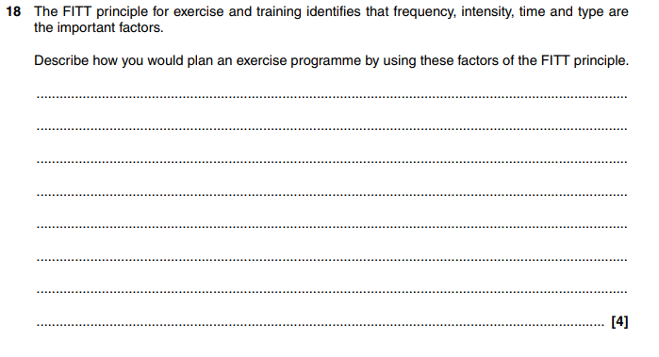
5
6

Slide 14
Mark scheme: How many did you get right?
1
2
3
4

Slide 15
5
6

Slide 16
Green Pen Action
I have highlighted using the mark scheme, the marks I missed out on…
I have a secure knowledge and understanding of… | I need to improve my knowledge and understanding of…
Next time I need to remember the following key words / terms in my answer… _____________________________________________ _____________________________________________ _____________________________________________
Yes
No

Slide 17
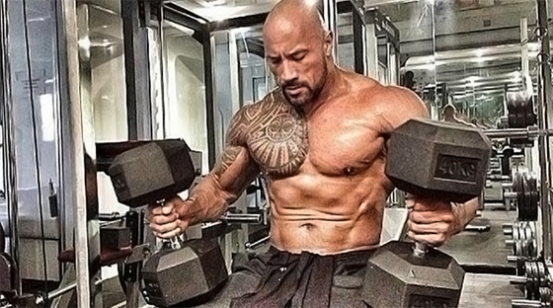
1.2b Optimising training Types of training

Slide 18
Exam Questions: How much do you know?
1
2
3
4

Slide 19
5
6
7
8

Slide 20
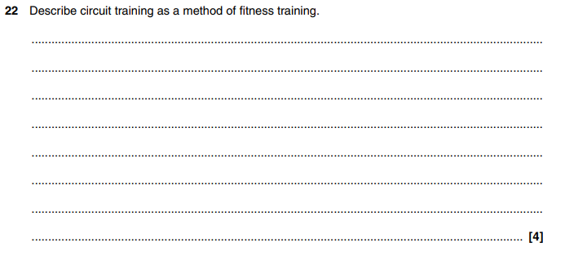
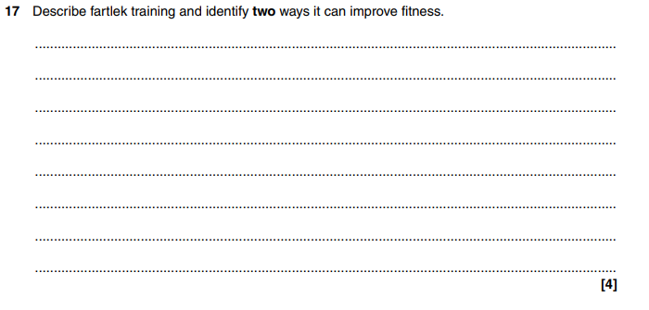
9
10

Slide 21
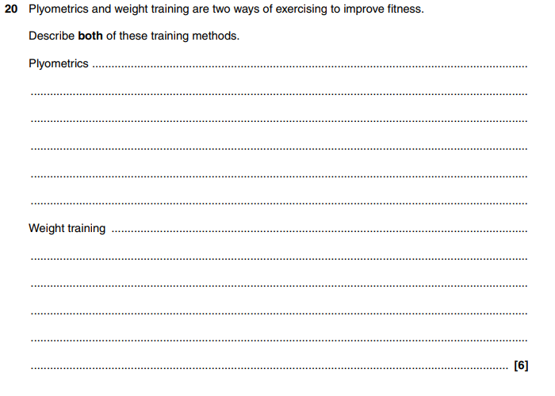
11

Slide 22
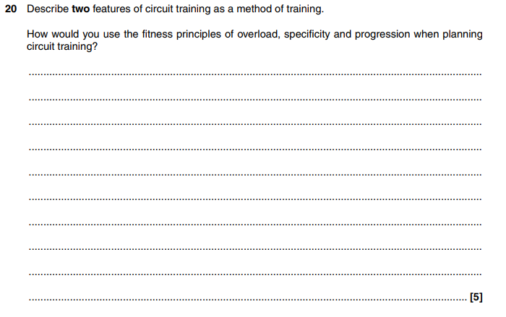
12

Slide 23
13
Total for Question 13= 3 marks

Slide 24
14
Total for Question 14= 6 marks

Slide 25
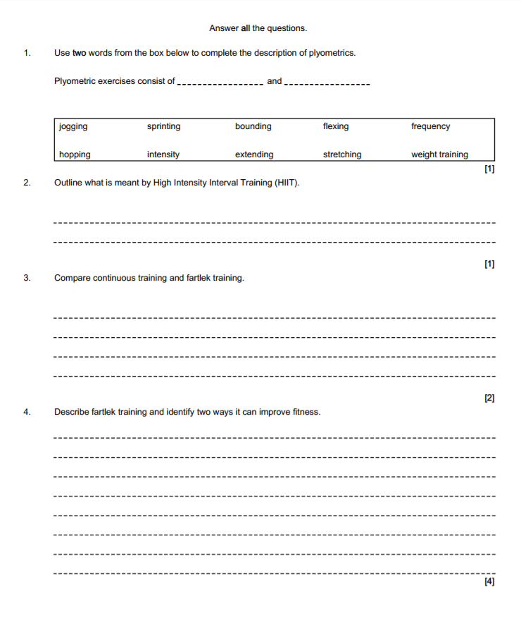
15
16
17

Slide 26
Mark scheme: How many did you get right?
1
2
3
4

Slide 27
5
6
7
8

Slide 28
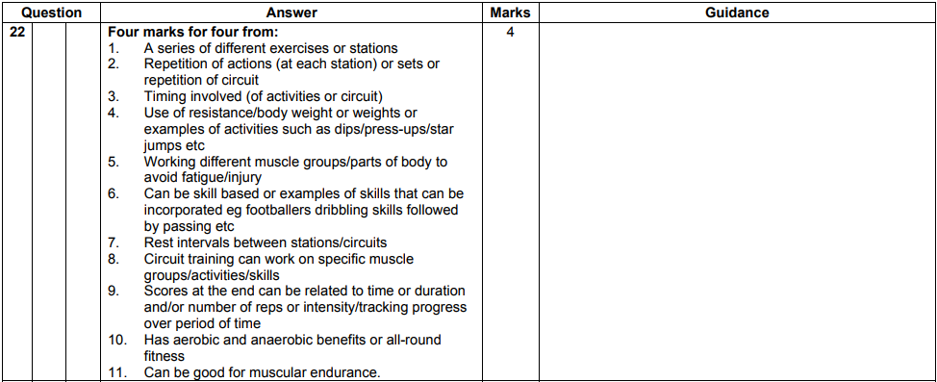
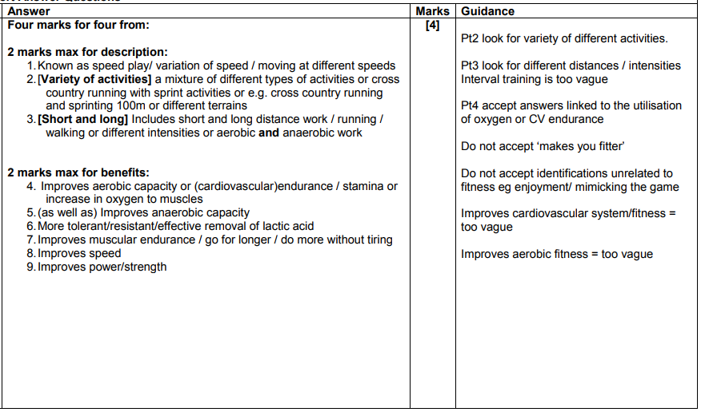
9
10

Slide 29
11

Slide 30
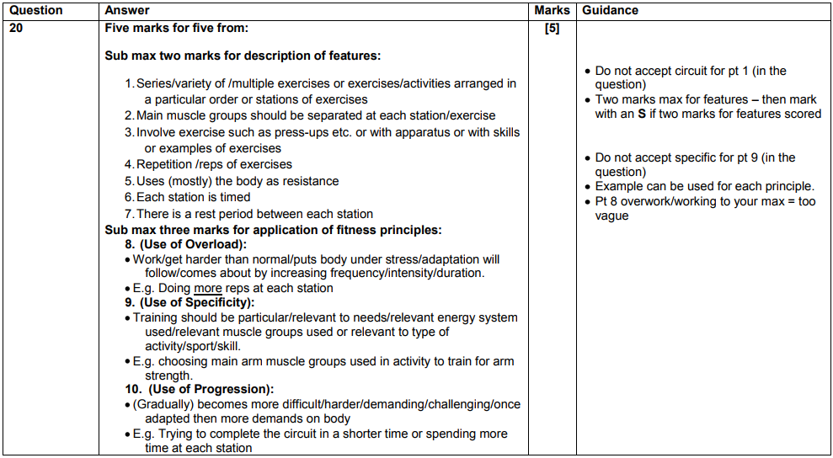
12

Slide 31
13
Total for Question 13= 3 marks

Slide 32
14
Total for Question 14= 6 marks

Slide 33
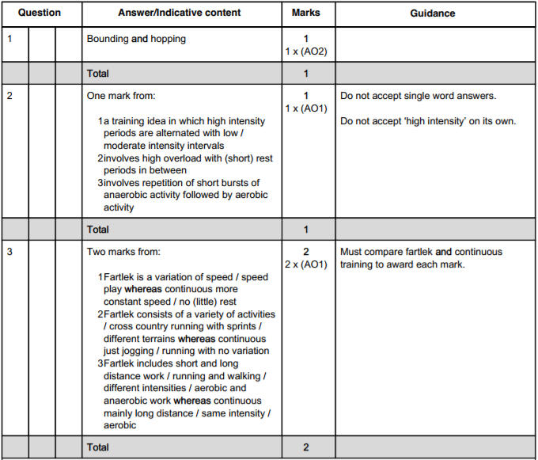
15
16
17

Slide 34
Green Pen Action
I have highlighted using the mark scheme, the marks I missed out on…
I have a secure knowledge and understanding of… | I need to improve my knowledge and understanding of…
Next time I need to remember the following key words / terms in my answer… _____________________________________________ _____________________________________________ _____________________________________________
Yes
No

Slide 35
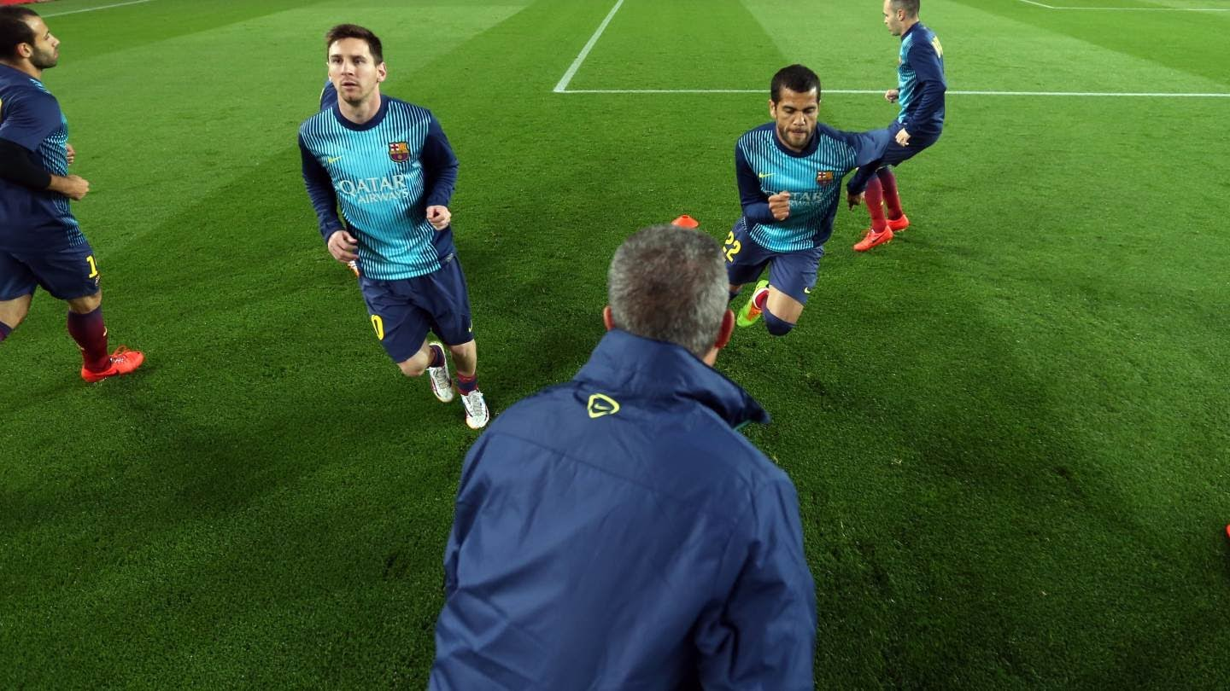
1.2b Optimising training Warm up and cool down procedures

Slide 36
Exam Questions: How much do you know?
1
2
3
4

Slide 37
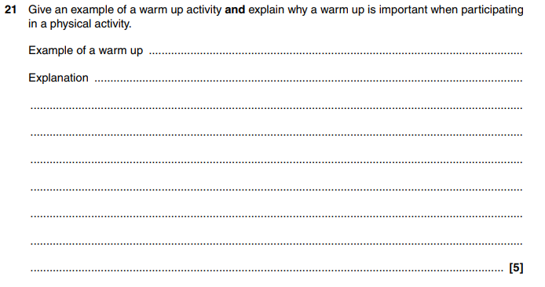
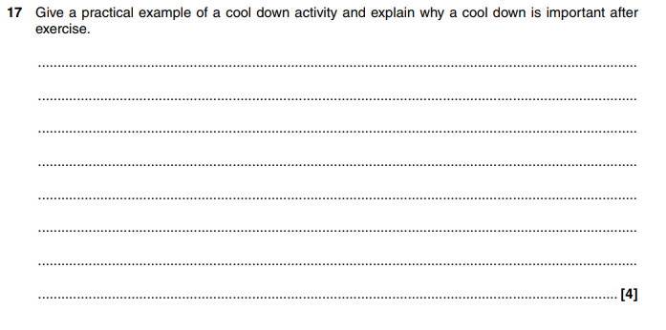
5
6

Slide 38
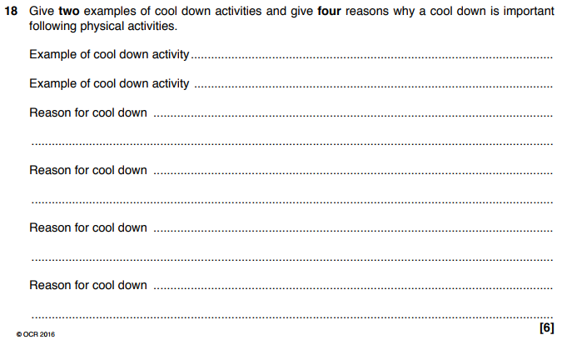
7

Slide 39
Mark scheme: How many did you get right?
1
2
3
4

Slide 40
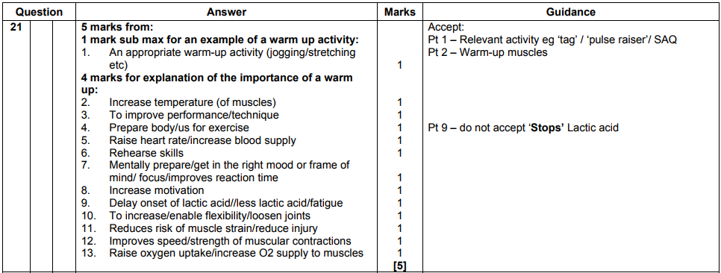
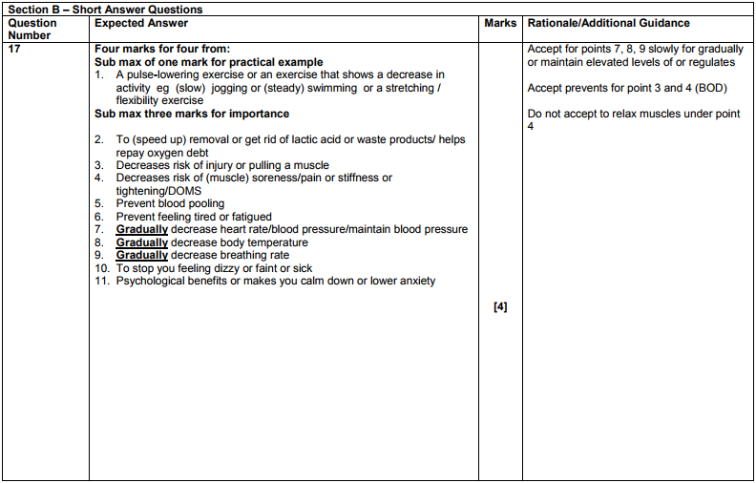
5
6

Slide 41
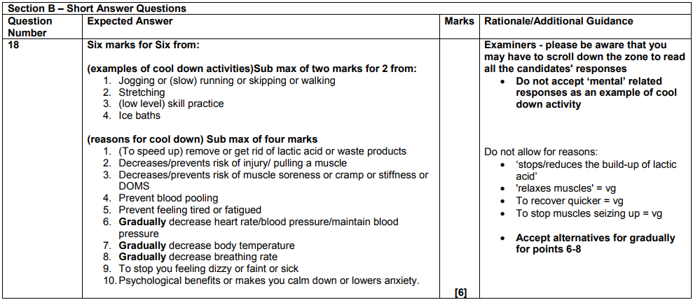
7

Slide 42
Green Pen Action
I have highlighted using the mark scheme, the marks I missed out on…
I have a secure knowledge and understanding of… | I need to improve my knowledge and understanding of…
Next time I need to remember the following key words / terms in my answer… _____________________________________________ _____________________________________________ _____________________________________________
Yes
No

