Slide 1
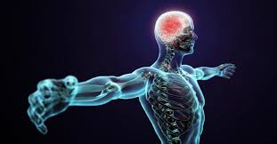
Learning Aim C The Psychological influence that motivation, self- confidence and anxiety have on participation in sport and activity
Name: _______________ Teacher: _____________

Slide 2
Command Words
Identify / name / give: List or name something
Describe: give a description of something.
Explain: give reasons why something is as it is. Usually 2 or 4 marks. REMEMBER make a statement and then use the word because / so / therefore to develop the statements to gain the second mark.
Make sure your answer is specific to muscular endurance and tennis
Command word.
Example
Explain why a high level of muscular endurance is beneficial for a tennis player player. (2 marks)
A high level of muscular endurance is important for a tennis player payer as they need to repeatedly go against a resistance when playing. So if a tennis player has good muscular endurance they will be able to sprint in a game for longer and they will be able to continuously return shots throughout the game.
The question is worth two marks, read through your answer to check there is enough information.
Include the word because / so / therefore to develop your statement.

Slide 3
Short Answer questions
Read the question carefully.
Look out for key words in the question.
Look at the number of marks available.
Make sure you make the same number of statements as there are marks available.
Try not to repeat the question in your answer.
If the question relates to a particular activity then make sure you make reference to it in your answer.
Make sure you look at the key command word – have you been asked to describe, explain or discuss?
Example
Describe how improved speed will benefit javelin performance. (2 marks)
Having more speed will generate more power in the throw. This means that the javelin will go further and he will achieve a greater distance.
Command word = describe
There are two marks available so you must make two statements.

Slide 4
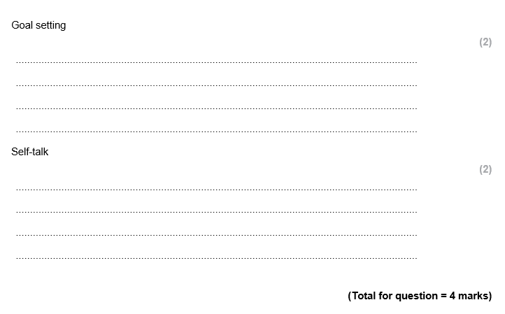
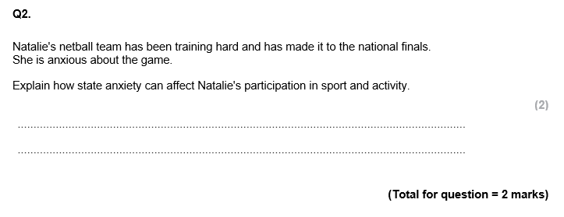

Slide 5
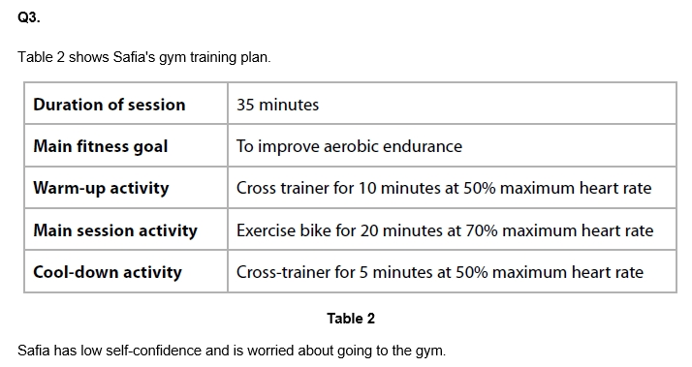
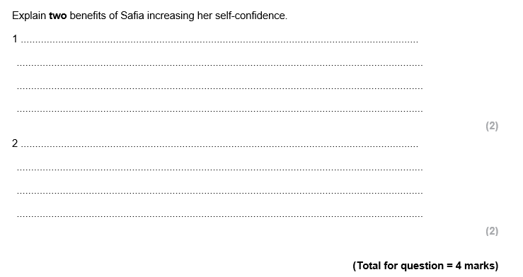

Slide 6
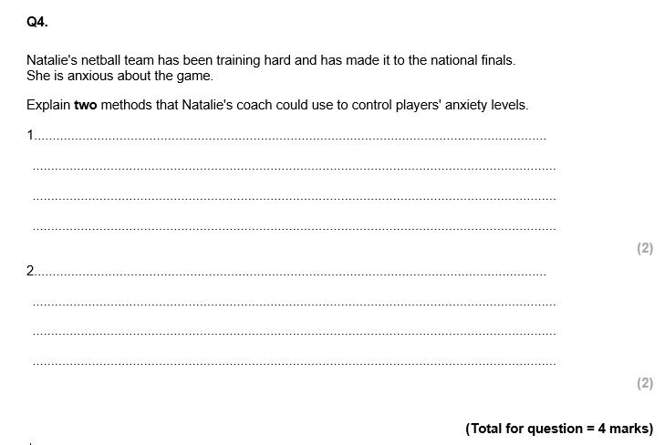
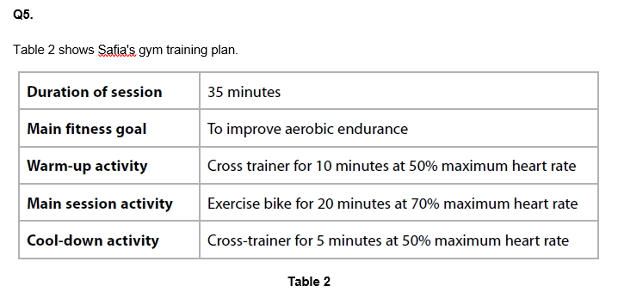
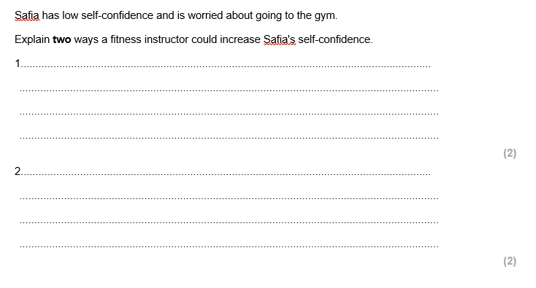

Slide 7
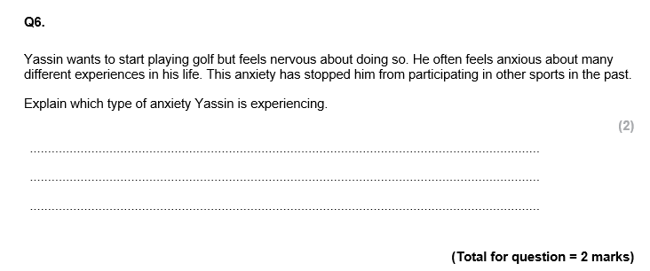
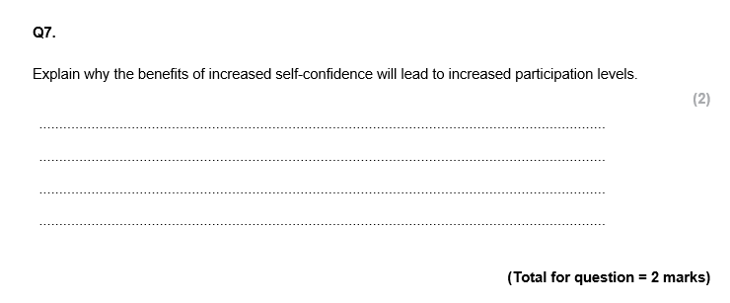

Slide 8
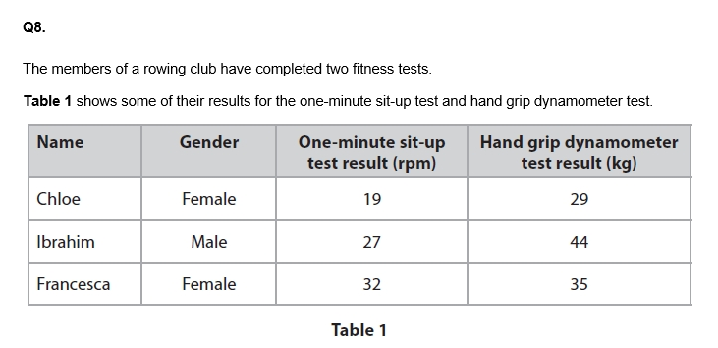
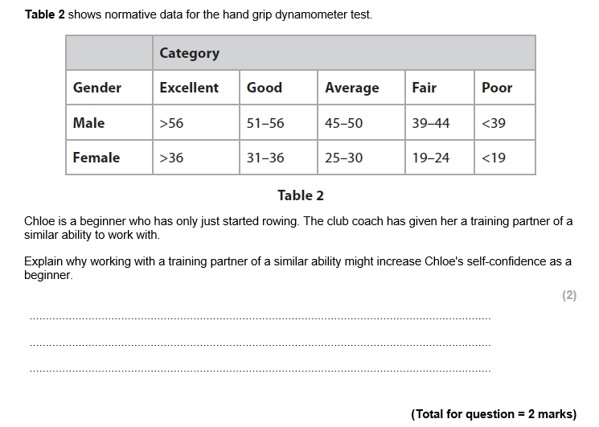

Slide 9
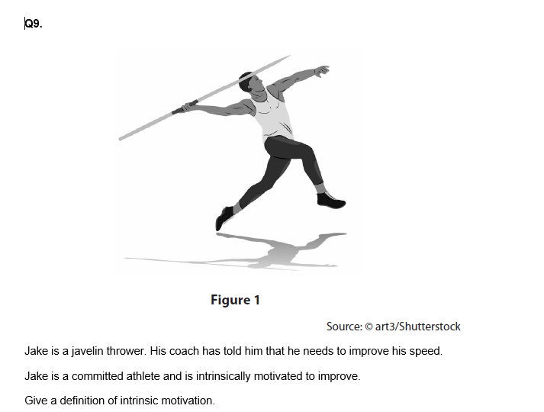
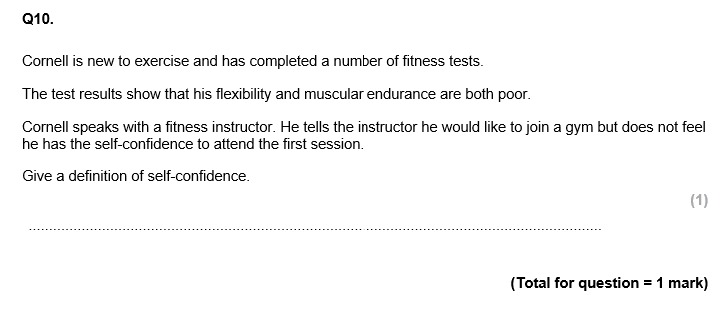

Slide 10
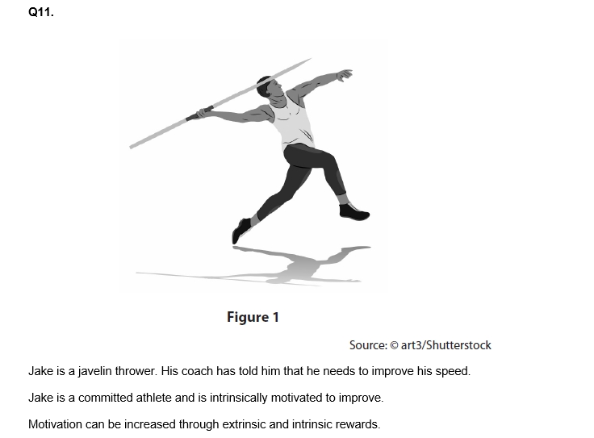

Slide 11
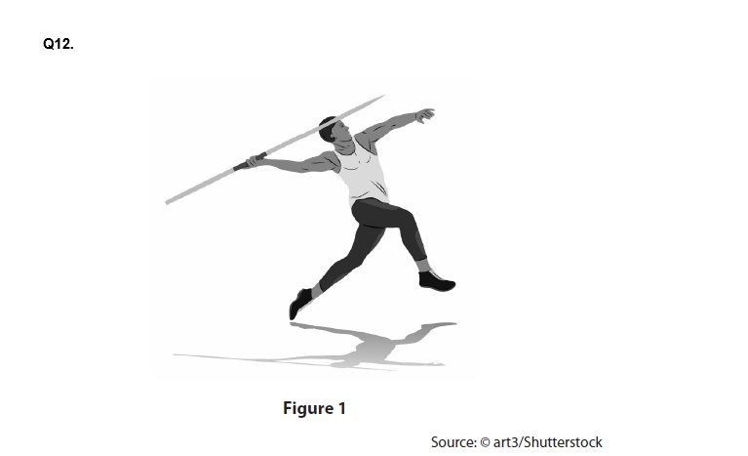
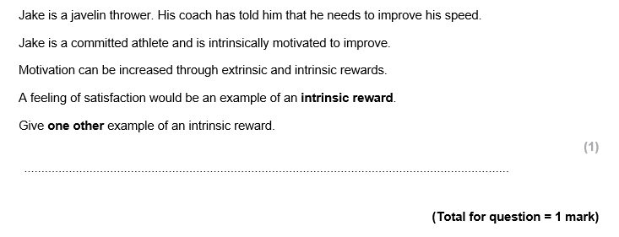
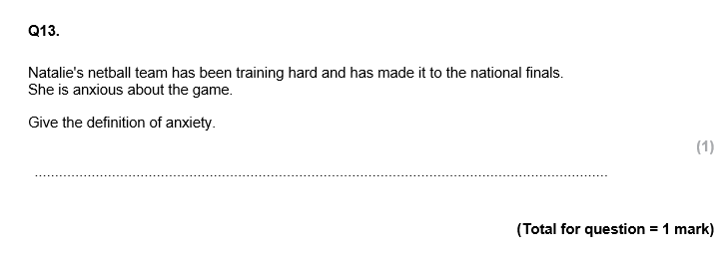

Slide 12
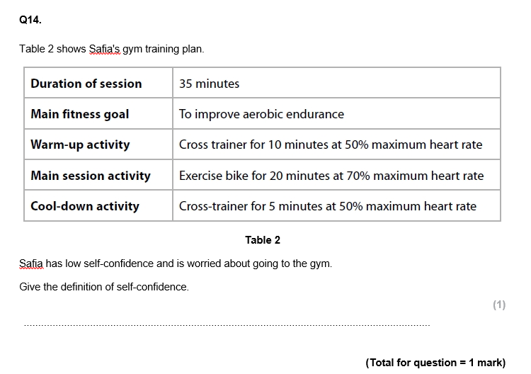
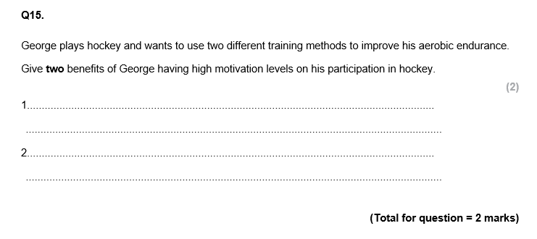

Slide 13
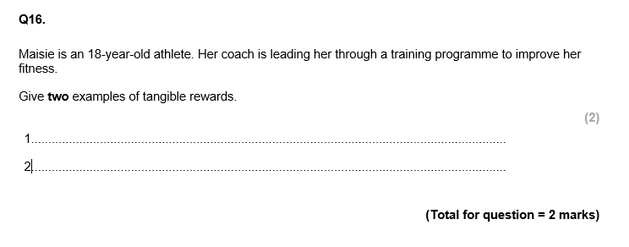
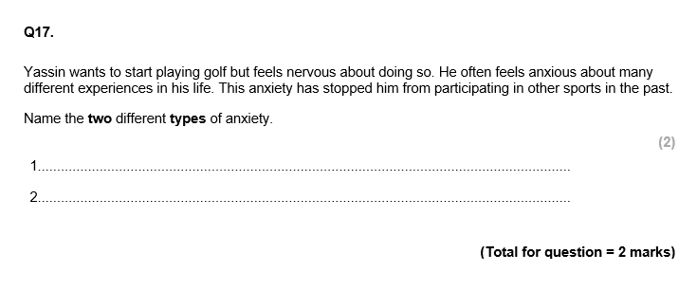

Slide 14
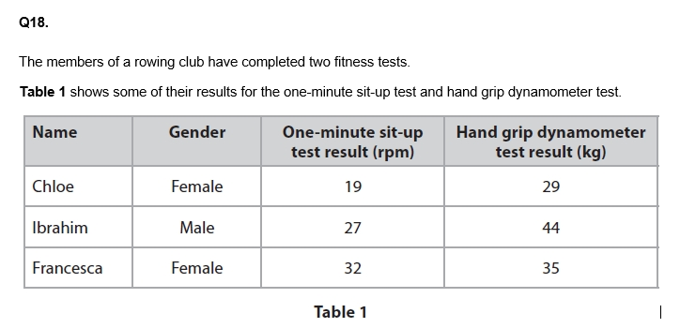
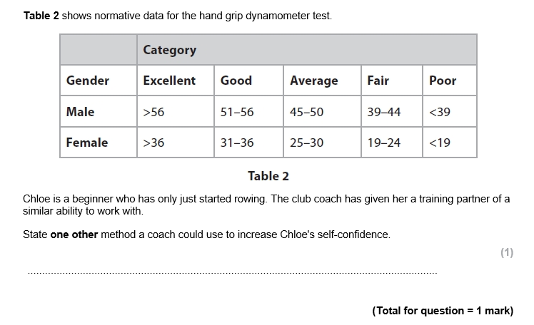
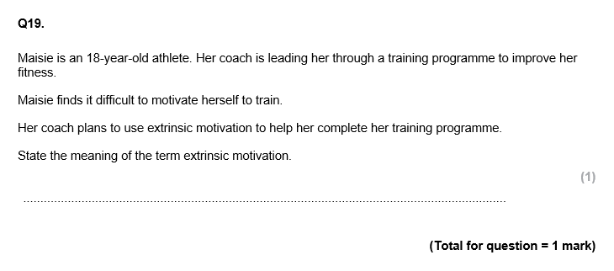

Slide 15
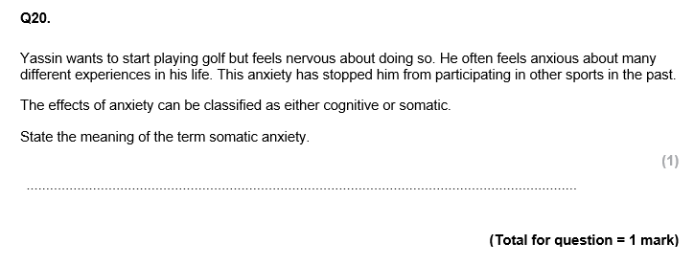
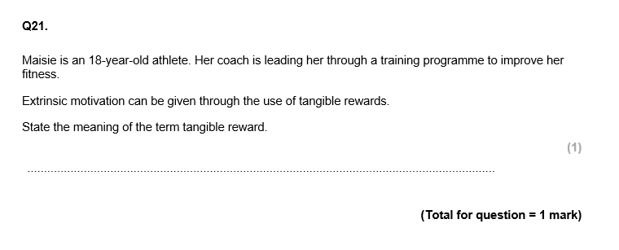

Slide 16
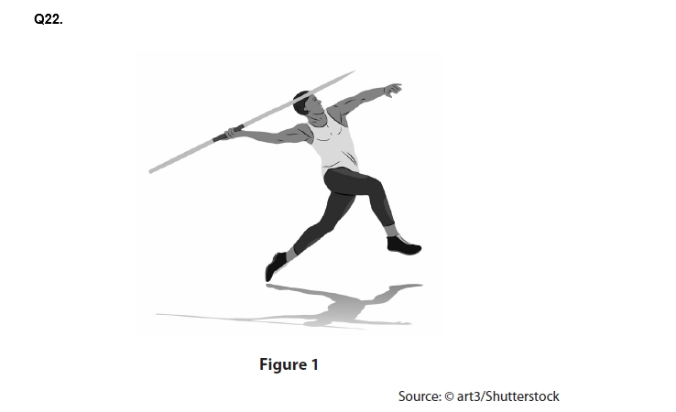
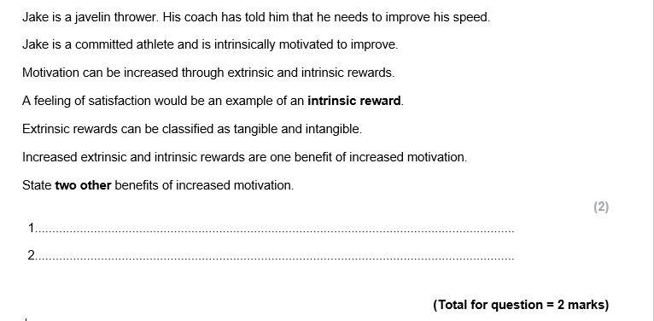
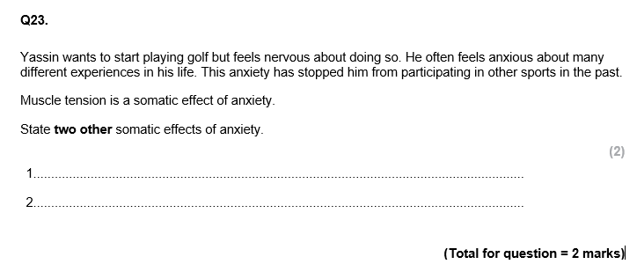

Slide 17
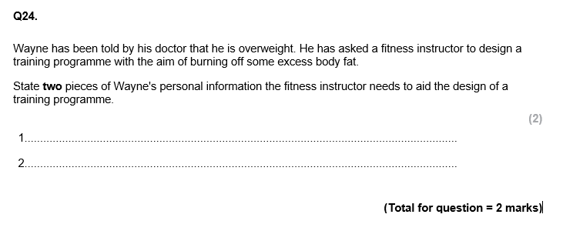

Slide 18
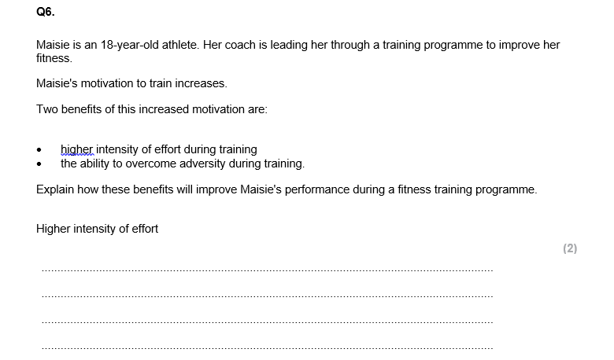
25

Slide 19
Mark Scheme How well did you do?!

Slide 20
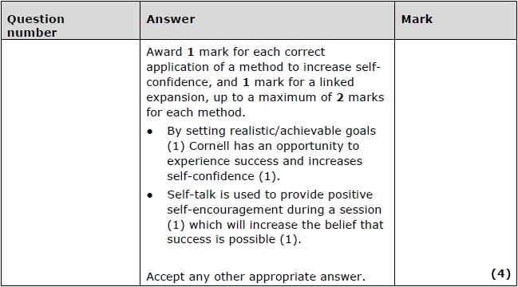
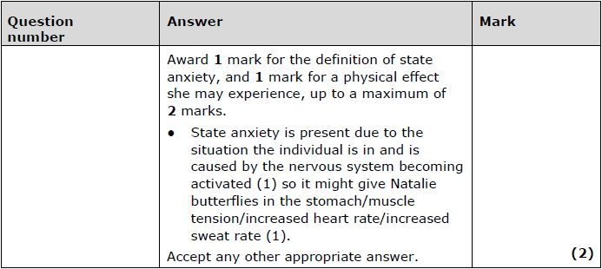
Q1.
Q2.

Slide 21
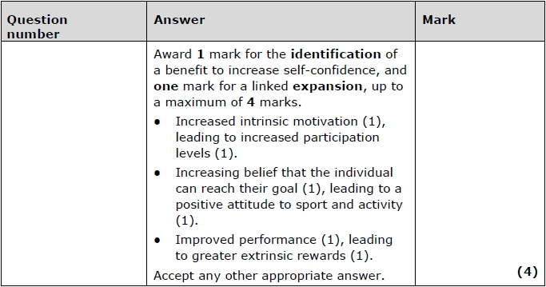
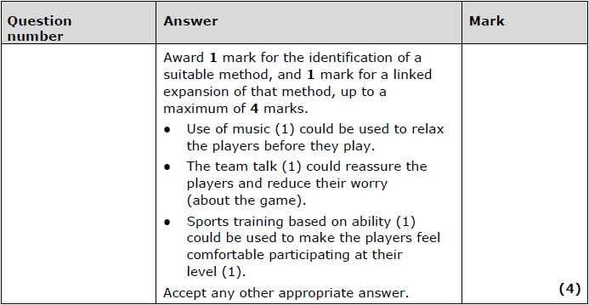
Q3.
Q4.

Slide 22
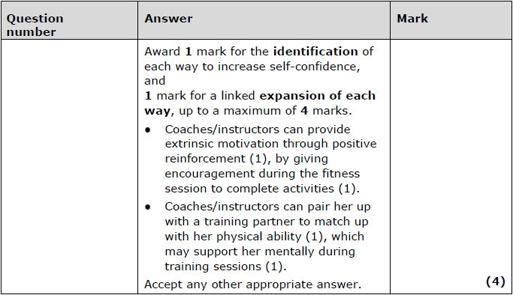
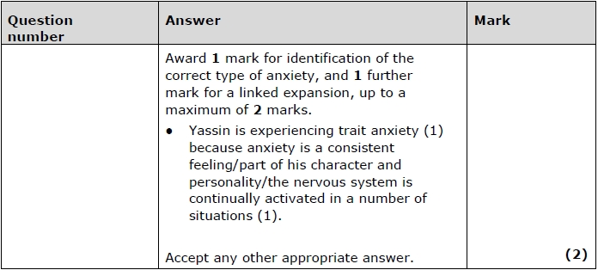
Q5.
Q6.

Slide 23
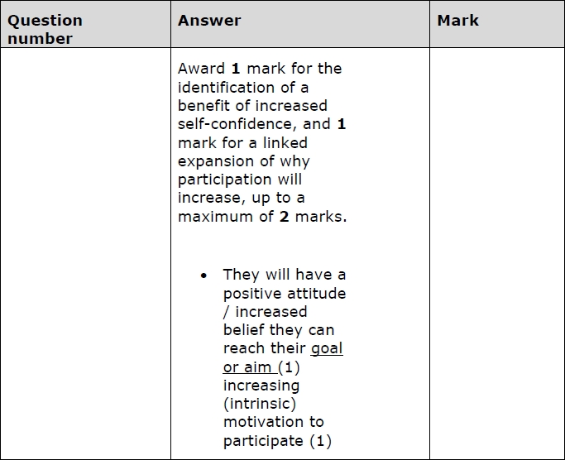
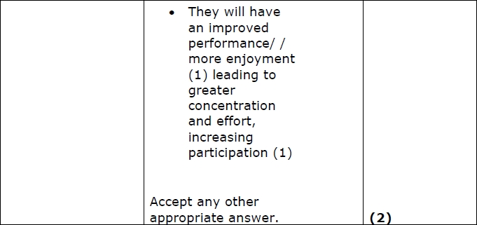
Q7.

Slide 24
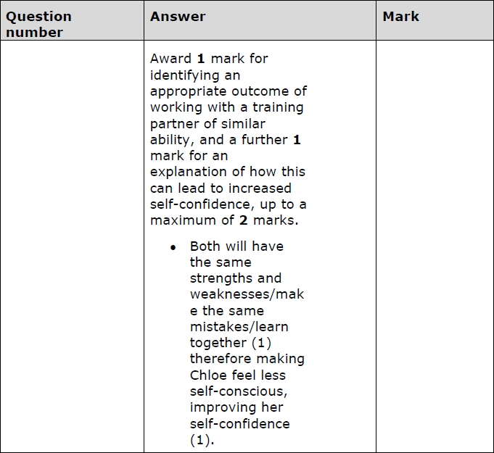
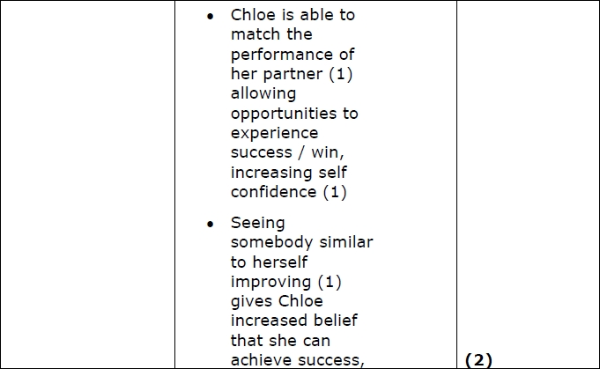
Q8.

Slide 25
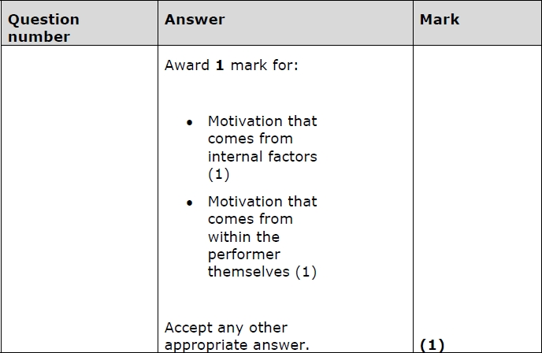
Q9.
Q10.

Slide 26
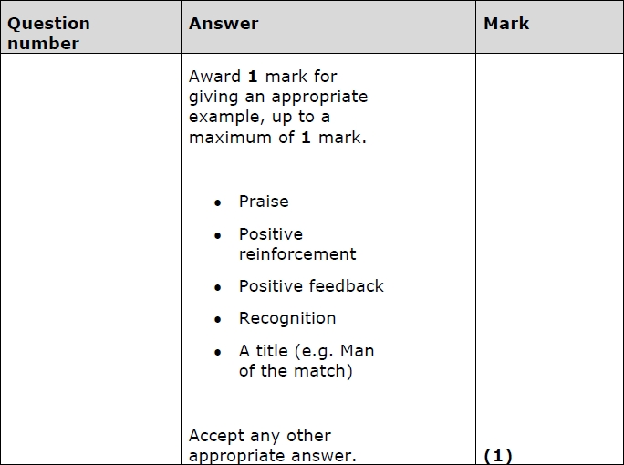
Q11.

Slide 27
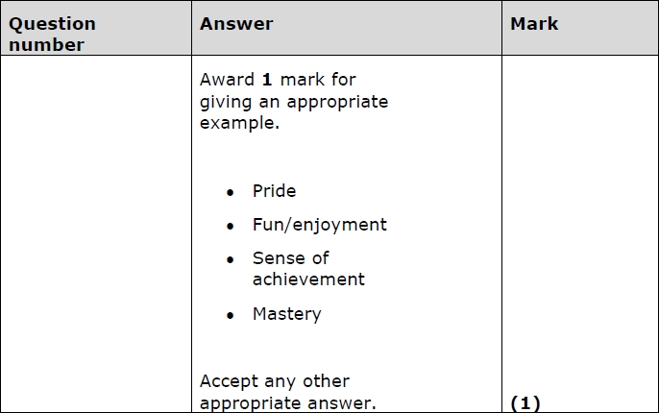
Q12.
Q13.

Slide 28
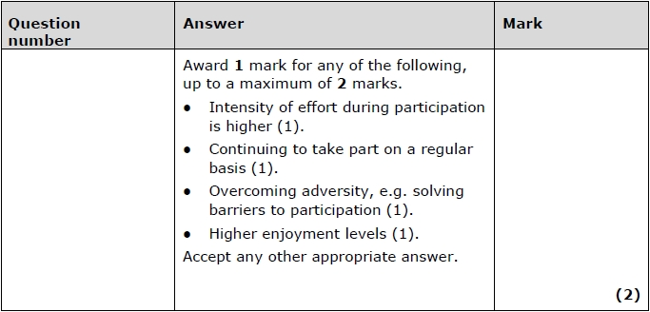
Q14.
Q15.

Slide 29
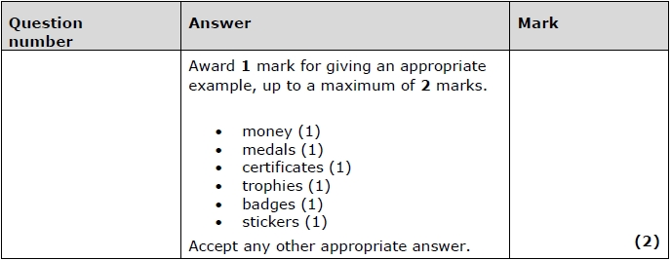
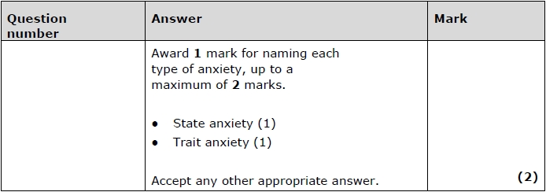
Q16.
Q17.

Slide 30
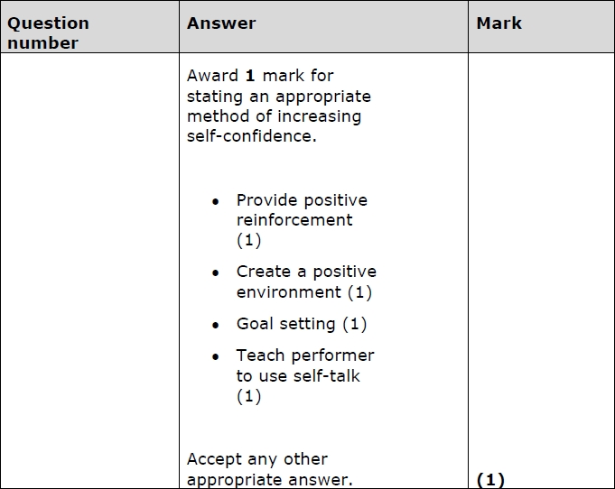
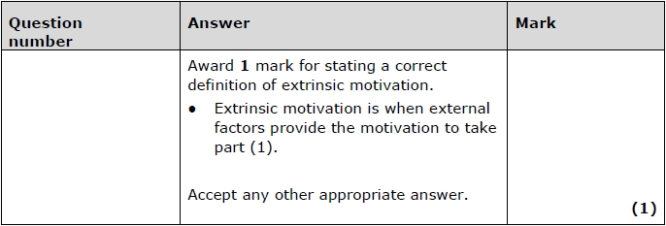
Q18.
Q19.

Slide 31
Q20.
Q21.
Q22.

Slide 32
Q23.
Q24.

Slide 33
Q25.
Q25.

Slide 34
Green Pen Action
I have highlighted using the mark scheme, the marks I missed out on…
I have a secure knowledge and understanding of… | I need to improve my knowledge and understanding of…
Next time I need to remember the following key words / terms in my answer… _____________________________________________ _____________________________________________ _____________________________________________
Yes
No

