Slide 1
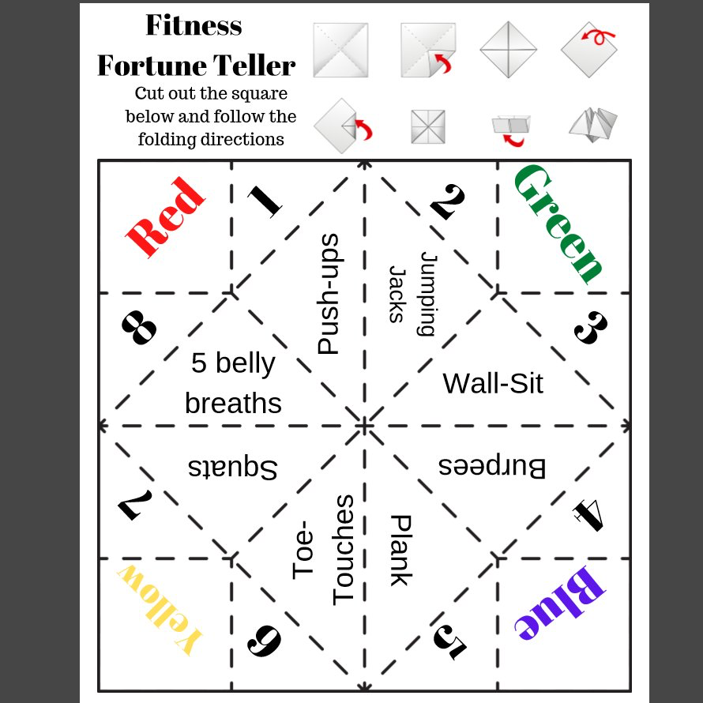
Sit ups
Sit ups

Slide 2
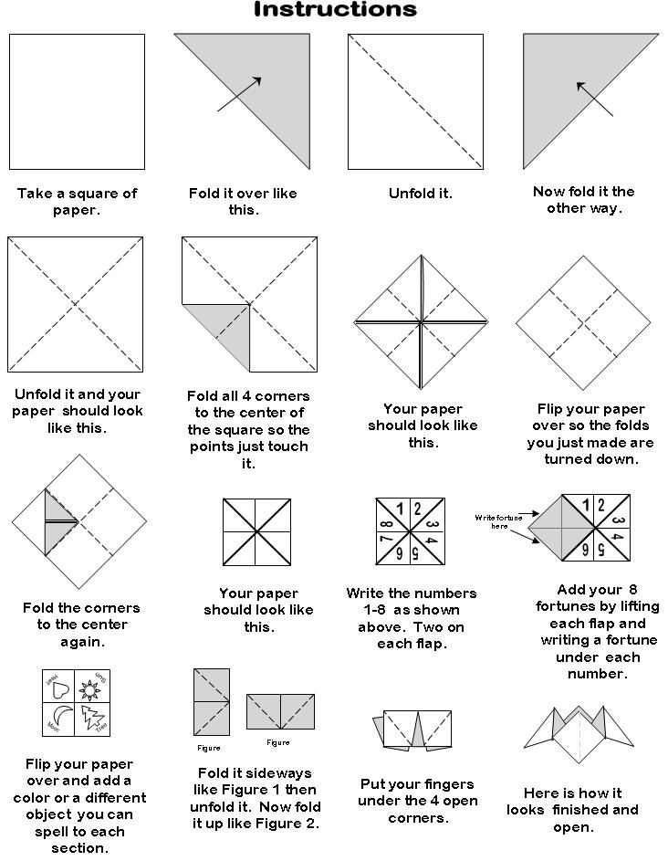
To make a square piece of paper:
Add your 8 exercises by lifting each flap and writing in underneath.

Slide 3
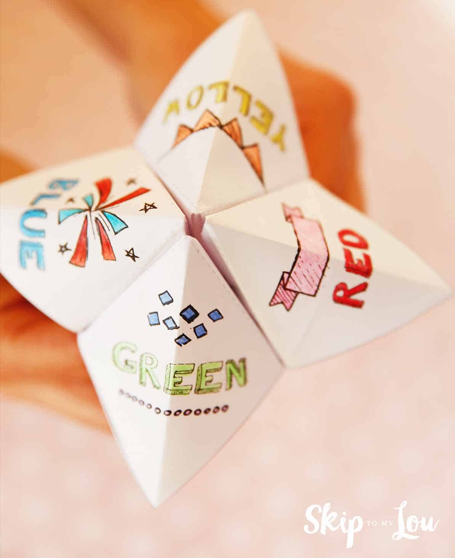
How to use your fortune teller!
Either ask a family member to choose or choose a colour from the top yourself.
Spell out the chosen colour, making 1 move of the fortune teller for every letter. E.g. If blue is chosen, you will move the fortune teller 4 times.
Open out the fortune teller where you land and either ask your family member to or choose a number yourself.
Move the fortune teller this many times.
Open out the fortune teller where you land.
Again either ask your family member to or choose a number yourself.
Open out the flap and complete the exercise underneath that number.
Repeat from the start!
If you are still unsure, you can watch this video to help you. https://www.youtube.com/watch?v=ZOg6xM-gmFE

Slide 4
YOUR TASK! Create your own “Fitness Fortune Teller”
Either using the template below or creating your own with some paper (if you don’t have a printer) create your own workout using different exercises.

Slide 5
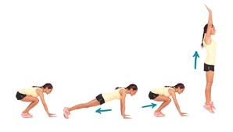
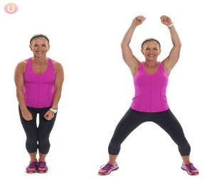
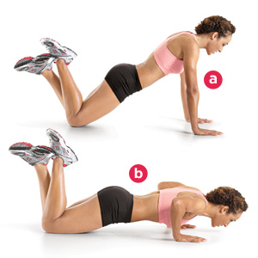
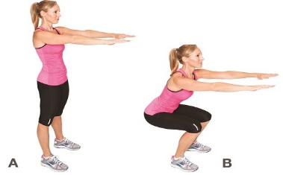
HELP! I don’t know what the exercises are!
Burpees
Wall Sit
Jumping Jacks
Push ups
Sit ups
Squats
Toe Touches
Plank

