Slide 1
Engineering R105
Regulations in Design and Engineering

Slide 2
Starter: match the words and images to the correct definitions below:
Registered Designs
Patents
a government authority or licence conferring a right or title for a set period, especially the sole right to exclude others from making, using, or selling an invention
Standards for the European Union. If a product meets these, it can be given a CE Mark. The marks show government officials that the product conforms to a standard, which enables it to be legally placed on the market within their country.
is a law that gives the owner of a work (like a book, movie, picture, song or website) the right to say how other people can use it.
images/logos
associated with the company protected
BY LAW
Is a monopoly for a design (for example a tread pattern) when applied to an article (for example a tyre) and is granted under the laws of a country the registered design is filed in. It protects the way a product looks.
In the UK, standards are regulated by the British Standards Institution (BSI). Products which meet these standards can be marked with the KiteMark.

Slide 3
Starter: match the words and images to the correct definitions below:
Registered Designs
Patents
a government authority or licence conferring a right or title for a set period, especially the sole right to exclude others from making, using, or selling an invention
Standards for the European Union. If a product meets these, it can be given a CE Mark. The marks show government officials that the product conforms to a standard, which enables it to be legally placed on the market within their country.
is a law that gives the owner of a work (like a book, movie, picture, song or website) the right to say how other people can use it.
images/logos
associated with the company protected
BY LAW
Is a monopoly for a design (for example a tread pattern) when applied to an article (for example a tyre) and is granted under the laws of a country the registered design is filed in. It protects the way a product looks.
In the UK, standards are regulated by the British Standards Institution (BSI). Products which meet these standards can be marked with the KiteMark.

Slide 4
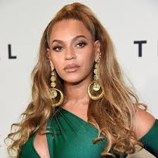
Copyright Patent Registered Designs
A law that gives the owner of a work (like a book, movie, picture, song or website) the right to say how other people can use it.
http://c4sif.org/2013/03/sopa-and-3-ways-to-think-about-intellectual-property/
https://www.youtube.com/watch?v=0Biy-okZ0l8

Slide 5
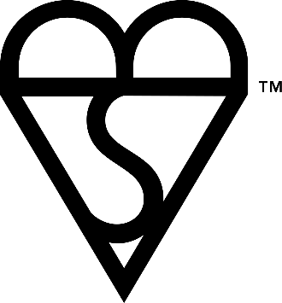
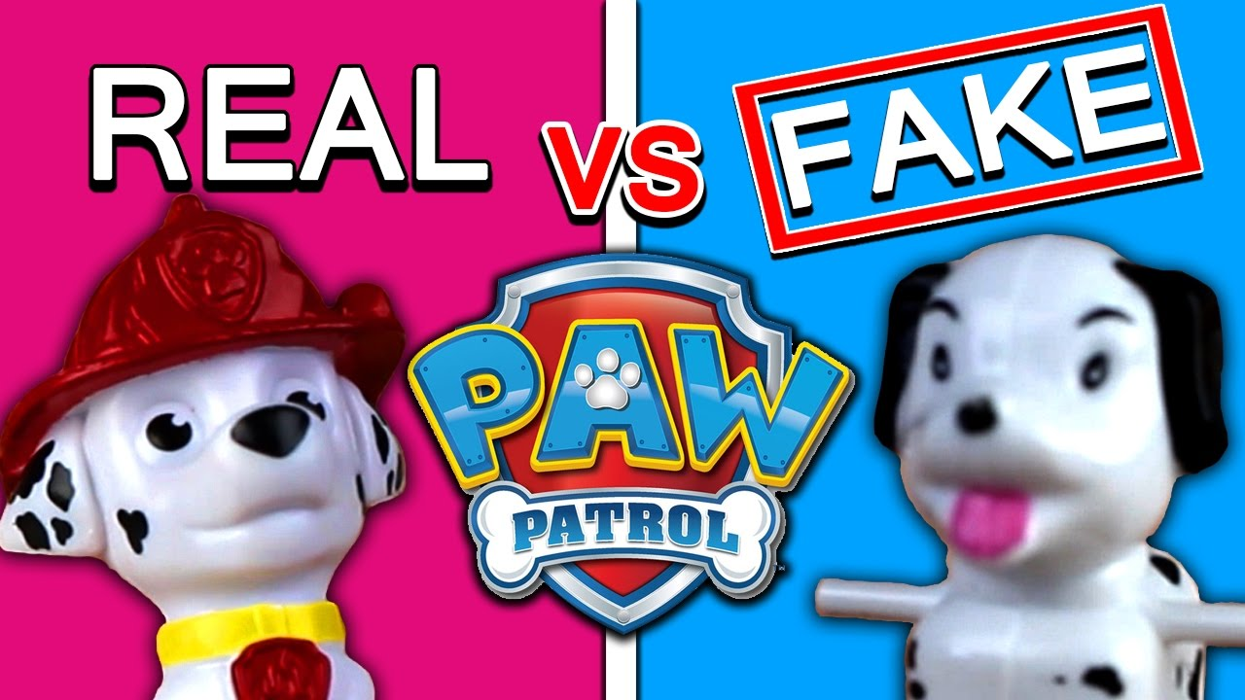
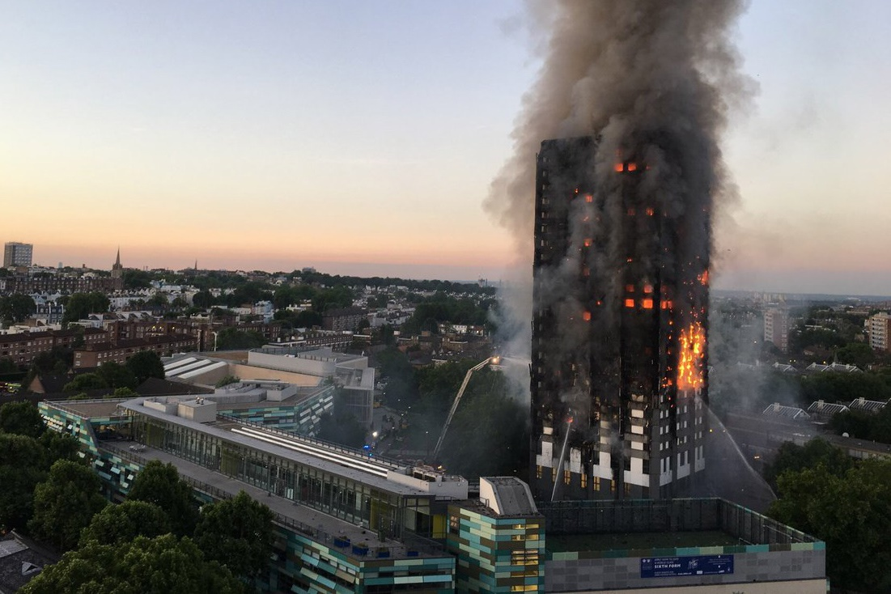
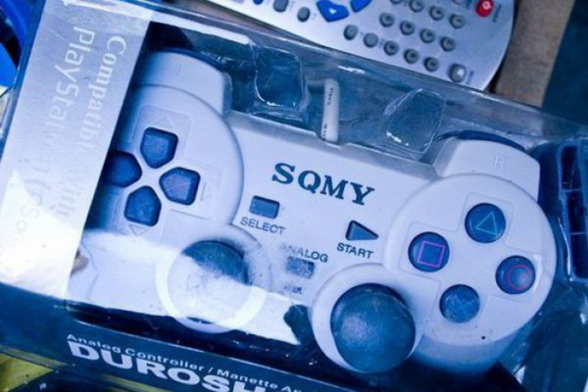
British Standards Institute & European Union
https://www.bsigroup.com/en-GB/kitemark/product-testing/
https://www.youtube.com/watch?v=tNc_MSIPNFM

Slide 6
Review
One piece of information in detail that you have learned today
Write 2 questions to test the knowledge of a friend about
Todays lesson

