Slide 1
DO NOW- Write your analysis in the boxes below describing the following points in relation to the torch. You need to do this in 2 detailed paragraphs. Paragraph one comments (blue) Paragraph 2 (green)
Maintenance is it easy to fix or clean? Why?
Recycle- what can be recycled? IS it good or bad?
DFMA- where has this been incorporated into the product?
Useful life- is it good for the environment? How is it powered and how much energy has been created to make and transport it ?
Tools to disassemble?
Is it easy disassemble ?- why?
Are any parts of the torch dangerous? Sharp? Choking hazard?

Slide 2
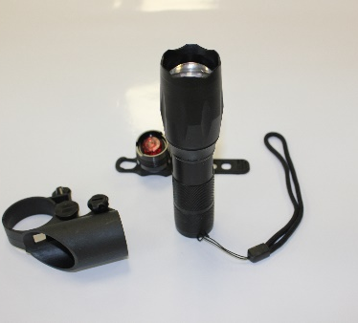
Torch disassembly and analysis
Photo of you disassembling torch here

Slide 3
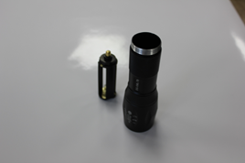
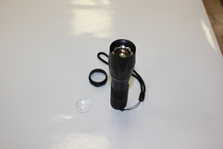
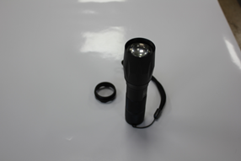
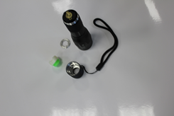
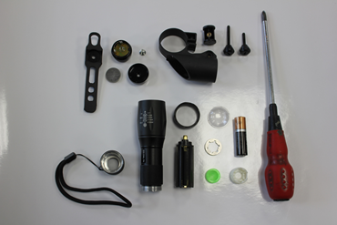
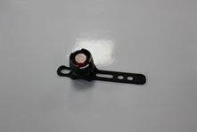
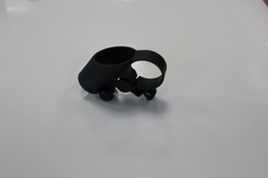
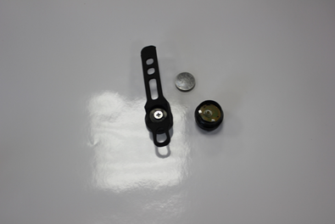
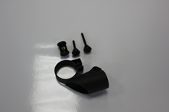
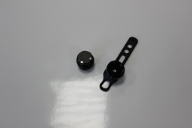
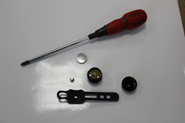
Torch disassembly instructions
2. Using your hands, twist the front end of the torch to unscrew the metal cap.
4. Remove the plastic push switch and metal collar from the torch and place onto the sheet.
5. Tilt the torch slightly to allow the battery holder to slide out carefully.
1. The Bike light consists of 3 parts, the torch, holder and back light.
3. Now remove the glass torch front carefully to access the inside of the torch
13. Once you have disassembled the torch, work your way backwards to reassemble the speaker as best you can!
8. By hand, you now need to unscrew the two bolts that tighten the torch to the holder.
12. For the final stage of Disassembly, remove the back light rubber strap form the light body using a screwdriver. .
10. Unscrew the metal front from the main attachment of the light
9. For the final stage, now take you back light for the bike and place it separately on your page.
7. In front of you , you now need to separately disassemble the torch holder.
11. Once open, now release the battery from the clips inside the light to allow the battery to come away.

