Slide 1
Product Design – revision time!

Slide 2
Questions then content…
What is meant by market pull?
Give me two reasons that a product evolves.
Which of the following movements is the odd one out: Art Nouveau, Arts and Crafts, De Stijl. Explain why.
What evolution factors are involved in a phone being redesigned?

Slide 3
Evolution
Word | Meaning
Product Evolution | This is when products are continuously for factors such as improvement, market pull, technology push, political and environmental needs
Market pull | This is when things are designed to satisfy the needs and wants of consumers. This is also changes that take place because of changing fashions and social attitudes.

Slide 4
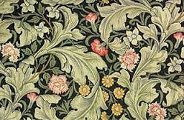
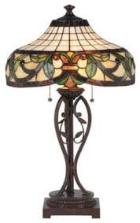
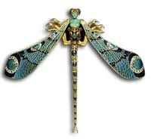
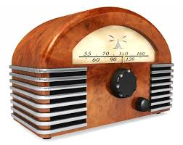
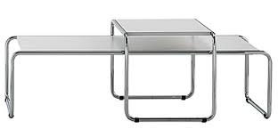
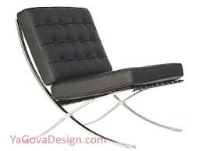
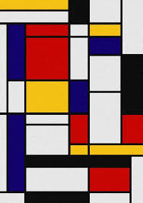
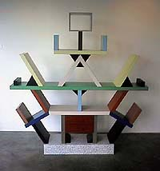
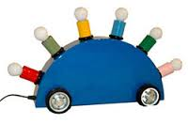
Design movements
Movement | Info | Image
Arts and crafts | Founded by William Morris. Often the designs are based on nature. Products are usually made by hand.
Art Nouveau | Flowing and curvy. They often use floral or insect motifs.
Art Deco | Inspired by African and Egyptian art. It involves bold colours, geometric, zigzag and stepped shapes.
Bauhaus | In Germany. Form follows function. Products thought to be designed with the function first before form.
De Stijl | This is a Dutch movement. The designs are basic and use primary colours and simple shapes.
Postmodernist | Rejects the ‘form follows function’ idea. They thought style should be the starting point. The Memphis movement and kitsch were also at the same time.

Slide 5
Questions then content…
How could a smoke alarm be designed so that it is suitable for deaf people?
Give me a way that a menu could be redesigned for a visually impaired person.
What is anthropometrics? Give an example of anthropometric data.

Slide 6
Human factors
Designing with disabilities in mind:
Braille = to enable blind people to be able to read the information
Instructions are often given in picture format so that people with reading difficulties can access the information
Designing with culture and religious values:
Dietary needs = some people can not eat certain foods based on their culture
Customs and celebrations = some people celebrate different things
Colours = some cultures think of particular colours in very different ways.
Word | Meaning
Ergonomics | This is how easy and comfortable a product is to use.
Anthropometrics | This is the data used to ensure that products are the correct shape and size. It used body measurement data.

Slide 7
Quality control
Word | Meaning
Quality Assurance | This is the systems and procedures that manufactures have in place to make sure that their products are high quality.
Quality control | This is testing – e.g testing that a component is the correct colour and/or size.

Slide 8
Quality – the laws
There are certain laws to protect customers:
Consumer protection from unfair trading regulations (this makes sure that anything the product claims is true)
The General Product Safety Regulations (this states that no one can put a product on the market unless it is safe).
Sale of Goods Act (this makes sure that a product performs as you would expect for a reasonable amount of time.)
Furniture and Furnishings (Fire Safety) Regulations (this makes sure that fabric products do not catch fire easily and do not give off toxic fumes when they burn.)

Slide 9
Quality – the standards
BSI – British Standards Institute.
British Toy and Hobby Association (BTHA)
The Internal Organisation for Standardisation (ISO)

Slide 10
Questions then content…
What are the functions of packaging?
What are the six Rs?
What is built in obsolescence?
What causes a product to have a carbon footprint?

Slide 11
Packaging
Functions:
Contain
Protect
Preserve
Inform
This is to hold them together and for storage
This is to stop them from breaking when a product is transported.
This is to stop foods from deteriorating when exposed to oxygen.
This provides the consumer with information about the product. Such as ingredients etc.

Slide 12
Environmental impact
The 6 R’s:
Recycle
Reduce
Repair
Reuse
Refuse
Rethink
Take an existing product that has become waste and re-process it to form a new product
Minimise the amount of material and energy used during the whole product’s life cycle
When a product breaks or doesn’t work properly, fix it.
Take a product that has become waste and use the material or parts for another purpose.
Don’t accept a product if you don’t need it or its not environmentally sustainable.
Our current lifestyles and the way we design and make.

Slide 13
Ethics and environmental issues
This means to not cause permanent damage to the environment and not using up finite resources (those that will run out eventually).
Sustainable
design
Built in
obsolescence
Biodegradable
Carbon
footprint
This is when a product has a built in life span and is only meant to last a certain amount of time. It will become obsolete (useless) after time. E.g. a balloon or razer blade.
This is something that will decay over time. For example paper and card are biodegradable but glass is not.
This is the amount of greenhouse gases that are released by making or using something. All products have a carbon footprint.

Slide 14
Questions then content…
What safety symbols do manufacturers have to display on their products?
If a material is ‘brittle’ what does that mean?
If a product has good plasticity what does this mean?

Slide 15
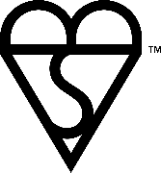
Symbols
Symbol | Info | Image
British Standards | This is also known as the kite mark. It shows that products have met certain standards.
CE mark (European standards) | This is the European standards for safety. Products must have this symbol to be sold in Europe.
Recycling | This is to inform consumers how to correctly dispose of their product.
Irritant | This means that it will be irritant to the skin.
Flammable | Will catch fire easily.

Slide 16
Symbols
Symbol | Info | Image
Environmental hazard | Is a danger to the environment so must be disposed of in a particular way.
Explosive | This is symbolising that the product will release a tremendous amount of energy in the form of heat, light and expanding pressure within a very short period of time.
Harmful | This symbol is to warn about hazardous materials, locations, or objects, including electric currents, poisons, and radioactivity.

Slide 17
Properties of materials
Property | Meaning
Strength | This is the ability to withstand forces without breaking.
Hardness | This is the ability to withstand scratching, rubbing or denting
Plasticity | This is if the material can change shape permanently
Brittleness | This means that the material can not withstand much stretching. Brittle materials are likely to crack or break.
Toughness | This is the opposite of brittle. It can absorb impact without breaking or snapping.
Durability | This means that it can withstand repeated use.

Slide 18
Questions then content…
Name three types of card.
What type of card would be suitable for a storage box?
What type of card would be suitable for a cereal box?
What are the different sizes of paper?
What are the most common sizes of paper?

Slide 19
Paper and card
Paper/card | Info
Cartridge paper | This is high quality and has a textured surface. Good for sketching, inks and watercolours.
Layout paper | Strong, thin and translucent and used for general design work.
Grid paper | May have square or isometric pattern printed on it.
Tracing paper | Translucent and used to copy images.
Solid white board | High quality bleached surface, which is ideal for printing.
Corrugated board | This is largely used in packaging as it has a ‘fluted inner core’ and two outer layers. It is strong.
Duplex board | This is a different colour and texture on each side. It often used where only one surface is seen.
gsm | This stands for grams per square metre. The gsm is above 200 for card.

Slide 20
Paper and card
Paper is available in: A0, A1, A2, A3, A4, A5 and so on.
Laminating paper/card gives it new properties
Paper and aluminium foil is often used to package food
Paper coated with polythene makes it waterproof
Foam core board = polystyrene being laminated between card.

Slide 21
Questions then content…
What are the different types of timber?
What forms does timber come in?

Slide 22
Timber
Type | Info
Softwoods | Grow in colder climates and are fast growing. This makes them relatively cheap. The trees have leaves like needles. Some examples are scots pine and Parana pine.
Hardwoods | These usually grow in warm climates and are slow growing. They are generally more expensive because of this. The trees have broad leaves are usually deciduous. Some examples are oak and teak. They tend to have a tighter grain and are denser than softwoods.
Manufactured boards | These are made by gluing sheets, blocks, chips or fibres of woods. Some examples are plywood, block board, clipboard, MDF and hardboard.

Slide 23
Timber
Timber is available in different sizes such as in planks and strips.
Rough sawn = wood is not smoothed after it’s cut. This makes it cheaper and useful for construction work.
Mouldings = hardwood strips that come in a range of cross-sections.
Veneers = cuts of wood that are glued to other materials to give them a nicer appearance.

Slide 24
Timber
There are different ways to finish wood:
Woodstain
Oil
Paint
Polyurethane varnish

Slide 25
Questions then content…
Name a ferrous metal?
What forms does metal come in?
What coatings can be applied to metals to protect them?

Slide 26
Metals – Ferrous metals
Type | Properties | Uses
Cast Iron | Very strong if compressed but brittle and may crack if dropped | Bench vices, car brake discs.
Mild steel | Quite strong and cheap, but rusts easily. | Car bodies, screws, nuts, bolts, nails
Stainless steel | Hard, it won’t rust. It is more expensive than mild steel. | Surgical equipment, sinks, kettles, cutlery

Slide 27
Metals – Non-ferrous metals
Type | Properties | Uses
Aluminium | Lightweight, resistant to corrosion, expensive, not as strong as steel. | Aeroplane bodies, cans
Copper | Fairly soft, malleable, ductile, very good electrical conductor. | Wiring, pipes, pans
Brass | Strong, resists corrosion, malleable, ductile, electrical conductor. | Door handles, taps, locks, electrical parts.

Slide 28
Metals
Metals are available in different shapes and sizes.
Sheet
Strip
Different shaped rods and bars
Pipe or tube
Angle
U-shaped channel
I-shaped girder

Slide 29
Metals
Metals are extracted from the earth.
Heat treatments:
Annealing
Hardening
Tempering
This is where the metal is heated and left to cool slowly. This makes it softer, more ductile and less brittle.
This is when you heat and rapidly cool a metal. This makes it harder.
This makes the metal tougher and less likely to break.
Possible metal coatings = painting, plastic coating, plating and lacquering.

Slide 30
Questions then content…
What are the two groups of plastic?
What plastic would be most commonly used for bottles?
What plastic has glass strands within it?

Slide 31
Plastics
Type | Meaning
Thermoplastics | These are easily formed, recyclable but do not resist heat very well.
Thermosetting plastics | These can resist heat and fire. They undergo a chemical change when heated to become hard and rigid.

Slide 32
Thermoplastics
Plastic | Properties and uses
Acetate | Hard, transparent and flexible.
Acrylic | Hard and shiny. Resists weather well. Can be used to make motorcycle helmet visors, baths, signs.
Low density polyethylene (LDPE) | Soft and flexible. Used for packaging, carrier bags, washing up liquid bottles
High density polyethylene (HDPE) | Stiff and strong but lightweight. Used for things like washing up bowls, baskets, folding chairs
PET | Light, strong and tough. Used to make see through drink bottles.
High impact polystyrene (HIPS) | Rigid and fairly cheap. Used for vacuum forming.

Slide 33
Thermosetting plastics
Plastic | Properties and uses
Epoxy resin (ER) | Rigid, durable and corrosion resistant. Used for circuit boards and wind turbine rotor blades.
Urea Formaldehyde (UF) | Hard, brittle and a good electrical insulator. Used for things like plug sockets and cupboard handles.
Melamine Formaldehyde (MF) | Strong and scratch proof. Used to laminate chipboard and for plates and bowls.
Glass reinforced plastic (GRP) | This is a thermosetting plastic that is mixed with glass strands to make it really strong. Used for racing car bodies an light aeroplanes.

Slide 34
Plastics
Plastics are mostly made from oil.
Shapes and sizes = films, rolls, foam, sheets, rods, tubes and granules.

Slide 35
Questions then content…
What different types of fixings are there?
Give some examples of standard components.
Why might a designer or manufacturer buy in some standard components?

Slide 36
Fixings and bindings
Double sided sticky pads
Ratchet rivets
Snap rivets
Velcro
Press stud fastenings
Magnets
Hooks
Staples
Spiral binding

Slide 37
Standard components
Standard components are pre-manufactured parts
Mass produced – so available at a lower cost
Saves time and makes manufacture more efficient
Saves money as specialist equipment and additional material isn’t needed.
Examples:
Screws and bolts
Rivets
Knock down fittings

Slide 38
Questions then content…
Name a smart material
Name a new material
What smart or new material would be suitable for a baby spoon?
What smart or new material is commonly used in jewellery?

Slide 39
New and smart materials
New and smart materials differ:
New = This is a material that has been developed with different and useful properties.
Smart = This is a material that changes its properties when their environment changes.

Slide 40
New materials
New material examples:
Corn-starch polymers
Precious metal clay
These are made from maize (sweetcorn) and are renewable. They are biodegradable so more sustainable.
This is a material that contains particles of metal. It is often used to make jewellery.

Slide 41
Smart materials
Smart material examples:
Thermochromic
materials
Shape memory alloys
They change colour with heat. Good for warning when something is too hot.
These can easily be shaped when cool but return to a ‘remembered’ shape when heated above a certain temperature.

Slide 42
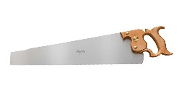
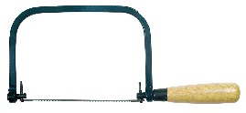
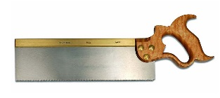
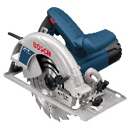
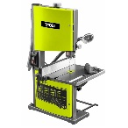
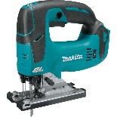
Tools:
Tool name | Use | Image
Panel saw | For wood
Coping saw | For wood or plastic
Hacksaw | For cutting metal and plastic
Tenon saw | For wood
Circular saw | To cut woods and boards like plywood
Band saw | Come in different widths and can make straight or curved cuts. Used to cut plastics and softer metals.
Jig saw | Interchangeable blades and variable speeds. You can make straight or curved cuts in all materials.

Slide 43
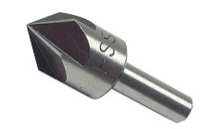
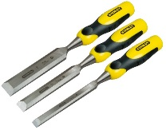
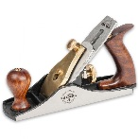
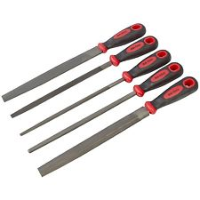
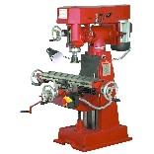
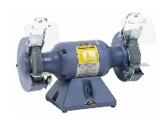
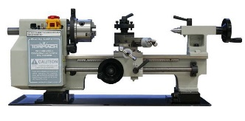
Tools:
Tool name | Use | Image
Counter sink | Widens the opening to an existing hole. This allows screw threads to sit flush on the surface.
Wood chisels | This is for making different shapes. Used for some joint creation. Used with a mallet.
Bench planes | For taking off think layers of a material. Used to shape wood.
Files | Hundreds of small teeth to cut away at a material. Available in different shapes. Usually used on metals and plastics. Rasps are used for wood.
Milling machine | Used to remove one thin layer of material at a time. Produce an accurate finish.
Bench grinder | Contains abrasive wheels of different grades. Used to remove metal for shaping and finishing.
Lathe | Used to cut and shape materials, to produce rounded objects. E.g. chair legs.

Slide 44
Casting and moulding:
Please refer to other PP for more info
Injection Moulding
Blow Moulding
Vacuum Forming

Slide 45
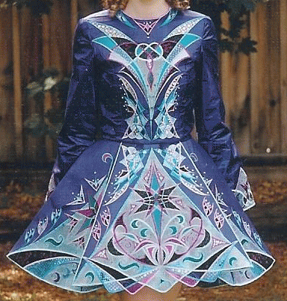
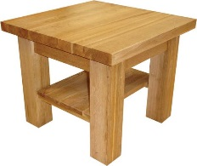
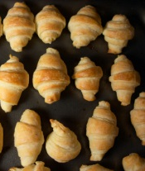
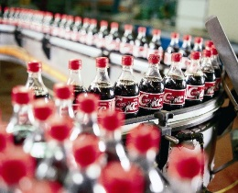
Scale of production:
One off production:
Batch production:
Mass production
Continuous flow production
Just in time production
This is when only one product is made at a time
See other PP
This is when a small quantity of identical products are made together
This is when hundreds/thousands/millions of identical products are made.
This is when many thousands of identical products are made.
The production line is kept running 24 hours a day, seven days a week.
This is when the manufacturer only orders what they need so they are only producing the necessary amounts of a product; this reduces wastage.

Slide 46
Consistency of production:
Manufacturers want their products to be consistent. They use things like jigs, templates and moulds to help to speed up the process.
These help to manufacture repetitive components. It makes sure that the workpiece is positioned in the correct place.
Jigs
Templates
Moulds
These are used to make repetitive shapes. They are easy to make and easy to use.
These are used to make 3D shapes. They are more commonly used in plastic forming such as vacuum forming, compression moulding and blow moulding.

Slide 47
CAD CAM:
CAD = Computer Aided Design
This involves designing products on the computer, rather than using pencil and paper.
Programs include: Adobe Illustrator, Techsoft 2D Design, Solidworks.
CAM = Computer Aided Manufacture
This is the process of making products with the help of computers.
Examples of CAM machines are CNC routers, laser cutters, laser printers.

