Slide 1
Year 11 Product Design Revision day P1-4
Period 1 & 2 - lecture theatre Theory and application
Period 3 – Group A Mr Gregson, Group B Mr Smith
Period 4- Group A Mr Smith, Group B Mr Gregson
Period 3 & 4- Product Analysis and Environmental factors
Design question- packaging

Slide 2
Topics we will cover this morning
Exam technique | Materials | Forming processes | Manufacturing methods | Packaging | Human Factors
Timing- questions | Woods | Die Cutting | One off | Nets/ Developments | Anthropometrics
Question choice & layout | Metals | Offset Lithography | Batch | Logo’s | Ergonomics
Marks | Plastics | Vacuum Forming | Mass | Purpose of packaging | 5th, 50th, 95th percentile
Equipment | Paper/ Card | Injection Moulding | Continuous
Key words/ phrases | Smart Materials |  | JIT
 |  |  | CAD/ CAM
 |  |  | CNC

Slide 3
Exam Technique
Marks
Look at the marks awarded for each question:
1 mark- state one fact
2 marks- state one fact and then expand or elaborate with an example
4 mark- either state 4 individual facts or 2 facts and then give an example
5 and above marks as above.
All Design questions:
You must answer the question!
Ensure to annotate against any criteria given
Use crayons to add colour (you get extra marks)
Use a range of 2D/ 3D drawings
Ensure to state specific materials, do not write wood, plastic or metal. Example, Pine, aluminium or Acrylic
Timing- questions
Exam Duration : 2 hours
Question 1: 30 minutes
Question 2: 10 minutes
Question 3: 15 minutes
Question 4: 15 minutes
Question 5: 20 minutes
Question 6: 15 minutes
Ensure to stick to these times!
Question Choice
Ensure to answer the correct design question.
Do not choose a textiles or food product when completing a design question!
Choose a Wood, Metals, Plastic, Paper, Card, electronics or CAD/ CAM product
Equipment
Black pen
Pencil
Ruler
Rubber
Crayons!

Slide 4
Exam Technique: language used
‘Design criteria’- think of ACESSFM. You can state or write about any of the key words- Aesthetics, Construction, Environment, Safety, Size, Function or Manufacture and Materials
‘Use notes and sketches’- ensure to draw and annotate in detail!
‘Explain’, ‘Describe’
‘You are advised to spend about 20 minutes on this question’

Slide 5
Exam Technique: language used

Slide 6
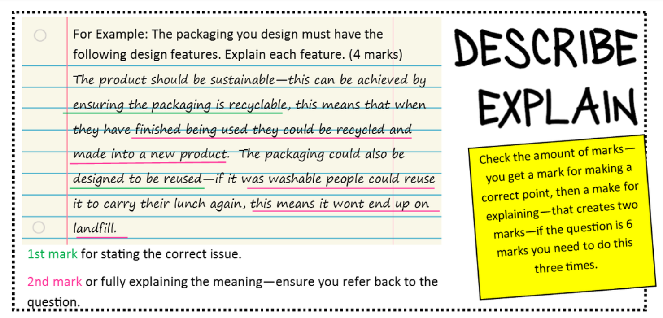
Exam Technique: language used

Slide 7
Exam Technique: language used

Slide 9
Topics we will cover this morning
Exam technique | Materials | Forming processes | Manufacturing methods | Packaging | Human Factors
Timing- questions | Woods | Die Cutting | One off | Nets/ Developments | Anthropometrics
Question choice & layout | Metals | Offset Lithography | Batch | Logo’s | Ergonomics
Marks | Plastics | Vacuum Forming | Mass | Purpose of packaging | 5th, 50th, 95th percentile
Equipment | Paper/ Card | Injection Moulding | Continuous
Key words/ phrases | Smart Materials |  | JIT
 | New Materials |  | CAD/ CAM
 |  |  | CNC

Slide 10
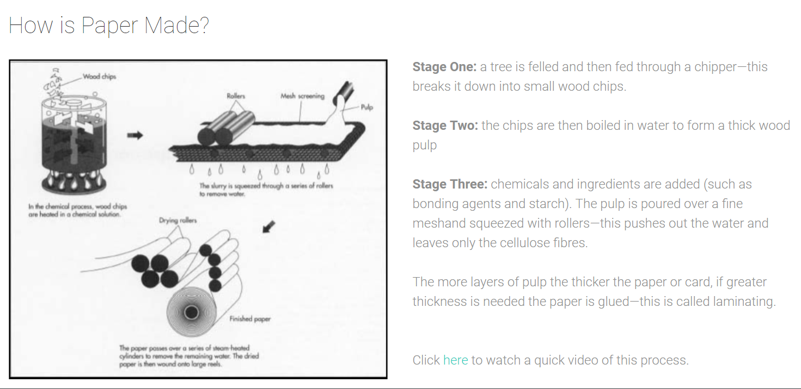
Materials: paper/ card

Slide 11
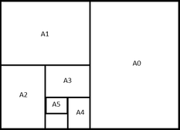
Materials: paper/ card- stock form

Slide 12
Materials: paper

Slide 13
Materials: boards

Slide 14
Paper/ Board- Finishes

Slide 15
Paper/ Board- Finishes

Slide 16
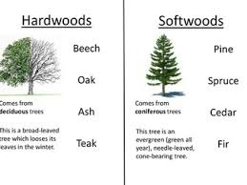
Materials: woods

Slide 17
Materials: ferrous metals
Cast Iron
Mild Steel
High Carbon Steel

Slide 18
Materials: non- ferrous metals

Slide 19
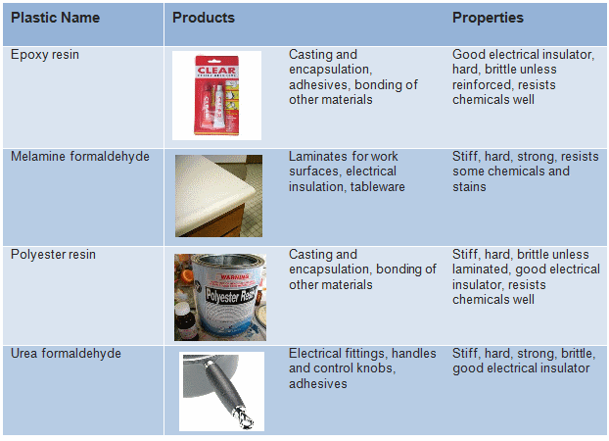
Materials: thermosets
Thermoset, or thermosetting, plastics are synthetic materials that strengthen during being heated, but cannot be successfully remoulded or reheated after their initial heat-forming.

Slide 20
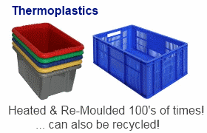
Materials: thermoplastics

Slide 21
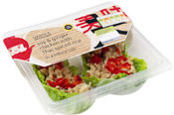
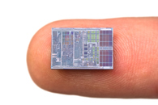
New materials
Precious Metal Clays
P: Made from 99% gold or silver and 1% clay. It can be shaped at room temperature, then heated. A: Very expensive and mainly used for jewellery, beads and small sculpture
Corn Starch Polymers
Nano technology
P: It is made from high starch vegetables including potatoes, corn and maize. It is biodegradable and environmentally friendly. A: Food packaging & Disposable cutlery
P: These improve the properties of a material, such as stiffness or elasticity. When added into polymers, they can be used as lightweight replacements for metals. A: Nanomaterials are used in car manufacturing to create cars that are faster, safer and more fuel efficient.

Slide 22
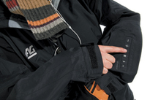
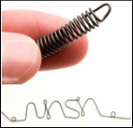
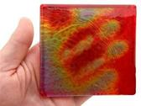
Smart materials
Quantuum Tunneling Composites
Shape memory alloys
Thermochromic inks
P: When heat or an electrical current passes through the wire contracts (shortens). A: Dental braces, mechanisms in sprinklers, used to hold broken bones together, spectacle frames
P: Can be mixed with acrylic paint. At room temperature it shows its usual colour, but when heated or cooled the colour changes or appears. A: Thermometers or other heat indicating items
QTC P: When pressed the QTC resists a current slowing or stopping the electrical charge passing through, this can then act as a switch or button. A: Fabric keyboard keys, switches

Slide 23
Materials review..10 questions
What is the stock form of paper? Give 3 examples
Name 2 different examples of types of papers
Name 2 examples of boards
Name 2 hardwoods
Name 2 softwoods
Is Cast iron a ferrous or non ferrous metal?
Name 2 non ferrous metals
What are the 4 types of finishes applied to paper/ card
Name 2 new materials
Name 2 smart materials

Slide 24
Topics we will cover this morning
Exam technique | Materials | Forming processes | Manufacturing methods | Packaging | Human Factors
Timing- questions | Woods | Die Cutting | One off | Nets/ Developments | Anthropometrics
Question choice & layout | Metals | Offset Lithography | Batch | Logo’s | Ergonomics
Marks | Plastics | Vacuum Forming | Mass | Purpose of packaging | 5th, 50th, 95th percentile
Equipment | Paper/ Card | Injection Moulding | Continuous
Key words/ phrases | Smart Materials |  | JIT
 | New Materials |  | CAD/ CAM
 |  |  | CNC

Slide 25
Manufacturing methods
One off
Description: One off production is where an item is made to the specification of a client. For example; wedding dresses, one of a kind furniture, bars.
Advantages: The products made are high quality and unique Employs people with high skills Workforce is engaged because each job is different and they will take pride in their work | Disadvantages: High labor costs, takes a lot of effort and a lot of skill Production takes a lot of time and is expensive, special templates, moulds or jigs would have to be made No economies of scale

Slide 26
Manufacturing methods
Batch
Description: this is where a set number of products are manufactured at one time. The product may be changed slightly and then the same number of products is manufactured again before stopping and being changed again. For example; garments like t-shirts (the pattern, materials or size might be changed each time), bread, coloured plastic cups.
Advantages: Because more products are made using the same template the cost is reduced Gives the customer and client more choice (e.g. colour) Materials can be bought in bulk so the item is cheaper | Disadvantages: Workers are less engaged than with one off as work can be repetitive You need to somewhere to store the materials until they are used (for example storing yellow plastic granules until you finish making with all the other colours

Slide 27
Manufacturing methods
Mass
Description: this is where a very large number of products are manufactured. Often in a production line. For example; socks and jeans, bottles, plastic knives and forks.
Advantages: The cost of making the moulds and templates are spread out over a large number of products Lower labour costs Materials can be bought in bulk, this reduces the products cost A large number of items are quickly produced | Disadvantages: Machinery is expensive to buy and production lines also cost a lot to set up Production lines are difficult to adapt and change If any part of the production line breaks then production will completely sto

Slide 28
Manufacturing methods
Continuous
Advantages: The cost of making the moulds and templates are spread out across an infinite amount of products Lower labour costs Materials can be bought in bulk, this reduces the products cost A large number of items are quickly produced | Disadvantages: Machinery is expensive to buy and production lines also cost a lot to set up Production lines are difficult to adapt and change If any part of the production line breaks then production will completely stop

Slide 29
Manufacturing methods
Just in time (JIT)
Advantages: No costs from the storage of goods or materials The cost of making the moulds and templates are spread out over a large number of products Lower labour costs A large number of items are quickly produced | Disadvantages: If stock isn't delivered on time then production shuts down Materials cannot be bought in bulk, only the amount needed as the materials aren't stored Machinery is expensive to buy and production lines also cost a lot to set up The software to run Just in Time is expensive to set up and so is monitoring stock levels Production lines are difficult to adapt and change If any part of the production line breaks then production will completely stop

Slide 30
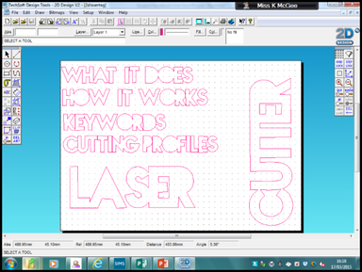
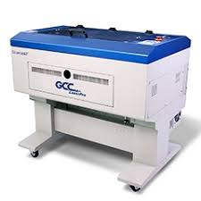
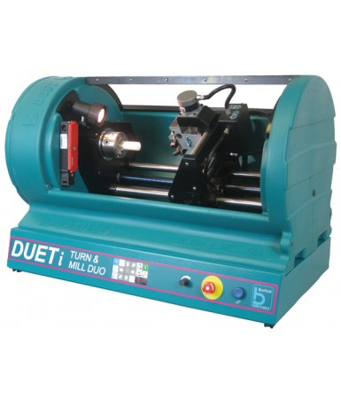
Manufacturing methods
CAD & CAM Keywords
 | CAD: Computer Aided Design - this is a piece of software that allows you to design products in 2D or 3D. In school we use 2D Design, ProDesktop and Google Sketchup. CAM: Computer Aided Manufacture - this is a piece of equipment of which it’s movements are guided by computers. In school we have the CNC lathe and the Laser Cutter. CNC: Computer Numerical Control - essentially this means that a program converts your CAD work into numbers, these numbers are then converted into co-ordinates which plot the movement of the cutter.

Slide 31
Manufacturing Review..10 questions
The name of the manufacturing method where a unique product is designed and made once only.
What is a disadvantage of batch production?
What is an advantage of Mass production?
State a disadvantage of continuous production.
Describe a disadvantage of JIT production.
Describe 2 advantages of CAD
Describe 2 advantages of CAM
Describe 1 disadvantage of CAD
Describe 1 disadvantage of CAM
What does CNC stand for?

Slide 32
Topics we will cover this morning
Exam technique | Materials | Forming processes | Manufacturing methods | Packaging | Human Factors
Timing- questions | Woods | Die Cutting | One off | Nets/ Developments | Anthropometrics
Question choice & layout | Metals | Offset Lithography | Batch | Logo’s | Ergonomics
Marks | Plastics | Vacuum Forming | Mass | Purpose of packaging | 5th, 50th, 95th percentile
Equipment | Paper/ Card | Injection Moulding | Continuous
Key words/ phrases | Smart Materials |  | JIT
 | New Materials |  | CAD/ CAM
 |  |  | CNC

Slide 33
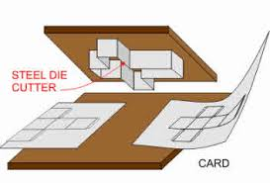
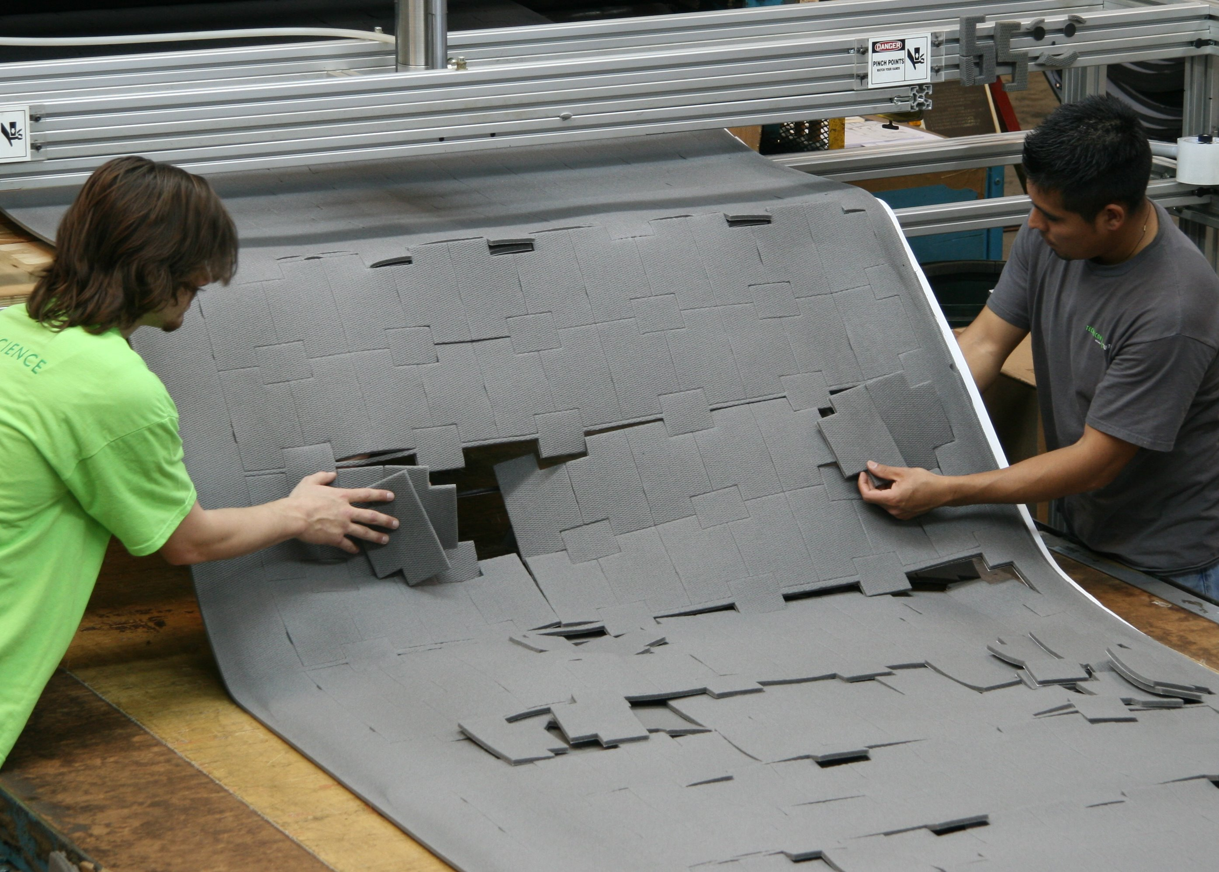
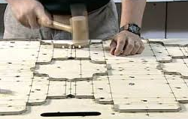
Forming processes- Die Cutting
Automated process
Used in batch and mass production
Used to manufacture a range of packaging

Slide 34
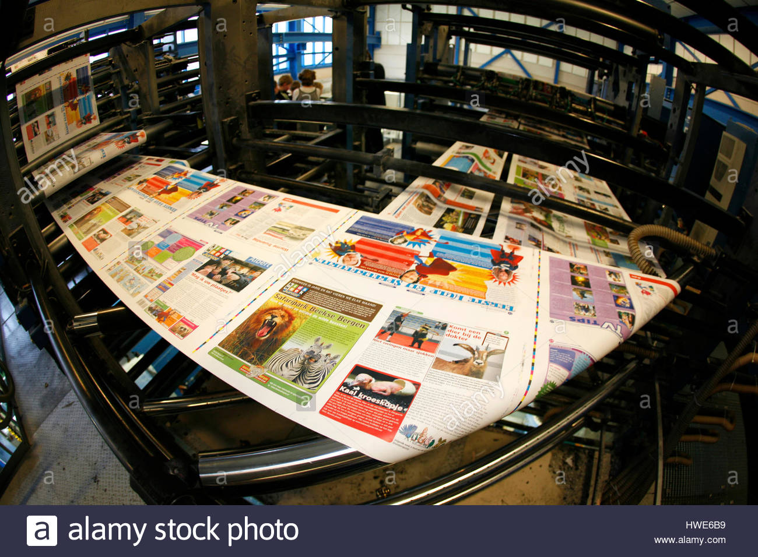
Forming processes- Offset lithography

Slide 35
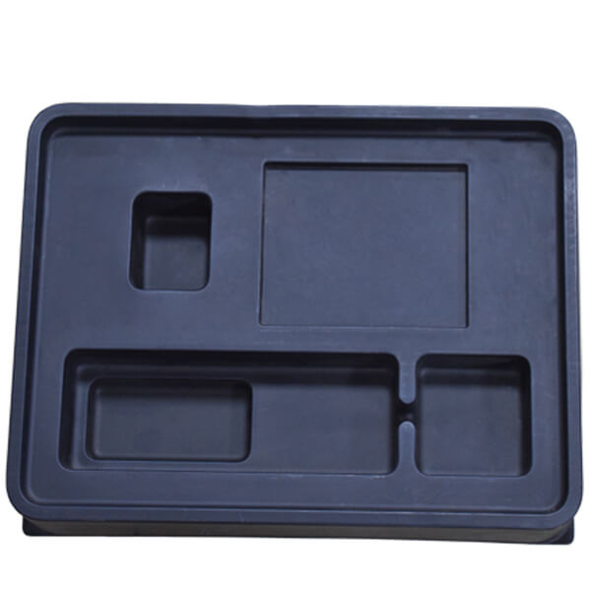
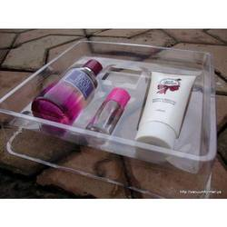
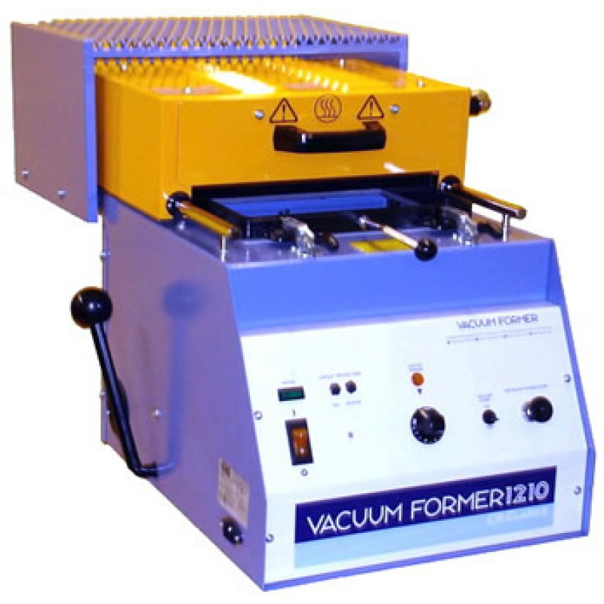
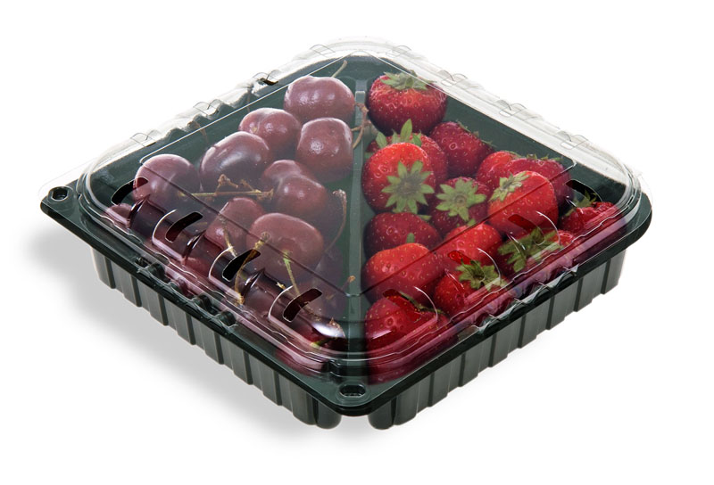
Forming processes- Vacuum Forming

Slide 36
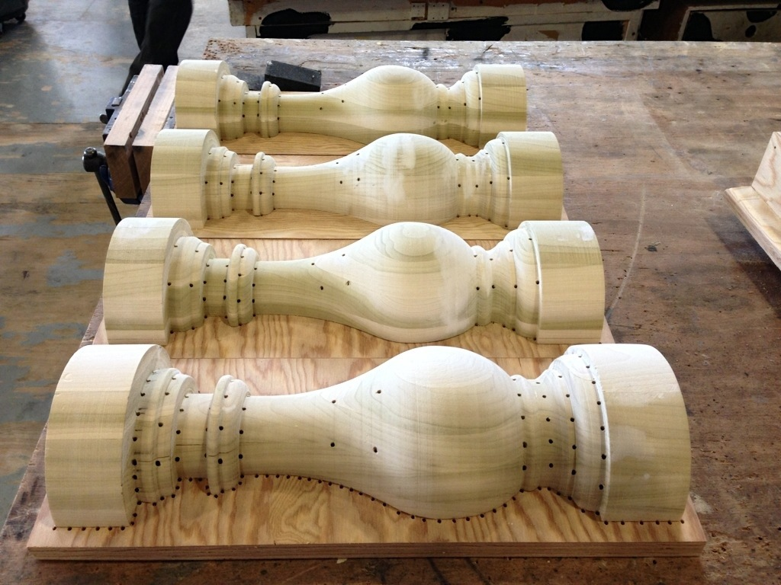
Forming processes- Vacuum Forming
Suitable for batch production
Molds/ formers made from wood, metal and sometimes hardplastics
Holes in the molds are to ensure the plastic gets sucked tight around the mold.

Slide 37
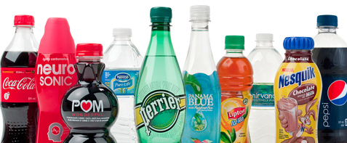
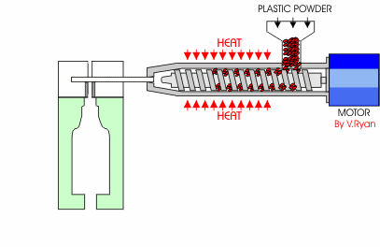
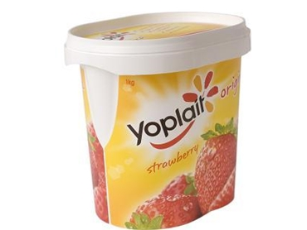
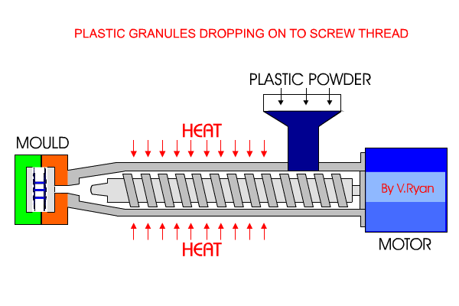
Forming processes- Blow & Injection moulding
Polyethylene terephthalate
Acrylonitrile Butadiene Styrene. Acrylonitrile Butadiene Styrene (ABS), is an opaque thermoplastic and amorphous polymer. ...
Polyethylene. ...
Polycarbonate. ...
Polyamide (Nylon) ...
High Impact Polystyrene. ...
Polypropylene.

Slide 38
Forming processes Review..10 questions
Name the process for cutting out card packaging
Which method of manufacture would this be suitable for?
Name the printing process for printing in colour for mass production.
What colours are used in this process?
Manufacturing process to make plastic bottles?
Plastic used to make plastic bottles?
Manufacturing process to make most plastic products
Name 2 plastics used for injection molding
Process to make plastic packaging for Easter Egg boxes?
Explain why this process is suitable for mass production but not continuous?

Slide 39
Topics we will cover this morning
Exam technique | Materials | Forming processes | Manufacturing methods | Packaging | Human Factors
Timing- questions | Woods | Die Cutting | One off | Nets/ Developments | Anthropometrics
Question choice & layout | Metals | Offset Lithography | Batch | Logo’s | Ergonomics
Marks | Plastics | Vacuum Forming | Mass | Purpose of packaging | 5th, 50th, 95th percentile
Equipment | Paper/ Card | Injection Moulding | Continuous
Key words/ phrases | Smart Materials |  | JIT
 | New Materials |  | CAD/ CAM
 |  |  | CNC

Slide 40
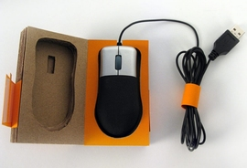
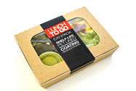
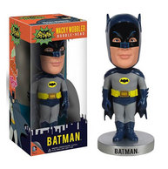
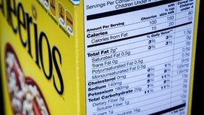
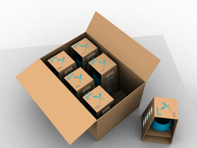
Packaging- Function
PROTECT
PRESERVE
INFORM
DISPLAY
TRANSPORT

Slide 41
Packaging- Common types

Slide 42
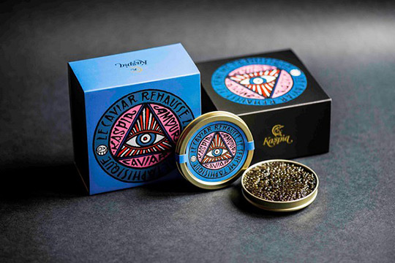
Packaging- Common types
Over packaging!
What so bad about this?

Slide 43
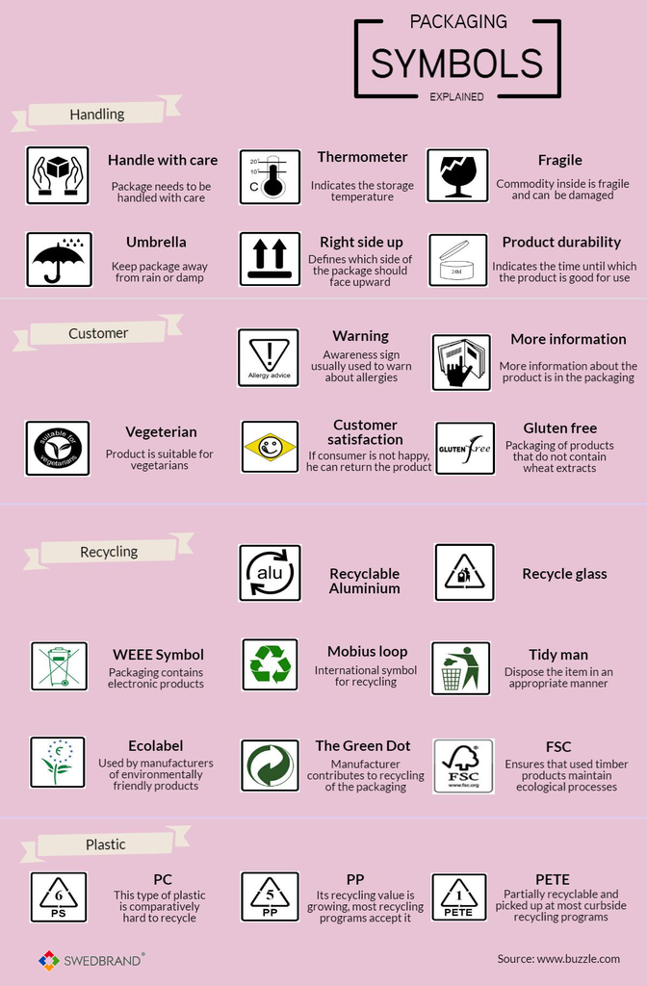
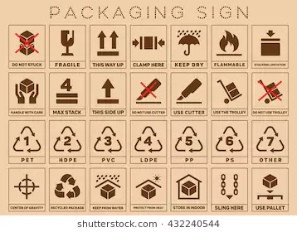
Packaging- Logo’s

Slide 44
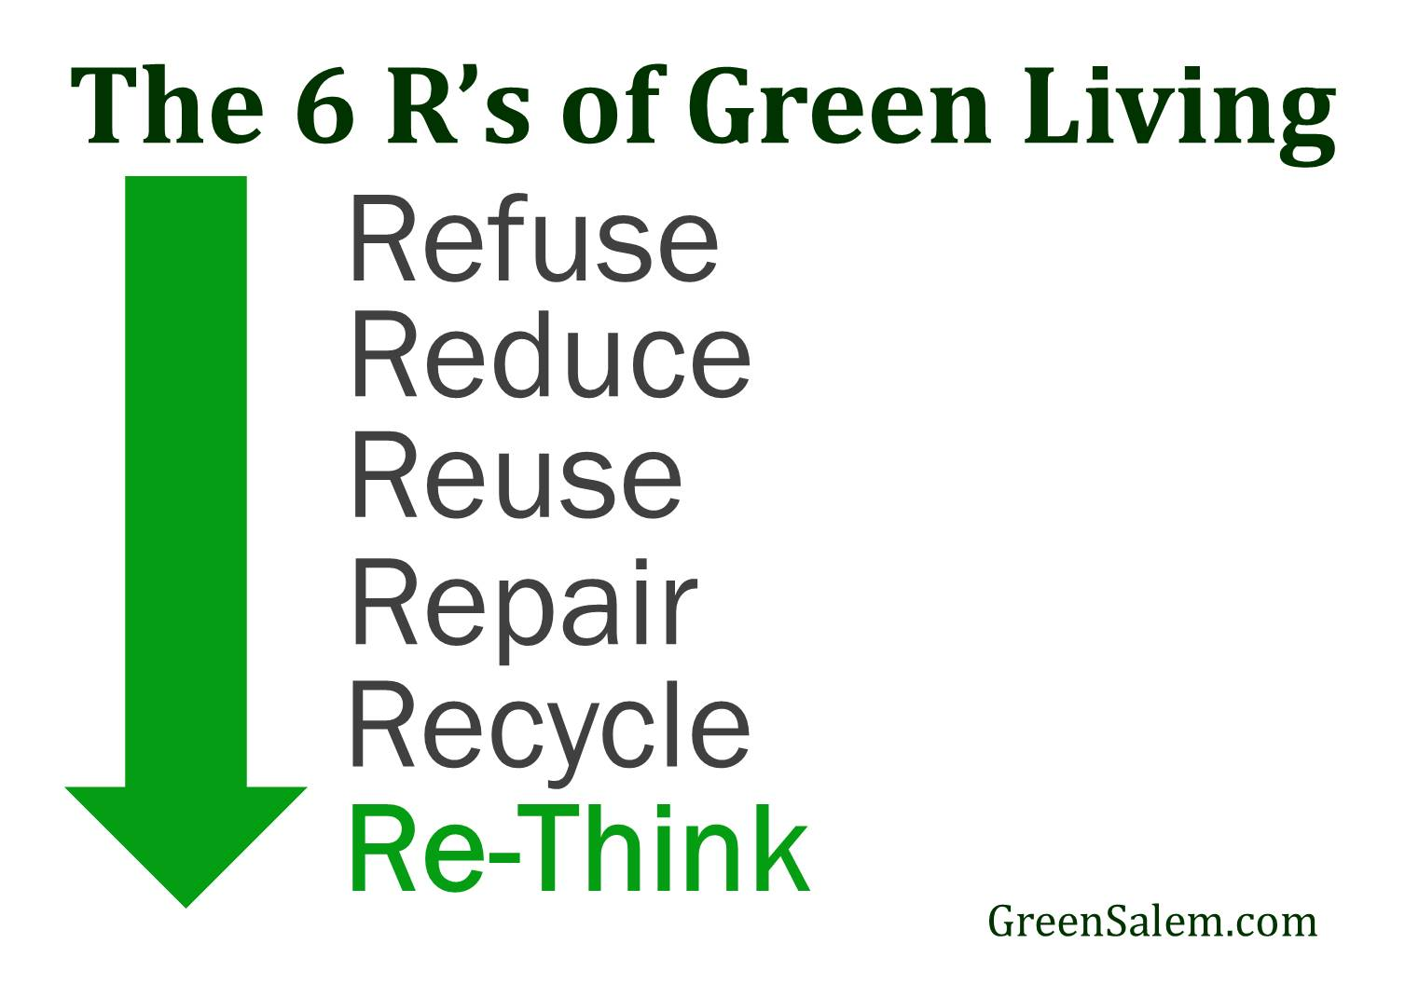
Packaging- sustainable?

Slide 45
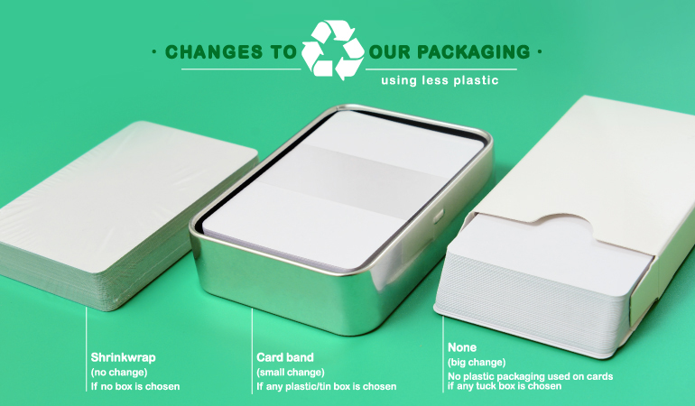
Packaging- sustainable?

Slide 46
Packaging review..10 questions
Name this logo
What does this logo indicate?
How would you improve this packaging to make it more environmentally friendly?

Slide 48
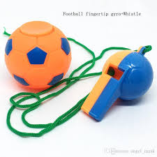
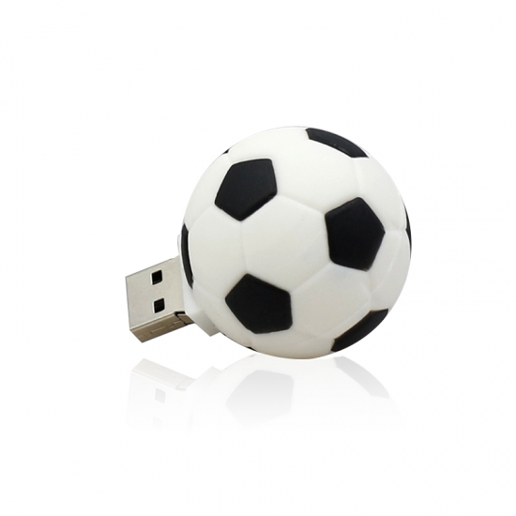
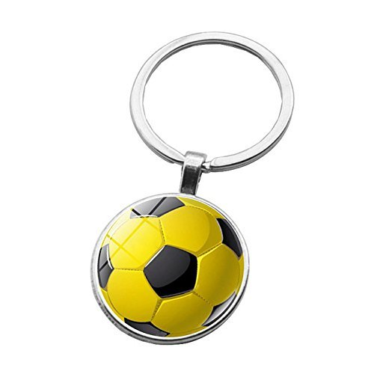
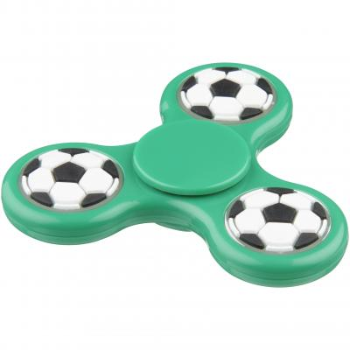
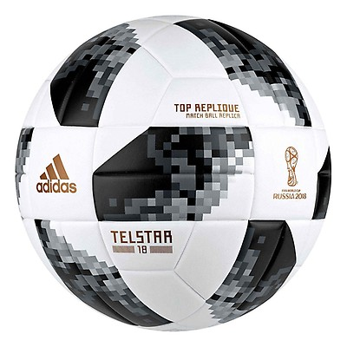
Design Question
The following products are likely to be sold for the 2018 Football world cup. Choose one of the products and design a suitable packaging solution that uses a range of materials.
Marks will be given for:
• a creative solution suitable for protecting the product
• materials, construction and assembly techniques needed for making
• safety considerations and features necessary for your product to be fit for purpose
• how well your design is communicated.
[15 marks]

Slide 49
Design Question
2. Evaluate your design and explain how your design is suitable to protect the product (4 marks)
3. What are the advantages of using Computer Aided Design (CAD) to develop your idea? (4 marks)
4. Describe one finishing technique that could be applied to the packaging to improve its aesthetics.
(4 marks)
5. What is the function of packaging? Fill in the missing answers below. (2 marks)
Protect
Preserve
……………………
……………………

Slide 50
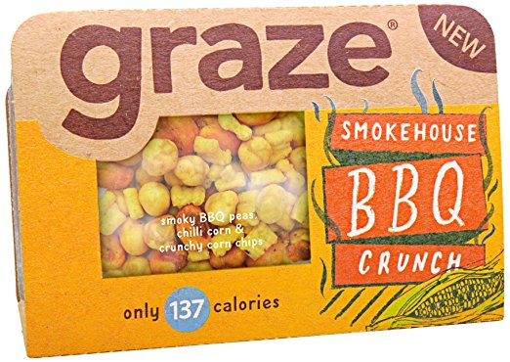
Product Analysis Question
Explain how the card packaging for the graze smokehouse BBQ Crunch selection could be manufactured in industry (6 marks)
What method of printing would be used to print the graphics onto the card packaging. Why would this be suitable? (4 marks)
The internal packaging is made from plastic. Name a suitable plastic and manufacturing method to make this part of the packaging.
Plastic…………………………………………………………………………….
Manufacturing method……………………………………………………(2 marks)
4. Using notes and drawings explain how you would make a batch of plastic moulds using the method you have suggested. (8 marks)
5. Explain which aspects of this product could be improved to make it more environmentally friendly. (6 marks)

