Slide 1
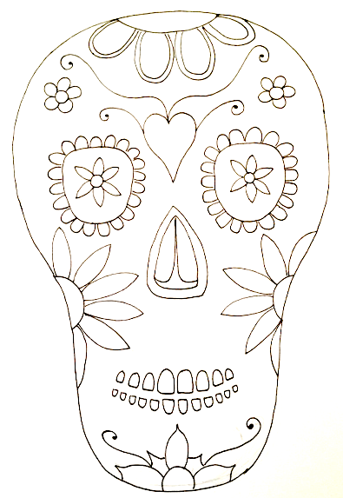
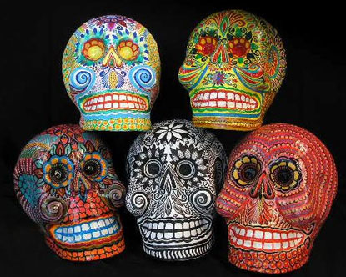
El Dia De Los Muertos
The Day of the Dead
DUE:
Prep 4 learning:
1. Watch on YouTube: Day of the Dead (It's NOT "Mexican Halloween") : Foamy The Squirrel
2. Provide 3 facts about the festival ‘Day of the Dead’
3. 6 images of Day of Dead skulls thoughtfully presented – not just printed out!
4. AIM HIGHER: what are the design principles for the skull designs?
Design principles:
What to include?
Style of composition?

Slide 2


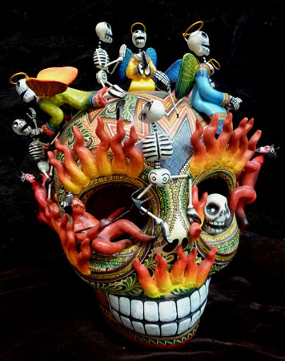
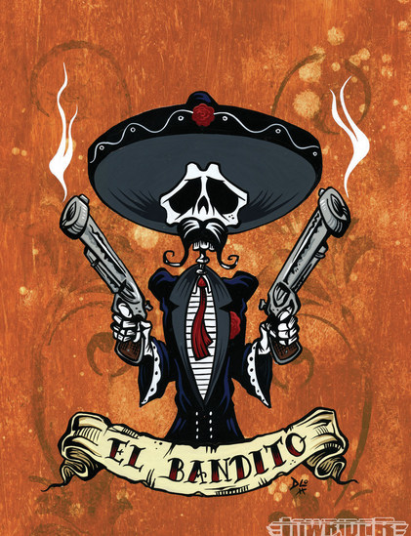
Communication self-motivated dedication resourceful
GT: 3/4 Orange questions
GT: 5 Yellow questions
GT: 6+ Green questions
Art heroes analysis
TASK: create one A3 sheet that includes a written analysis, visual analysis and research images
TIPS:
Use the differentiated analysis questions to aid your written work
Don’t try to copy a full piece of work but choose an enlarged section (which still shows the style)
Make sure your name is on your work
Make the title eye catching, relevant to your artist style(s)
Choose one of your 6 images to write about
limited
basic
competent
Well informed
confident
sophisticated
1 lessons + independent time hand in:

Slide 3
limited
basic
competent
Well informed
confident
sophisticated

Slide 4
Art heroes analysis
Challenge version
Ensure that you complete the A3 written and visual analysis sheet
But also include…..
How the festival inspires you?
What they make and how?
What do other people think of their work?
What I like about their work?
What I have found out about the festival.
Further reading
http://www.rd.com/culture/day-of-the-dead-facts/
https://www.inside-mexico.com/day-of-the-dead-story/

Slide 5
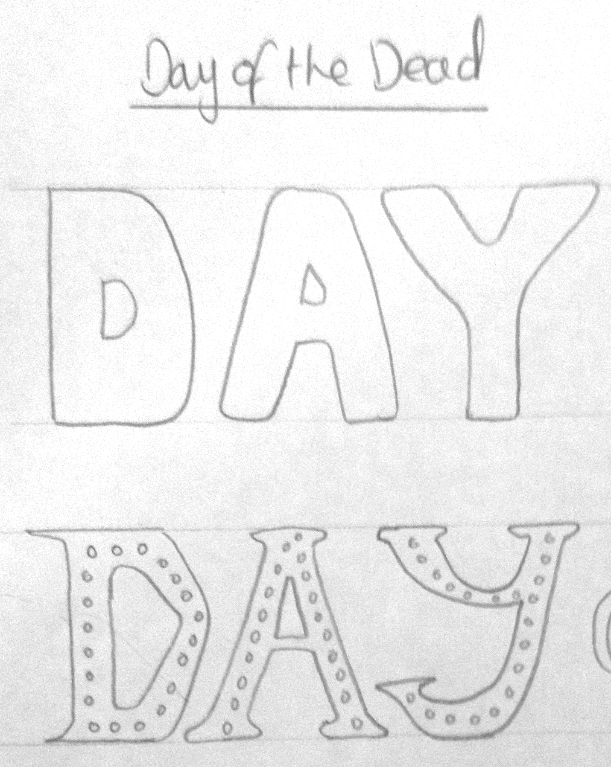
THINK!
A title for an exercise book
A neat title
Guidelines used to keep all letters the similar size
A title for a creative piece
Font relates to the theme

Slide 6
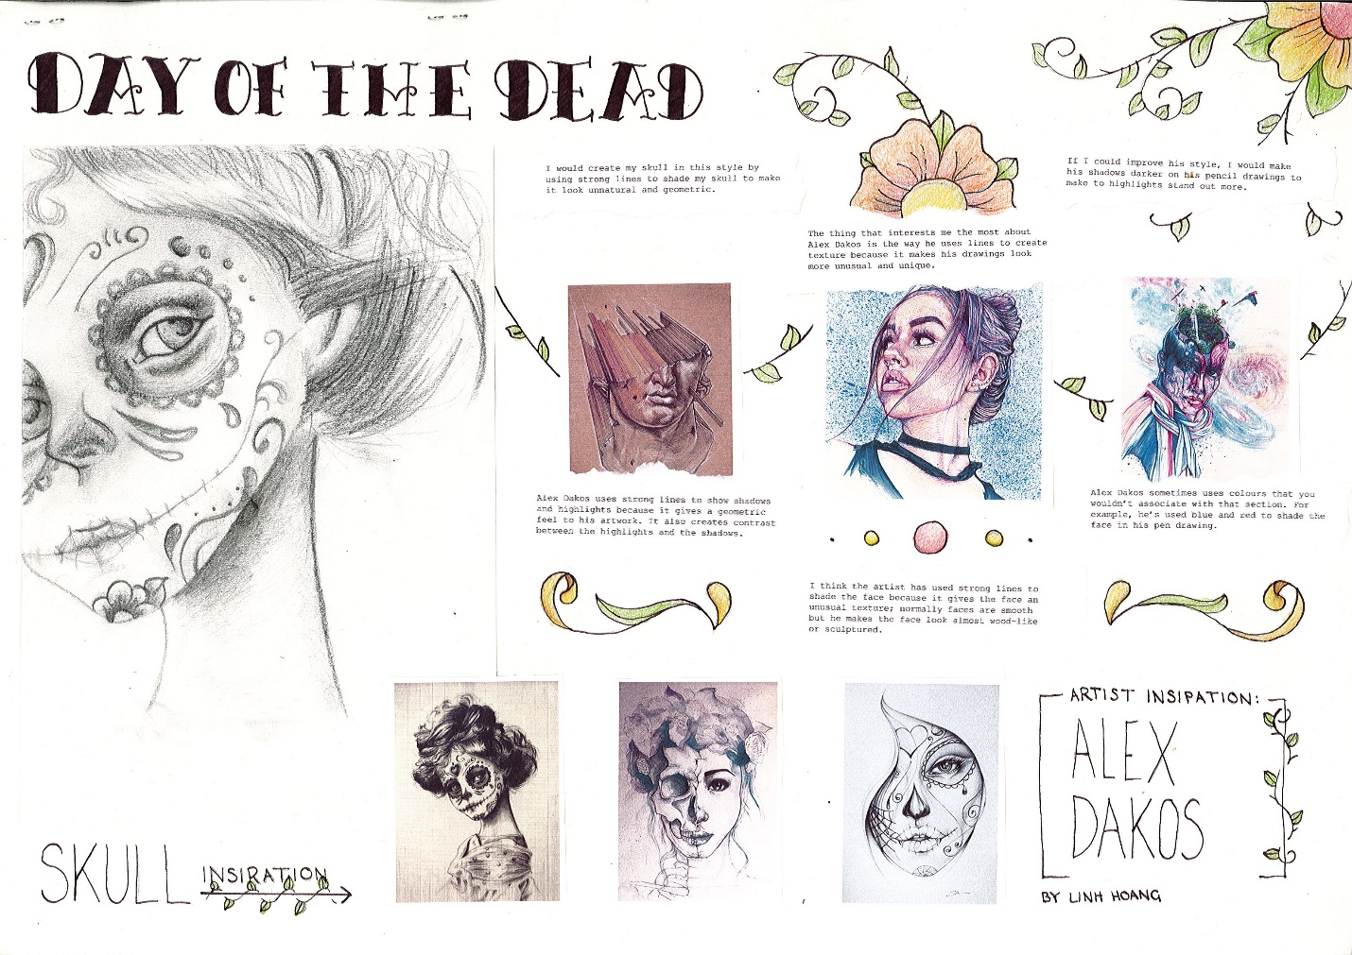
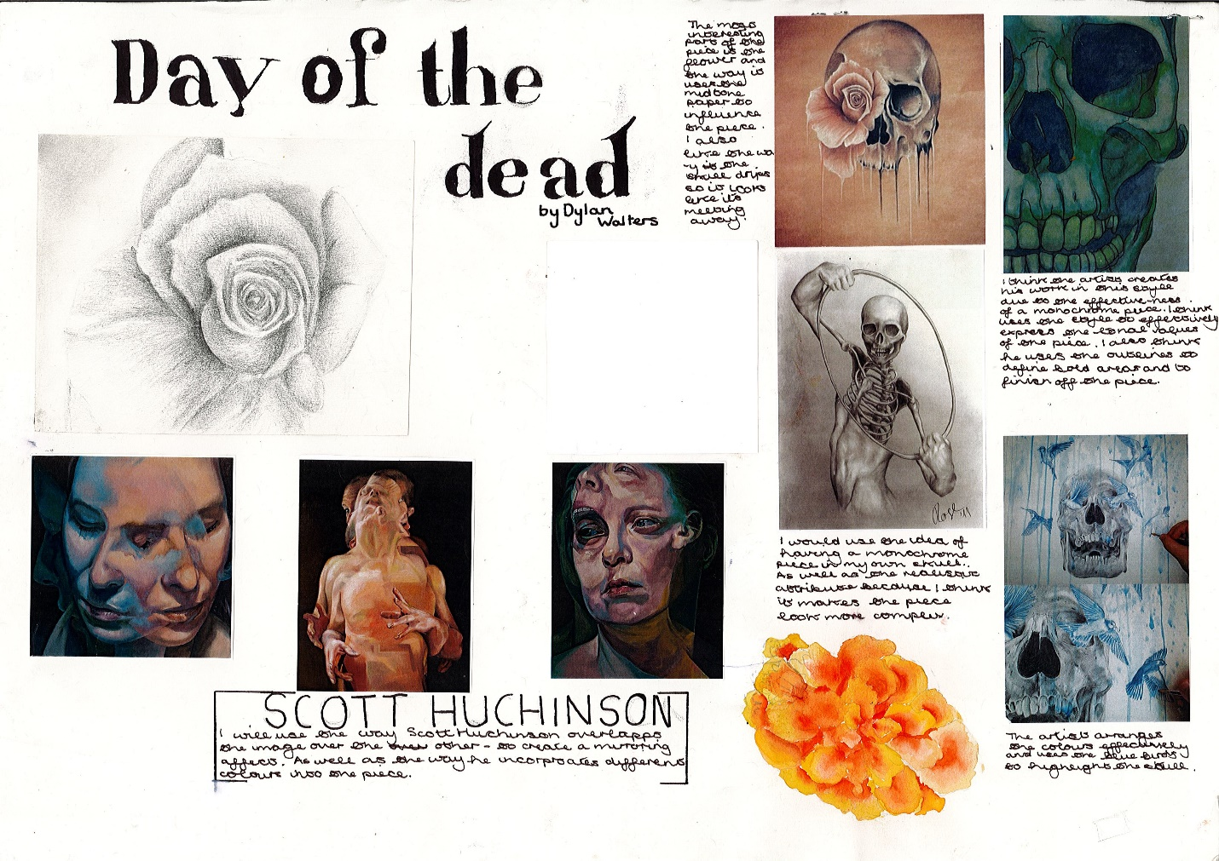
Examples of previous work ‘confident’

Slide 7
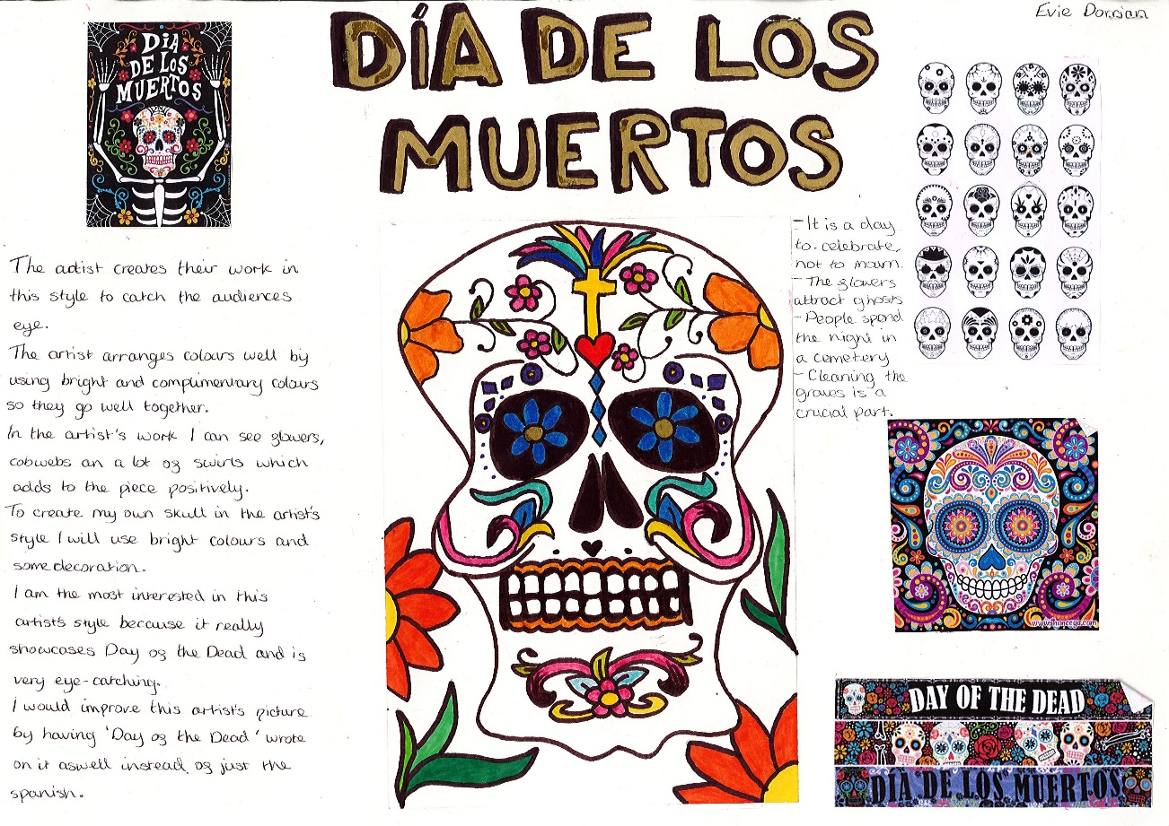
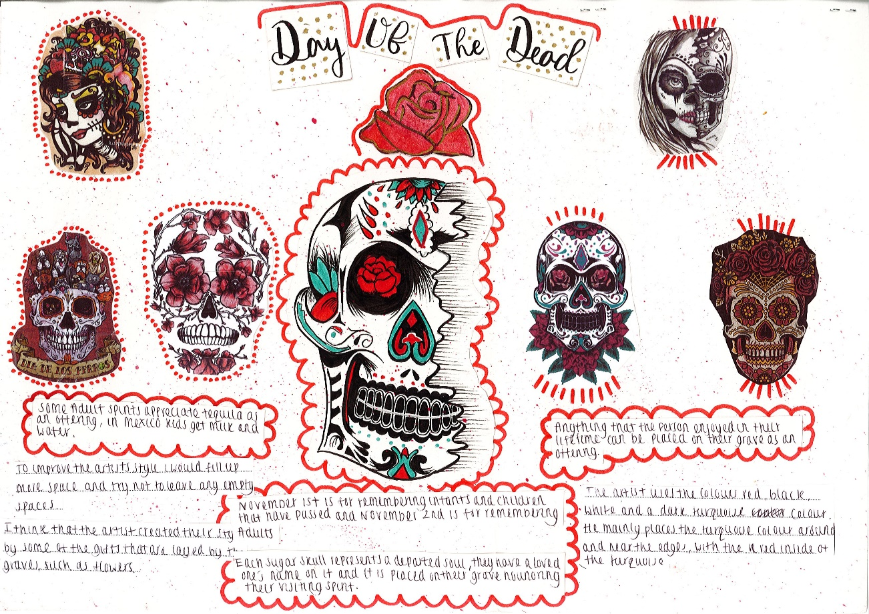
Examples of previous work ‘well informed’

Slide 8
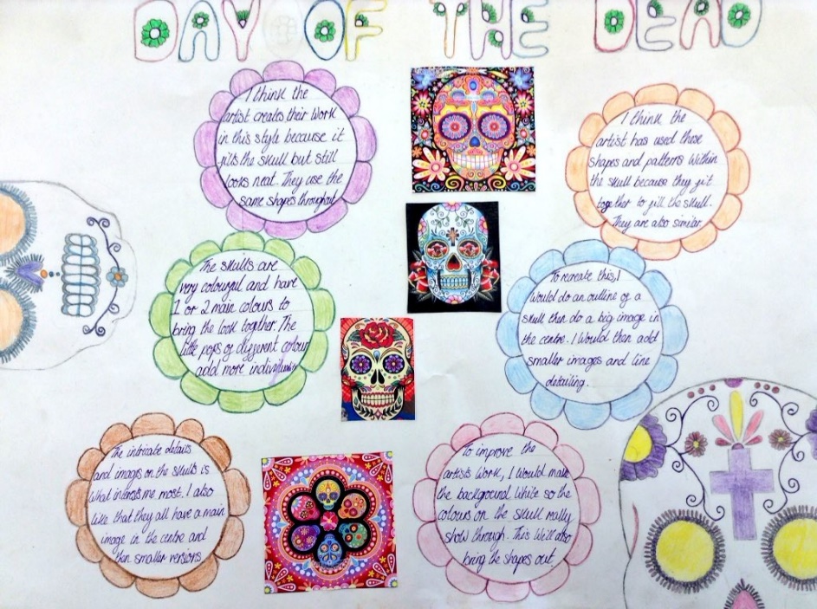
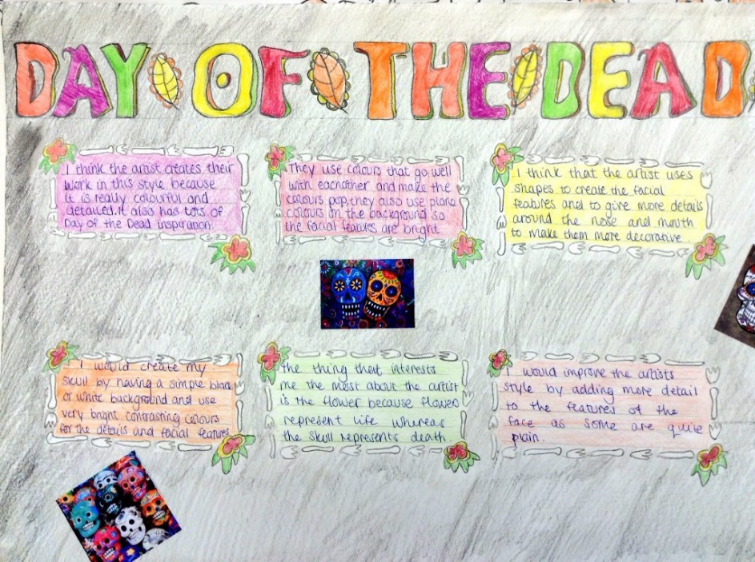
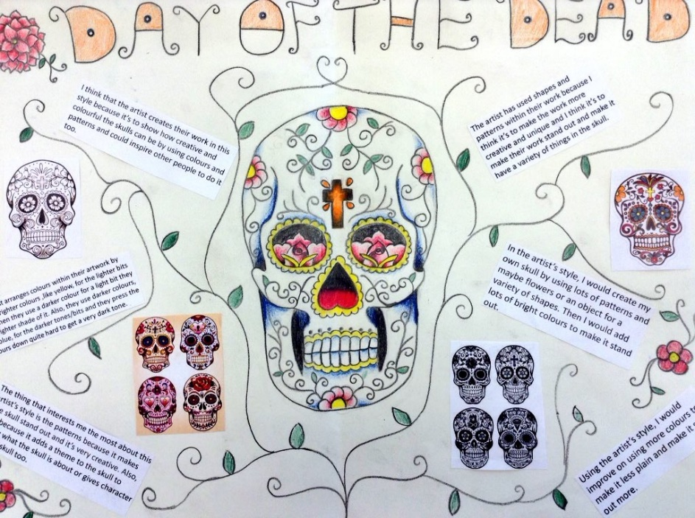
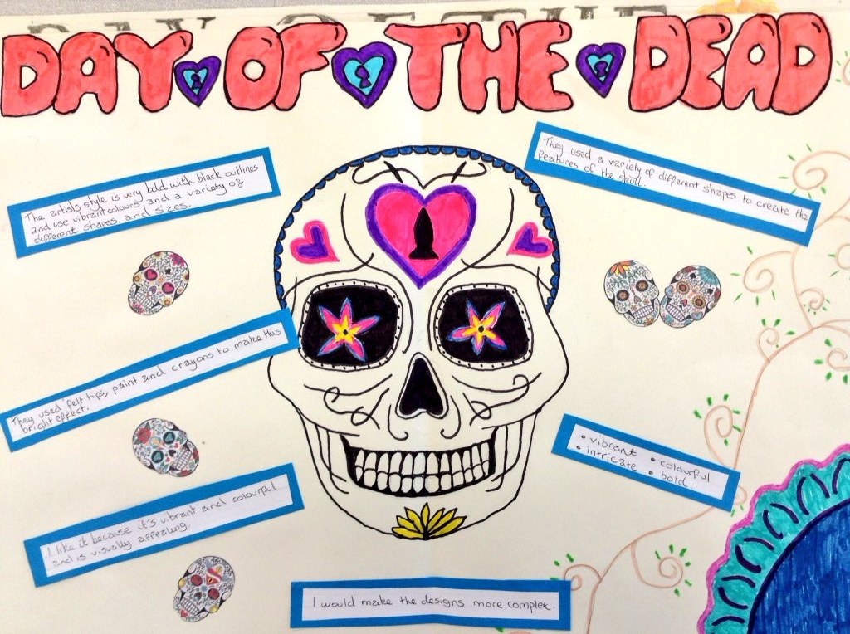
Examples of previous work ‘competent’

Slide 9
Presentation of your work
Example Layout
tit
A3 paper
Decorate the background in the festival style
Day of the Dead
Written work
Typed or very
neatly written
IMAGE of Day of the Dead artwork
Personal visual analysis drawing with colour
Written analysis
1.
2.
3.
4.
5.
6.
Paper trimmed
with cutter
NOT scissors
IMAGE of Day of the Dead artwork
No overlapping
Straight
IMAGE of Day of the Dead artwork
IMAGE of the artwork you analysed
IMAGE of Day of the Dead artwork

Slide 10
This marking scheme allows you to know what we are looking for in a good artist page
Remember to self assess yourself as you are working through to ensure you get the best possible outcome
 | SCORE | REQUIREMENT
WRITTEN ANALYSIS | 1 2 3 | I have used art keywords and adjectives in some of my answers I have used art keywords and adjectives in most of my answers I have used art keywords and adjectives in all of my answers
 | 3 | All of my answers are written in full sentences
 | 3 | I have proof read my writing and corrected spelling mistakes
VISUAL ANALYSIS | 1 2 3 | My drawing/tracing is scruffy My drawing/tracing is neat My drawing/tracing is accurate and controlled
 | 1 2 3 | I have gone over some of the outlines when applying colour I show control near the edges when applying colour I have applied all colour with control
PRESENTATION | 1 2 3 | My presentation is scruffy My presentation is neat and tidy My presentation is thoughtful and faultless Look at the writing, cutting & sticking, titles etc
 | 1 2 3 | There is a lot of empty space on my artist page I am starting to consider layout on my artist page My artist page is full and visually exciting
TOTALS | /21 SELF
 | /21 PEER
Teacher feedback

Slide 11
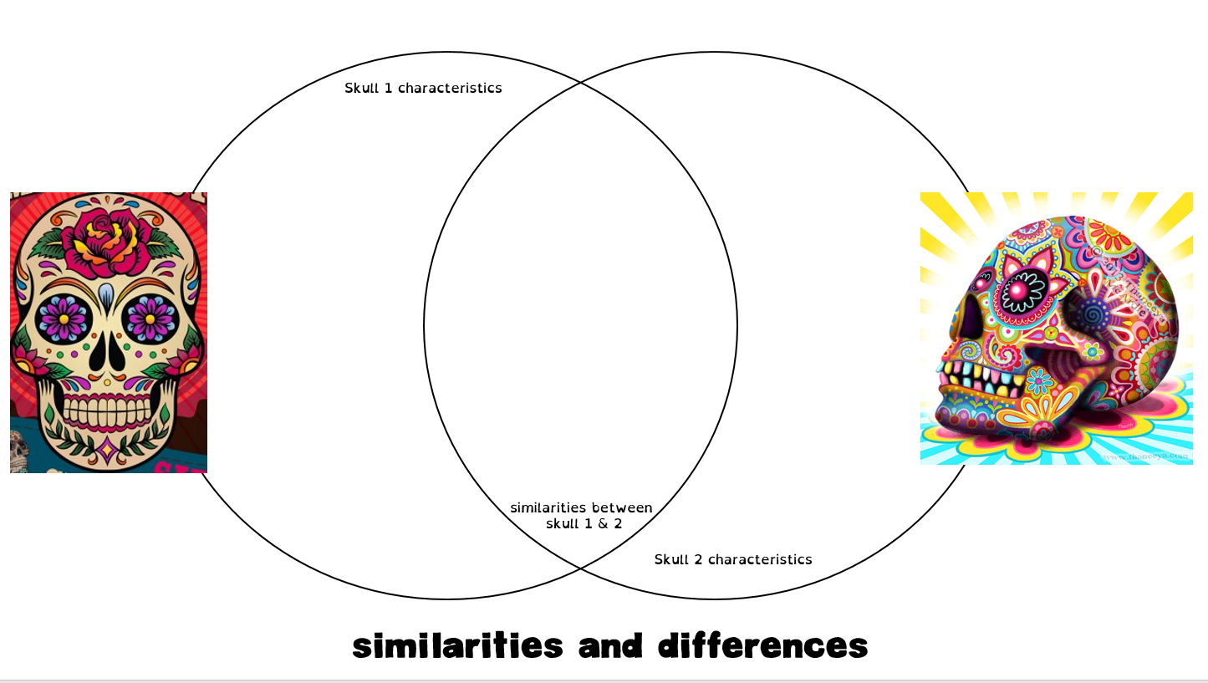
Complete the worksheet comparing two Day of the Dead artworks

