Slide 1
GCSE PHOTOGRAPHY
YEAR 10 COURSEWORK

Slide 2
outline
Unit 1: Portfolio
45 Hour to Complete Portfolio
120 Marks
60 % of Qualification
Candidates need to
Produce a portfolio of work
for this unit that demonstrates
a personal response to a starting point.
Unit 2: OCR Externally Set Task
10 Hour Supervised Task
80 Marks
40% of Qualification
For this unit OCR will give
students a choice of
starting points in the form
of written and/or visual
starting points

Slide 3
oUTLINE
Unit 1: Portfolio
45 Hour to Complete Portfolio
120 Marks
60 % of Qualification
Candidates need to
Produce a portfolio of work
for this unit that demonstrates
a personal response to a starting point.
Unit 2: OCR Externally Set Task
10 Hour Supervised Task
80 Marks
40% of Qualification
For this unit OCR will give
students a choice of
starting points in the form
of written and/or visual
starting points

Slide 4
COURSEWORK PROJECT PORTRAITURE

Slide 5
Portraiture
Portrait photography or portraiture is photography of a person or group of people that displays the expression, personality, and mood of the subject. Like other types of portraiture, the focus of the photograph is usually the person’s face, although the entre body and the background or context may be included. photography of people can be broken down into numerous categories. It is important for photographers to identify separate styles in order to choose the right creative direction for projects.

Slide 6
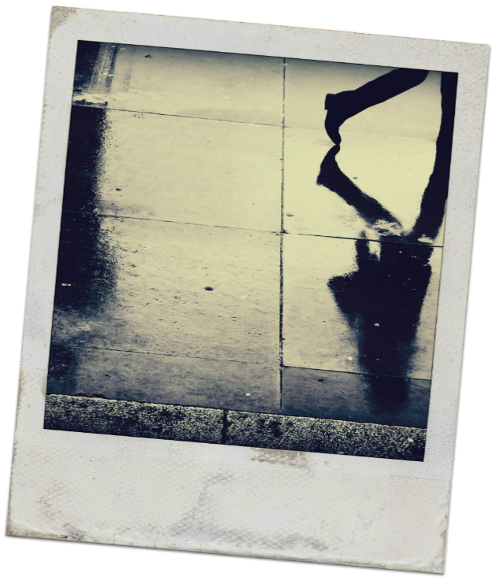
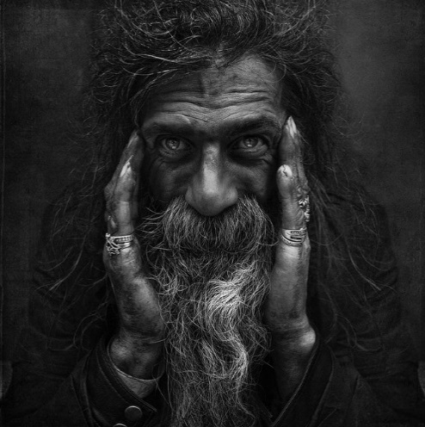
traditional
Traditional or Classical portraiture would refer to an image where face is the predominant element. The purpose of the photograph is to depict visual representation of that person. Subject is expected to be looking directly at the camera. With what is described as a head-shot, two thirds or full body framing can be used

Slide 7
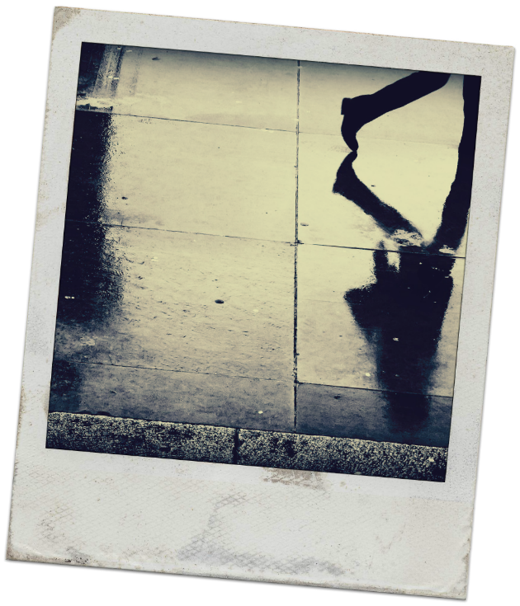
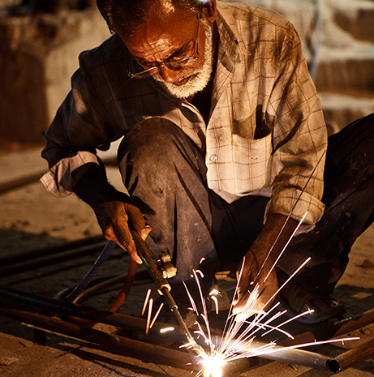
environmental
The term Environmental Portrait refers to an image where the subject is photographed in person’s natural environment. For example, a worker photographed at the construction zone, teacher in the classroom, sculptor in a sculpture studio and so on. Surroundings are used to compliment the subject and to emphasize his character. Subject and setting are chosen by the photographer.

Slide 8
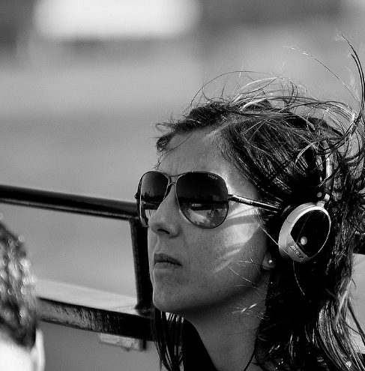
candid
A candid portrait is taken without a subject expecting or acknowledging the photographer. This style used in photo journalism, travel photography, street photography and event photography. As opposed to an environmental portrait this image is captured at the moment rather than set up.

Slide 9
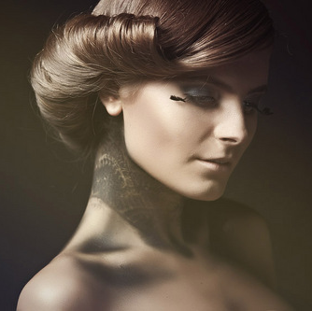
Glamour
The term Glamor Portrait refers to portraits where emphasis is given to highlight the sexy romantic appeal of the subject.

Slide 10
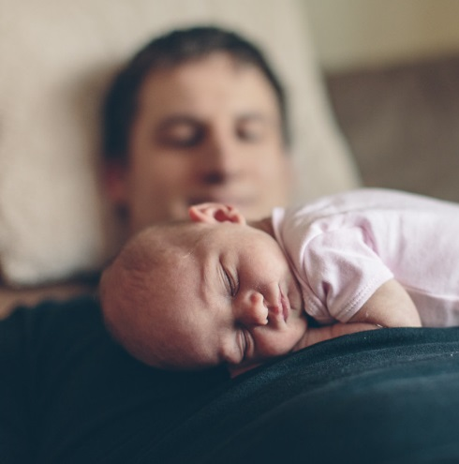
lifestyle
The term Lifestyle Portrait refers to portraits where emphasis is given to suggest the “style of living” of the individuals depicted. Technically it is a combination of environmental portrait and candid portrait. More weight is given to communicate the feeling of life experience of the subject. Style has numerous implications in commercial and fine art photography. Editorial, fashion, pharmaceutical, and food industries often use lifestyle images to evoke emotions in viewers by depiction of desired life styles. It is common to see this style used in wedding and family portrait photography as well.

Slide 11
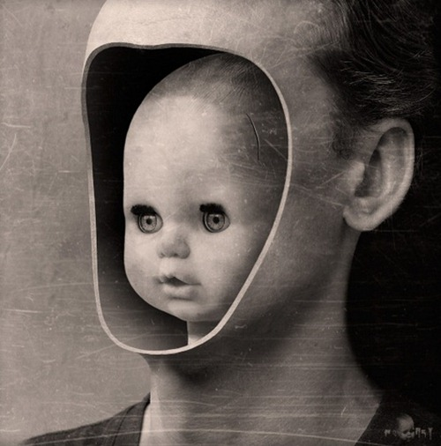
surreal
Surreal Portraits are created to emphasize the other reality. A depiction of a person’s interpreted subconscious mind. Surrealism is an art movement started in the early 1920‘s and still alive and well. In photography tricks and special effects are used to achieve a surreal look.

Slide 12
Conceptual
Conceptual Portrait refers to images where concept adds a fourth dimension. The hidden meaning of the concept will leave the viewer guessing as it is often open for interpretation. Conceptual artists generally get offended when asked what did they mean in their photograph. It is the job of the viewer to decide. Conceptual Portraits are often used in advertising photography but concepts are much easier to understand.

Slide 13
abstract
Abstract portraits are created with a purpose of creating art and not based on realistic representation of a person. Collage or digital manipulation is often used.

Slide 14
Name
Gcse photography
Coursework: Portraiture
Background
Inspiration images
Initial ideas

Slide 15
STYLES OF PORTRAITURE
?

Slide 16
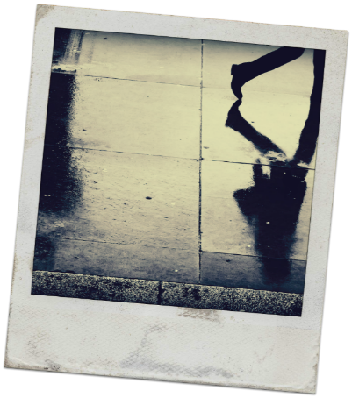
The Fundamental styles of portraiture
A clear example of each style of portraiture and a small passage of information
Traditional
Environmental
Candid
Conceptual
Lifestyle
Glamour
Abstract
Surreal
Traditional
Environmental
Candid
Conceptual
Lifestyle
Glamour
Abstract
Surreal
Traditional
Environmental
Candid
Conceptual
Lifestyle
Glamour
Abstract
Surreal
4
5
6+

Slide 17
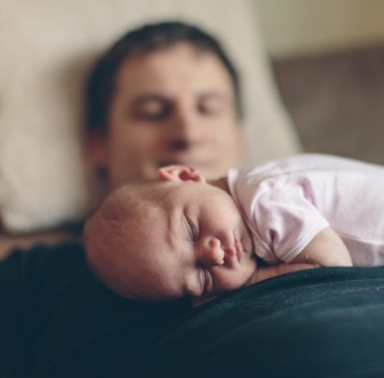
Pages to complete
Cover page
8 styles of portraiture

Slide 18
Inspiration page
Select 1 of the 8 fundamentals styles of portraiture that you want to explore
Research clear and obvious examples of this style of portraiture
Collect 15/20 high quality images for your inspiration page
Information about the style of portraiture
Why you chose that style
6+ briefly discuss the work of key photographers that have
influenced your decision and inspired your ideas.
Traditional
Environmental
Candid
Conceptual
Lifestyle
Glamour
Abstract
Surreal
4
5
6+

Slide 19
Cover page
8 styles of portraiture
Inspiration page

Slide 20
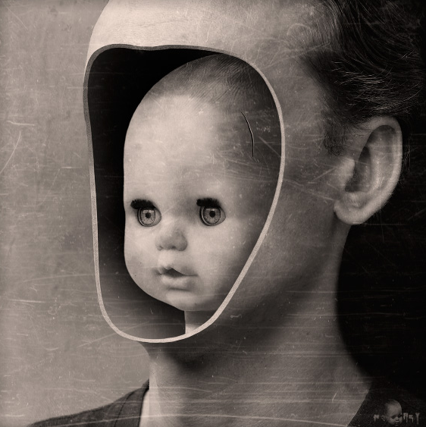
Artist: Adnrey Title: Core Date: 2007

Slide 21
context
The piece, entitled ‘Core’ was created by Adnrey in 2007. The artist Adnrey is a contemporary digital artist and illustrator whose work typically explores a darker, surreal reality to portraiture. Characteristically his work combines the styles of surrealism with conceptual; art in which the idea or concept presented by the artist is considered as important as the final outcome.

Slide 22
The piece, ‘Core’ shows a hollow portrait occupied by a dolls head. I believe the most important element within this piece is the portrait of the doll because this, I feel, is responsible for conveying the concept of this piece. The original photograph, prior to editing, I believe to be a staged event taken within a studio space. The image has been heavily manipulated using a program similar to, if not Photoshop. In my opinion the theme of the work centres on the notion of an internal identity, the concept of an inner child. A person's supposed original or true self, especially when regarded as concealed in adulthood.
Content

Slide 23
The type of lighting used, given its suspected studio location, looks to be artificial. However, due to the substantial amount of editing it is difficult ascertain the direction and placemen of lighting. The choice of lighting has little impact on the photograph, showing relatively medium tones with little highlight. In support of the photographs studio location an ISO of 100 can be assumed, keeping noise to a minimum. The photograph adopts a narrow depth of field, between f/5.6 and f/8. This can be presumed from the nature of the photograph, portraiture. This aperture value is ideal for creating a blur background, keeping only the subject focus, creating a sense of separation from the background. Given the subject matter it is important to consider the focal length of the piece. It can be assumed that the selected focal length lies between 85mm and 135mm, this assumption is based on the subject being a portrait. Support for this theory comes from the lack of distortion in the portrait, making portraits share caricature qualities. The portrait is clean and sharp and therefore provides clear evidence for a quick shutter speed being adopted. The common rule being that the shutter speed should match or exceed the focal length means a value of 1/85sec. – 1/135sec. or greater.
process

Slide 24
The type of lighting used, given its suspected studio location, looks to be artificial. However, due to the substantial amount of editing it is difficult ascertain the direction and placemen of lighting. The choice of lighting has little impact on the photograph, showing relatively medium tones with little highlight. In support of the photographs studio location an ISO of 100 can be assumed, keeping noise to a minimum. The photograph adopts a narrow depth of field, between f/5.6 and f/8. This can be presumed from the nature of the photograph, portraiture. This aperture value is ideal for creating a blur background, keeping only the subject focus, creating a sense of separation from the background. Given the subject matter it is important to consider the focal length of the piece. It can be assumed that the selected focal length lies between 85mm and 135mm, this assumption is based on the subject being a portrait. Support for this theory comes from the lack of distortion in the portrait, making portraits share caricature qualities. The portrait is clean and sharp and therefore provides clear evidence for a quick shutter speed being adopted. The common rule being that the shutter speed should match or exceed the focal length means a value of 1/85sec. – 1/135sec. or greater.
process

Slide 25
The type of lighting used, given its suspected studio location, looks to be artificial. However, due to the substantial amount of editing it is difficult ascertain the direction and placemen of lighting. The choice of lighting has little impact on the photograph, showing relatively medium tones with little highlight. In support of the photographs studio location an ISO of 100 can be assumed, keeping noise to a minimum. The photograph adopts a narrow depth of field, between f/5.6 and f/8. This can be presumed from the nature of the photograph, portraiture. This aperture value is ideal for creating a blur background, keeping only the subject focus, creating a sense of separation from the background. Given the subject matter it is important to consider the focal length of the piece. It can be assumed that the selected focal length lies between 85mm and 135mm, this assumption is based on the subject being a portrait. Support for this theory comes from the lack of distortion in the portrait, making portraits share caricature qualities. The portrait is clean and sharp and therefore provides clear evidence for a quick shutter speed being adopted. The common rule being that the shutter speed should match or exceed the focal length means a value of 1/85sec. – 1/135sec. or greater.
process

Slide 26
The type of lighting used, given its suspected studio location, looks to be artificial. However, due to the substantial amount of editing it is difficult ascertain the direction and placemen of lighting. The choice of lighting has little impact on the photograph, showing relatively medium tones with little highlight. In support of the photographs studio location an ISO of 100 can be assumed, keeping noise to a minimum. The photograph adopts a narrow depth of field, between f/5.6 and f/8. This can be presumed from the nature of the photograph, portraiture. This aperture value is ideal for creating a blur background, keeping only the subject focus, creating a sense of separation from the background. Given the subject matter it is important to consider the focal length of the piece. It can be assumed that the selected focal length lies between 85mm and 135mm, this assumption is based on the subject being a portrait. Support for this theory comes from the lack of distortion in the portrait, making portraits share caricature qualities. The portrait is clean and sharp and therefore provides clear evidence for a quick shutter speed being adopted. The common rule being that the shutter speed should match or exceed the focal length means a value of 1/85sec. – 1/135sec. or greater.
process

Slide 27
The type of lighting used, given its suspected studio location, looks to be artificial. However, due to the substantial amount of editing it is difficult ascertain the direction and placemen of lighting. The choice of lighting has little impact on the photograph, showing relatively medium tones with little highlight. In support of the photographs studio location an ISO of 100 can be assumed, keeping noise to a minimum. The photograph adopts a narrow depth of field, between f/5.6 and f/8. This can be presumed from the nature of the photograph, portraiture. This aperture value is ideal for creating a blur background, keeping only the subject focus, creating a sense of separation from the background. Given the subject matter it is important to consider the focal length of the piece. It can be assumed that the selected focal length lies between 85mm and 135mm, this assumption is based on the subject being a portrait. Support for this theory comes from the lack of distortion in the portrait, making portraits share caricature qualities. The portrait is clean and sharp and therefore provides clear evidence for a quick shutter speed being adopted. The common rule being that the shutter speed should match or exceed the focal length means a value of 1/85sec. – 1/135sec. or greater.
process

Slide 28
The type of lighting used, given its suspected studio location, looks to be artificial. However, due to the substantial amount of editing it is difficult ascertain the direction and placemen of lighting. The choice of lighting has little impact on the photograph, showing relatively medium tones with little highlight. In support of the photographs studio location an ISO of 100 can be assumed, keeping noise to a minimum. The photograph adopts a narrow depth of field, between f/5.6 and f/8. This can be presumed from the nature of the photograph, portraiture. This aperture value is ideal for creating a blur background, keeping only the subject focus, creating a sense of separation from the background. Given the subject matter it is important to consider the focal length of the piece. It can be assumed that the selected focal length lies between 85mm and 135mm, this assumption is based on the subject being a portrait. Support for this theory comes from the lack of distortion in the portrait, making portraits share caricature qualities. The portrait is clean and sharp and therefore provides clear evidence for a quick shutter speed being adopted. The common rule being that the shutter speed should match or exceed the focal length means a value of 1/85sec. – 1/135sec. or greater.
process

Slide 29
I believe this piece to be effective because its ability to portray deeper connotations. It requires the viewer to invest time, to ask questions and look beyond the aesthetic qualities of the portrait. It presents the opportunity for the viewer to personally engage with the piece, to reflect on their inner personality or child. Moving beyond the initial feel of terror and peculiarity, the work makes me feel inquisitive, what is the work about? What is the artist attempting to convey? Does the piece explore the idea of identity? Is it about growing up too quickly? About neglecting your childhood? The colour enhances the notion of a personal interpretation by allowing the viewing not to be influences by colour. The lack of colour, use of a monochrome pallet introduces the sense of nostalgia. Longing for the past, for what was once.
Opinion & mood

Slide 30
To recreate this study I would combine a traditional self-portrait with a childhood portrait photograph. I could also alter the use of colour by its inclusion in the present-day portrait. This will help to reinforce the notion of nostalgia and generate a contrast between the new and old. To further develop the work I could include the contemporary portrait in the piece, have the subject removing the face as if it was a mask, supporting the idea of identity. There is a clear link to my theme of surreal portraiture within the work as Andrey creates work to emphasis the other reality, work that exists outside the realms of reality. The work of Andrey will influence the development of my work as I begin to explore the idea of identity through layers and masks.
create

Slide 31
RESEARCH Photographer that links to your chosen style
Contextual Link
Complete an Analysis

Slide 32
TITLE PAGE
8 STYLES OF PORTRAITURE
MOOD BOARD
CHOSEN STYLE OF PORTRAITURE
CONTEXTUAL LINK 1
CONTEXTUAL LINK 2

Slide 33
Photoshoot 1 plan & breakdown

Slide 34
Contextual link 1

Slide 35
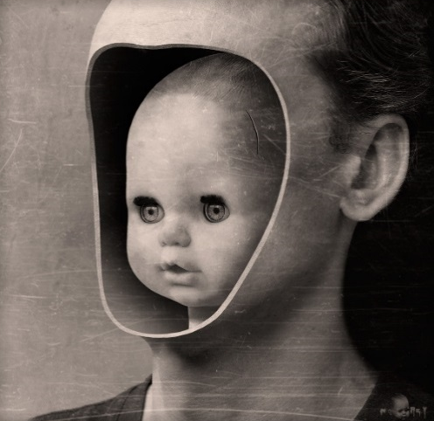
To further develop the work I could include the contemporary portrait in the piece, have the subject removing the face as if it was a mask, supporting the idea of identity. There is a clear link to my theme of surreal portraiture within the work as Andrey creates work to emphasis the other reality, work that exists outside the realms of reality. The work of Andrey will influence the development of my work as I begin to explore the idea of identity through layers and masks.
to help reinforce my interpretation of identity and hiding ones true self I would develop this piece by having the subject physically removing the mask, exposing a second portrait. combining the ideas behind this piece with the work of Adnrey, his study ‘core’ will allow me to effectively achieve this.
CONTEXTUAL LINK 1
CONTEXTUAL LINK 2

Slide 36
Preparation for photoshoot 1

Slide 37
YOUR 1ST PHOTOGRAPHY PIECE
CONTEXTUAL LINK 1
CONTEXTUAL LINK 2
PHOTOSHOOT 1

Slide 38
PHOTOSHOOT 1 REVIEW & PLAN
WHAT IS YOUR CHOSEN STYLE OF PORTRAITURE?
WHO IS YOUR 1ST CONTEXTUAL LINK?
WHO IS YOUR 2ND CONTEXTUAL LINK?
WHO IS YOUR 3RD CONTEXTUAL LINK?
WHO IS YOUR 4TH CONTEXTUAL LINK?
WHAT ARE YOUR SOURCES?
WHAT IS THE CONCEPT THAT UNDERPINNES YOUR LINKS?
WHAT IS YOUR IDEA FOR YOUR 1ST PHOTOSHOOT?
WHAT IS THE CONCEPT BEHIND THIS?
WHO/ what IS INVOLVED?
WHERE IS IT?
POSSIBLE SETTINGS? (ISO, Aperture & shutter speed)
PARAGRAPH 1
IMAGES OF YOUR
PHOTOGRAPHERS
PARAGRAPH 2
IMAGES TO SUPPORT
YOUR IDEAS

Slide 39
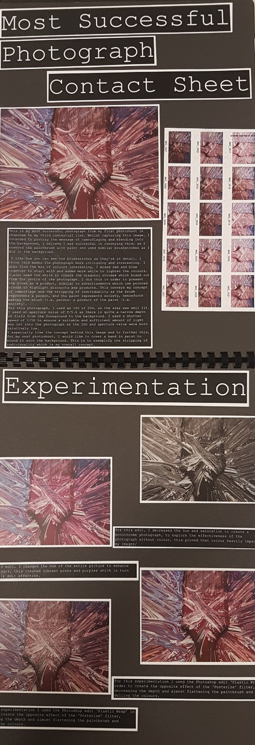
TITLES: PHOTOSHOOT 1
CONTACT SHEET
MOST SUCCESSFUL PHOTOGRAPH
INITIAL ENHANCEMENTS
MOST SUCCESSFUL PHOTOGRAPH EVALUATION
WHAT SETTINGS HAVE YOU USED?
(ISO, APERTURE, SHUTTER SPEED)
WHY HAVE YOU USED THOSE SETTINGS?
WHAT MAKES YOUR PHOTOGRAPH SUCCESSFUL?
HOW COULD YOU IMPROVE YOUR PHOTOGRAPH?
PHOTOSHOOT 1

Slide 40
REFINING MY IDEA
PHOTOSHOOT 2
PHOTOSHOOT 1

Slide 41
REFINING MY IDEA
What was your 1st photoshoot?
What was the concept?
How was it inspired?
What went well?
What needs improving?
Concept? Controls? Composition?
what is your idea for your 2nd photoshoot?
How has this developed?
who/ what is involved?
where is it?
possible settings? (ISO, aperture & shutter speed)

Slide 42
OBVIOUS EXPERIMENTATION
UNSUCCESSFUL EXPERIMENT
LEAST SUCCESSFUL PHOTOGRAPH EVALUATION
WHAT SETTINGS HAVE YOU USED?
(ISO, APERTURE, SHUTTER SPEED)
WHY HAVE YOU USED THOSE SETTINGS?
WHAT MAKES YOUR EXPERIMENTATION UNSUCCESSFUL?
HOW COULD YOU IMPROVE YOUR PHOTOGRAPH?
PHOTOSHOOT 1

Slide 43
CONTACT SHEET
MOST SUCCESSFUL PHOTOGRAPH
PHOTOSHOOT 2
LEAST SUCCESSFUL EXPERIMENT
INITIAL ENHANCEMENTS

